Slide 1
Blue-Cloud’s Open Science platform
Gear up for the Blue-Cloud Hackathon
17 January 2021
What tools does it bring to Ocean scientists & researchers, developers and innovators?
Pasquale Pagano, CNR – ISTI (Italy), pasquale.pagano@isti.cnr.it

Slide 2
Blue-Cloud VRE
One place for discovery and access
One place for store, share, and preserve
One place for execute analysis and processes

Slide 3
Blue-Cloud VRE
System of System
Blue-Cloud VRE is built with dedicated services leveraging on existing marine infrastructures, standards, EOSC resources and services
Extensible
Blue-Cloud VRE can integrate services and resources resulting from existing marine initiatives
Open
Blue-Cloud VRE promotes open science and practices

Slide 4




Blue-Cloud VRE
A SoS to support and promote Open Science
Scientific Result
Enable
Repeat, Reproduce, Reuse, Evaluate
Active collaboration
Effective sharing
Provenance and attribution
Adopt
As-a-service approach
Standards
Economy-of-scale to reduce operational costs
Research
data
Research
data
01101010
01100001
11010010
Blue-Cloud VRE
01101010
01100001
11010010
Research
Process
Research
Software

Slide 5
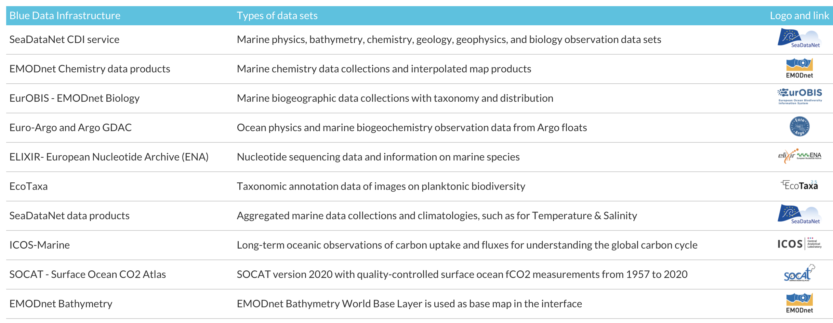
One place for discovery
SeaDataNet
EMODnet Chemistry
EcoTaxa
Argo
EurOBIS
The first step enables users to identify interesting data collections, with free search, geographic and temporal criteria;
The second step enables users to drill down per interesting BDI to get more specific data sets at granule level, using again free search, geographic and temporal criteria

Slide 6
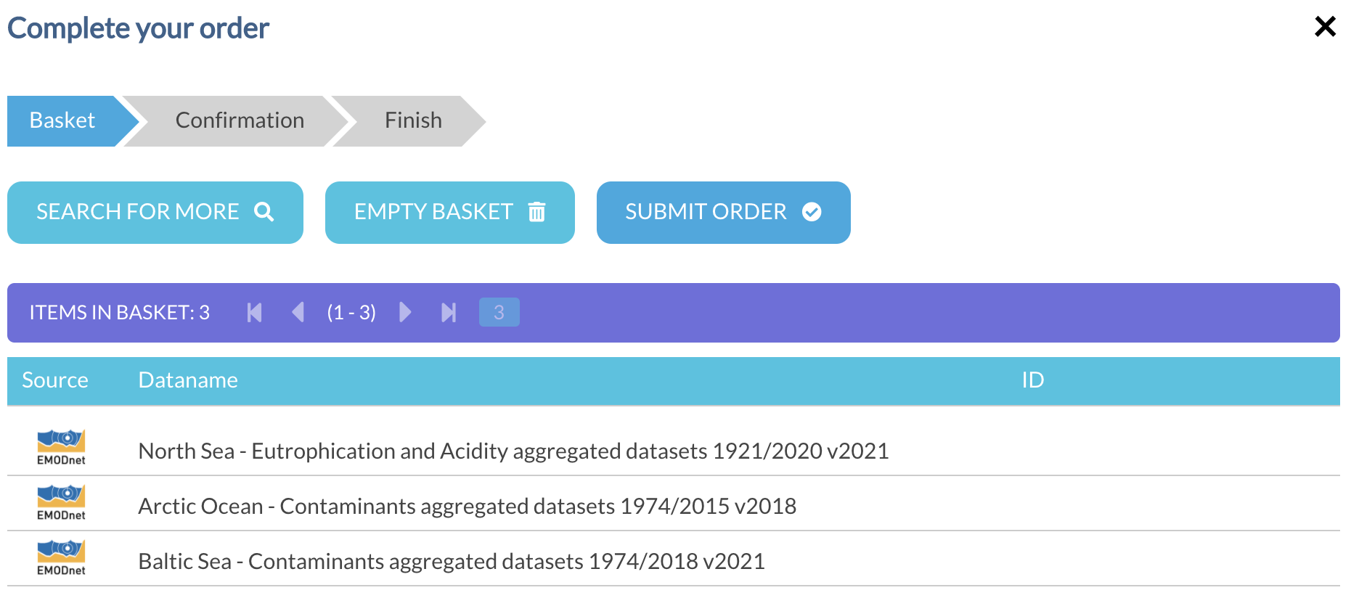
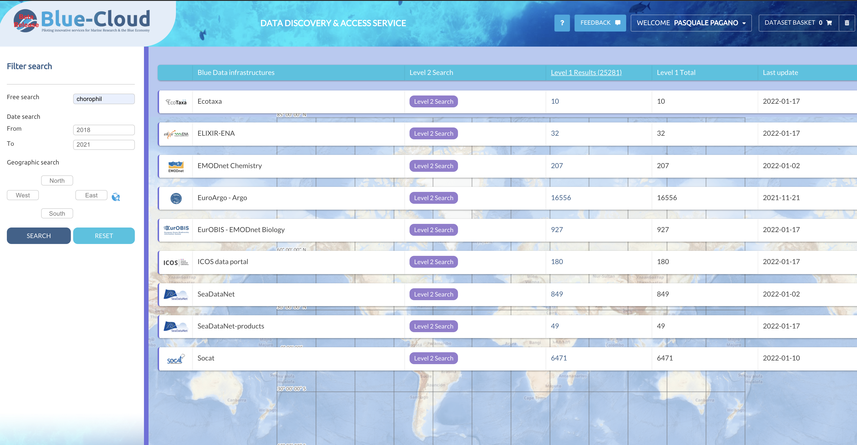
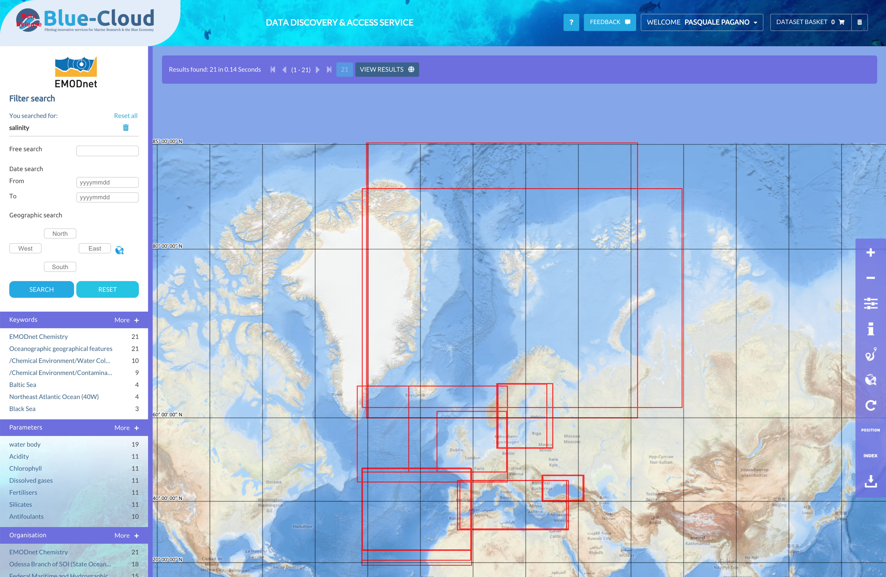
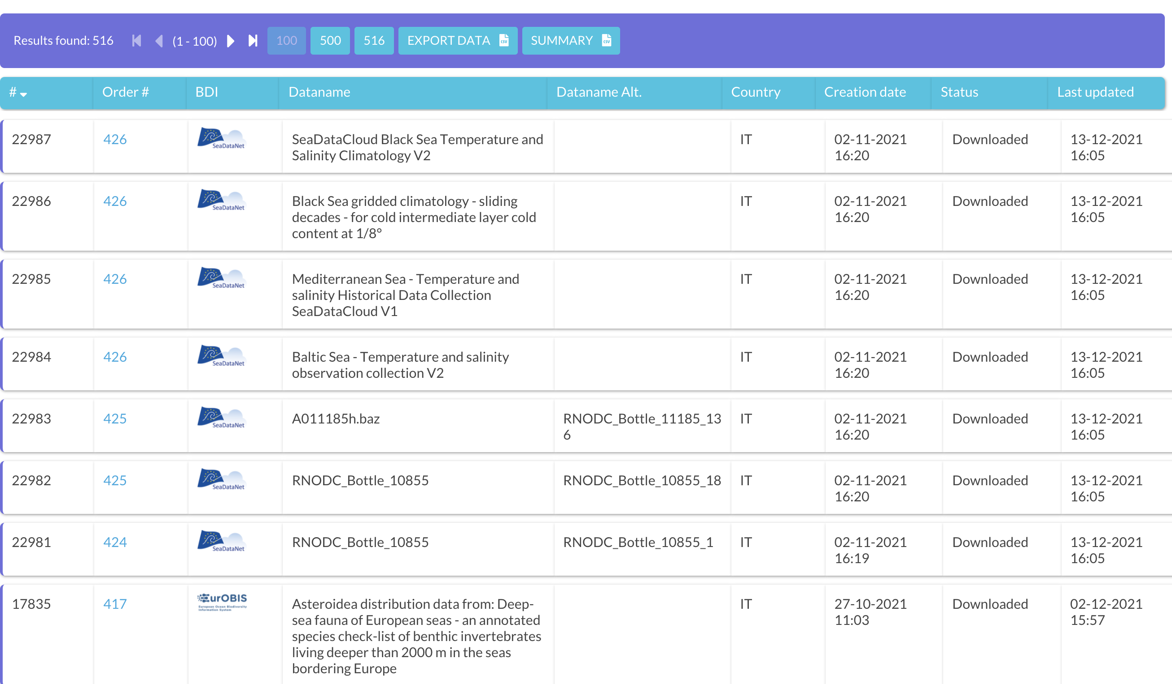
One place for access
Compose and submit shopping request at the granule level
Retrieve the datasets by downloading from the Dashboard
Push datasets to the Blue-Cloud VRE Data Pool

Slide 7
One place for store, share, and preserve datasets
Common workspace to easily exploit technologies and services not designed to work together
File System
Fault-tolerant
Versioning
Provenance
Controlled Sharing
Fully-replicated

Slide 8
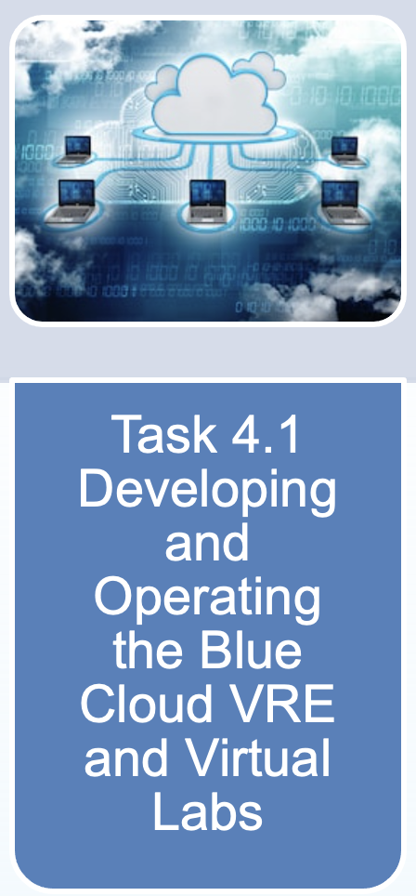
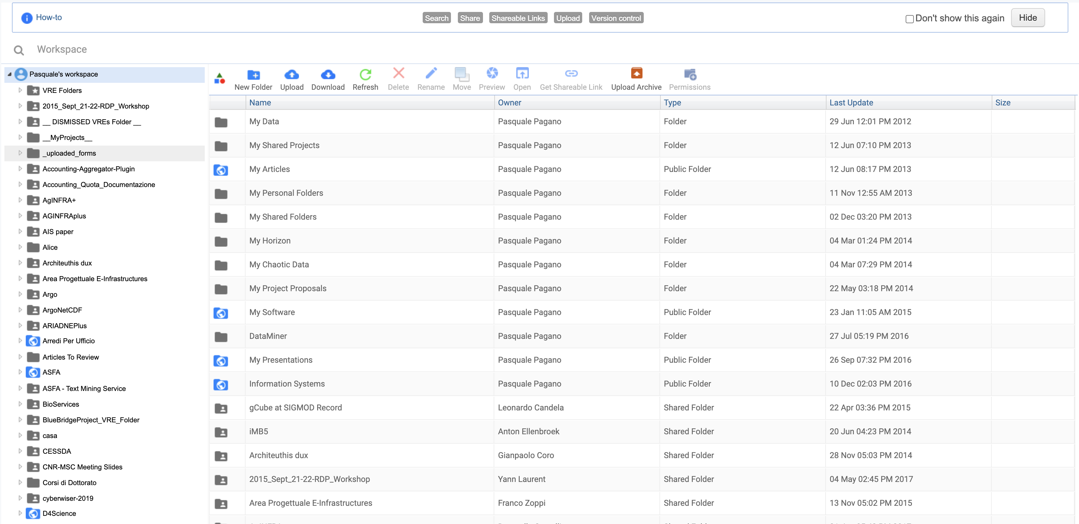
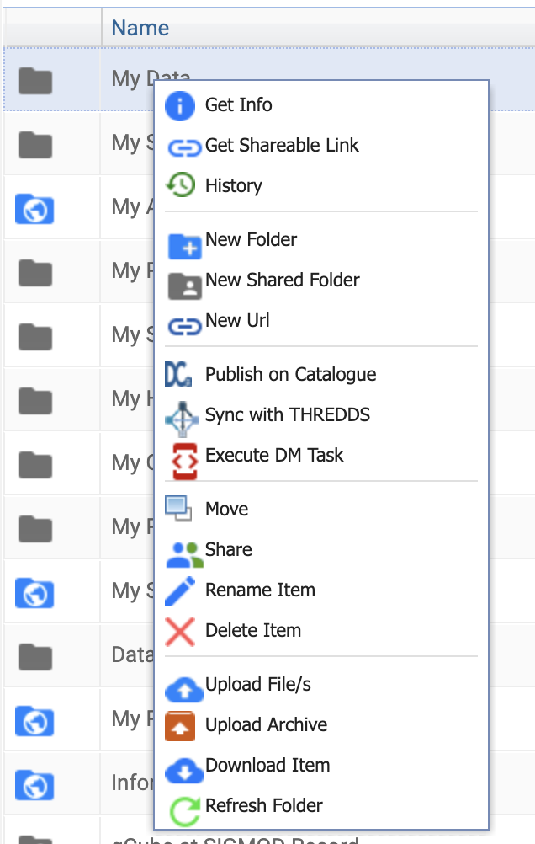
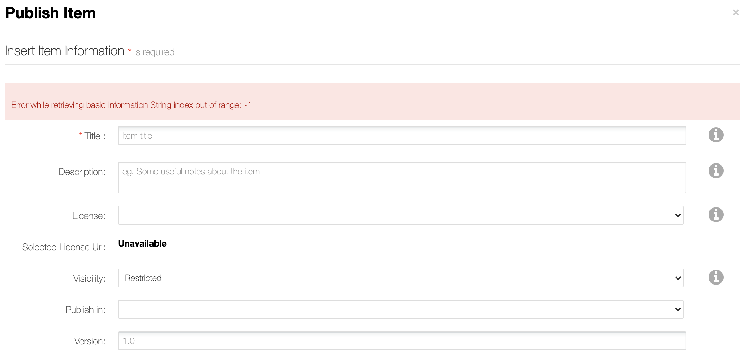
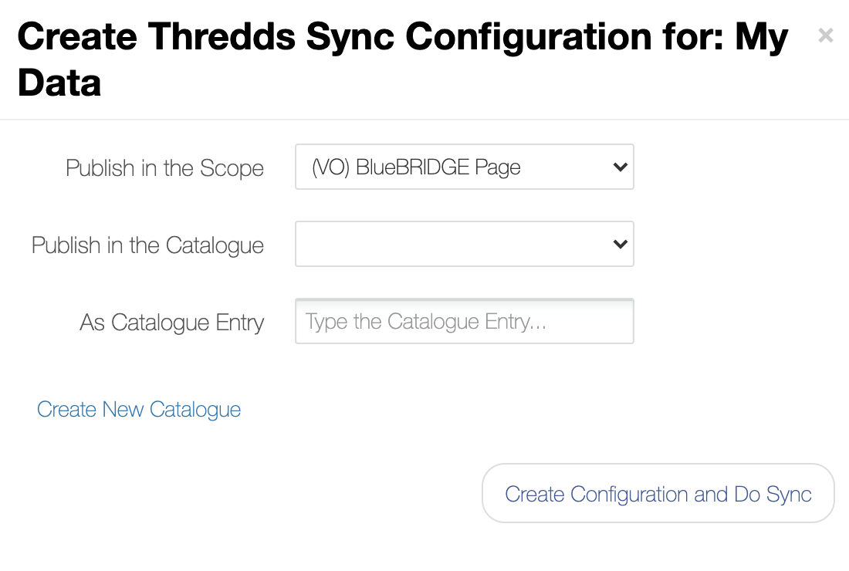
One place for store, share, and preserve datasets
Just one Workspace across all different services
VLab
Rstudio
JupyterHub notebooks
Analytics Engine
Just one Workspace where to store data, script, notebooks, computational methods
Private
Shared with your colleagues
Shared with all Vlab members

Slide 9
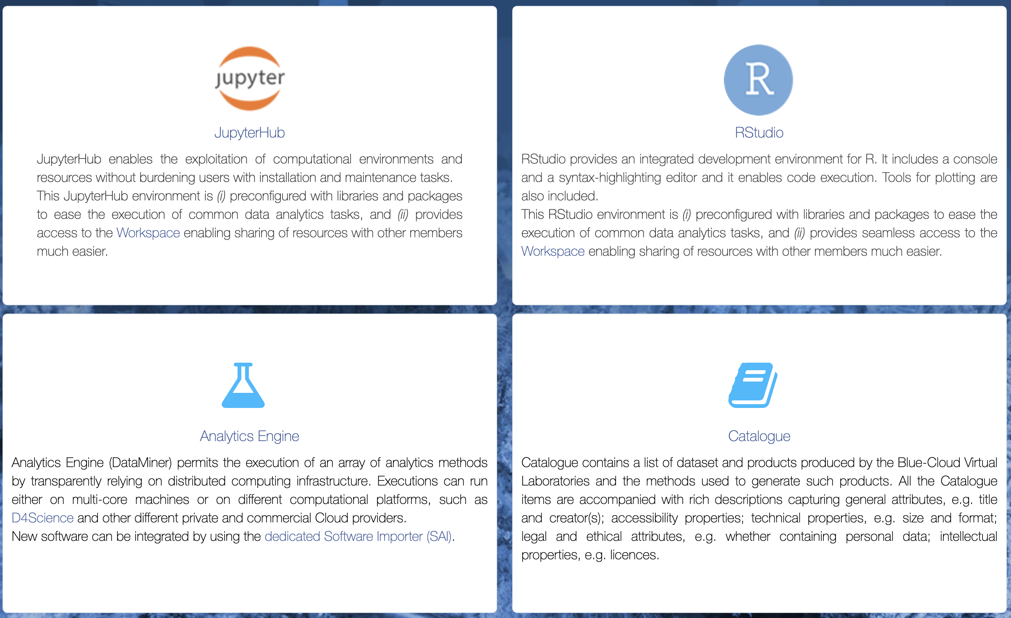
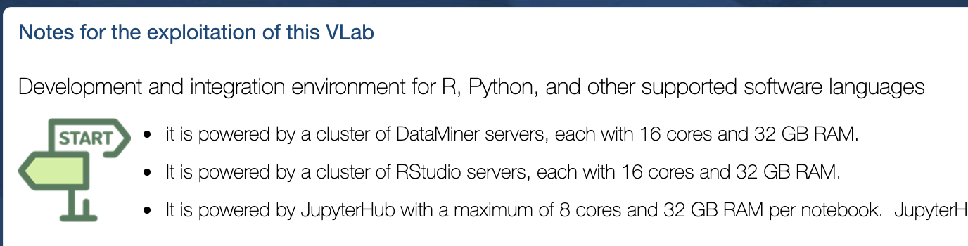
One place for execute analysis and processes
interactive notebooks via JupyterHub and community-specific applications delivered as a Docker container extend the Analytics framework
Technical Knowledge
as on your desktop
Services
+ services
+ resources
+ collaboration

Slide 10
One place for execute analysis and processes
 | DataMiner | Docker App | Rstudio | JupyterHub
Parallel processing on multi-cores
Multi-tenancy and concurrent access
Auditing
Distributed processing on multi-nodes
Failover Mgmt and Resubmission
Provenance Mgmt
Workspace (versioning)
Sharing, Provenance
WPS interface
Supported
Just Failover
Via Docker Image
Executor algorithm

Slide 11
One common place
Collaboration
Sharing
Reuse
Reproducibility
Blue Cloud VRE promotes Open Science

