Slide 1




Imaging the brittle/ductile transition zone at the Los Humeros geothermal field using seismic noise beamforming
Katrin Löer¹, Tania Toledo², Gianluca Norini³, Xin Zhang⁴, Andrew Curtis^{4,5}, Erik H. Saenger^{1,6,7}
¹Bochum University of Applied Sciences
²GFZ Potsdam
³CNR Milano
⁴University of Edinburgh
⁵ETH Zurich
⁶Ruhr-University Bochum
⁷Fraunhofer IEG Bochum
This project has received funding from the European Union’s Horizon 2020 research and innovation programme under grant agreement No. 727550 and the Mexican Energy Sustainability Fund CONACYT-SENER, project 2015-04-68074.
www.gemex-h2020.eu
Notes:
We have been looking at the deeper structures of LH using ambient seismic noise and a method called 3C beamforming.
In this presentation I would like to show you what exactly we did, what we found and why this is important.

Slide 2
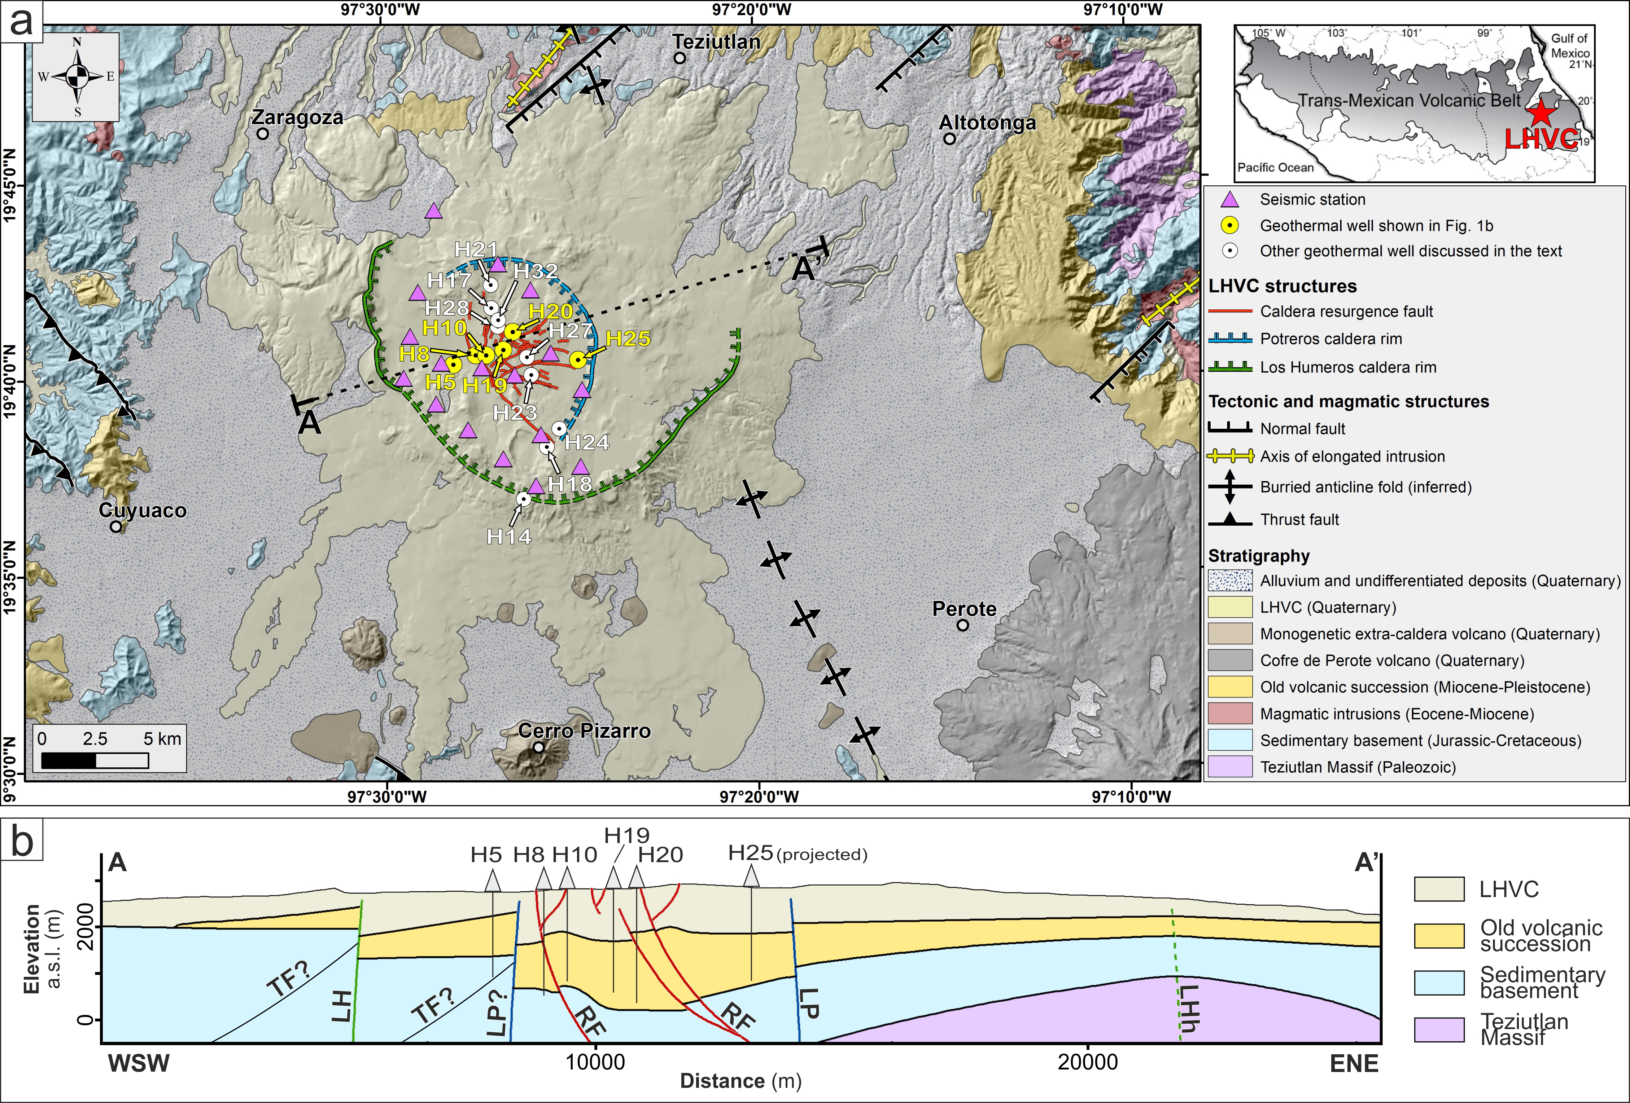

Introduction
seismic station
geothermal well
after Norini et al. 2019
And below 2 km?
Continuation of faults?
→ brittle/ductile (BD) transition
Imaging the BD transition zone using seismic noise
K. Löer, T. Toledo, G. Norini, X. Zhang, A. Curtis, E. H. Saenger
Notes:
This is the study area:
top view of LH caldera showing geothermal wells and central broadband seismic stations
below, cross section along the line A-A’ and main geological sections
From well log analysis and outcrops we have a fairly good idea about what the subsurface for the upper 2 km looks like.
However, we do not know, what is below.
WHY IS THIS IMPORTANT?
Problem
very hot area → rocks become ductile and fractures cannot exist → fluids cannot circulate (secondary permeability) → geothermal potential not usable
Idea:
identify onset of brittle/ductile transition, which limits the maximum depth of secondary permeability related to faults
asses rock volume available for geothermal exploitation

Slide 3
Methods
topographic surface
well log analysis (0-2 km)
local seismicity analysis (0-4 km)
depth
seismic noise beamforming (2-15 km)
+ inversion
?
Imaging the BD transition zone using seismic noise
K. Löer, T. Toledo, G. Norini, X. Zhang, A. Curtis, E. H. Saenger
Notes:
In our study we have combined results from three different methods, each of which is sensitive to a different depth.
As we have seen, well logs sample the upper 2 km.
Local seismicity analysis jointly estimates locations of micro-earthquakes and subsurface structure.
Most earthquakes occur above 4 km depth, hence, this method provides structural information to a maximum of 4 km depth.
The third method is three-component beamforming of ambient noise combined with an inversion scheme, and with this we can “look” 15 km deep.
Beamforming is an ARRAY TECHNIQUE and makes use of the data recorded at all the seismic stations you can see here on the map.
In fact, the data we use are ambient seismic noise data recorded continuously.
Noise consists of both surface and body waves, here focus on surface waves, Rayleigh waves in particular.
In the following I will give a quick overview of the seismic array, its implication for the depth sensitivity, and the beamforming method itself

Slide 4
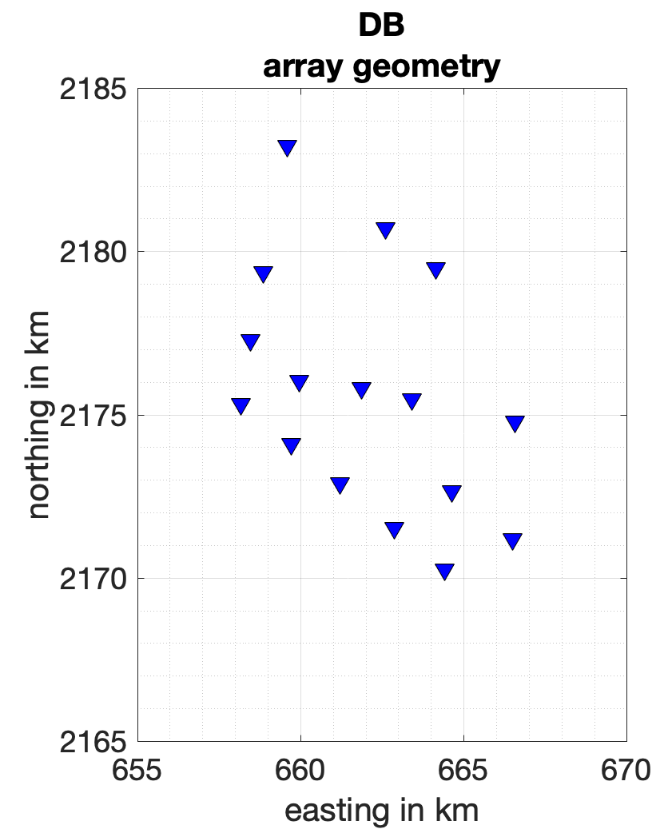






Array sensitivity
$$2 d_{min}≤λ≤3 d_{max}$$
$$3.2 km≤λ≤41.7 km$$
resolvable
wave length
$$d_{max}=13.9 km$$
$$f=\frac{v}{λ}$$
$$v_{min}=1.5 km s^{−1}$$
$$z≈0.4 λ_{R}$$
$$v_{max}=5 km s^{−1}$$
$$d_{min}=1.6 km$$
$$1.3 km≤z≤16.7 km$$
$$0.12 Hz≤f≤0.47 Hz$$
depth
frequency
oceanic
microseism
Tokimatsu, 1997, Proc. IS-Tokyo’95 First Int. Conf. Earthq. Geotech.
Imaging the BD transition zone using seismic noise
K. Löer, T. Toledo, G. Norini, X. Zhang, A. Curtis, E. H. Saenger
Notes:
Close up of broadband seismic stations in LH
Note that the depth sensitivity of beamforming depends on the station geometry of the array (in particular min and max station spacing):
Starting from a rule of thumb by Tokimatsu (1997), we first estimate the minimum and maximum wavelength the array can resolve (for LH these are around 3 km and 40 km, respectively).
Considering that Rayleigh waves oscillate at different depths depending on their wavelength, we can then derive the depth range these waves are sensitive to
On the other hand, by converting wavelength to wavenumber and estimating local minimum and maximum velocities, we also obtain the frequency range the array can resolve.

Slide 5
Three-component beamforming
Ambient seismic noise from everywhere
predominantly from Pacific ocean and
Gulf of Mexico (< 1 Hz)
Imaging the BD transition zone using seismic noise
K. Löer, T. Toledo, G. Norini, X. Zhang, A. Curtis, E. H. Saenger
Notes:
In principle, ambient noise comes from everywhere.
In the frequency range of interest, however, it predominantly arrives from the Pacific ocean and the Gulf of Mexico

Slide 6
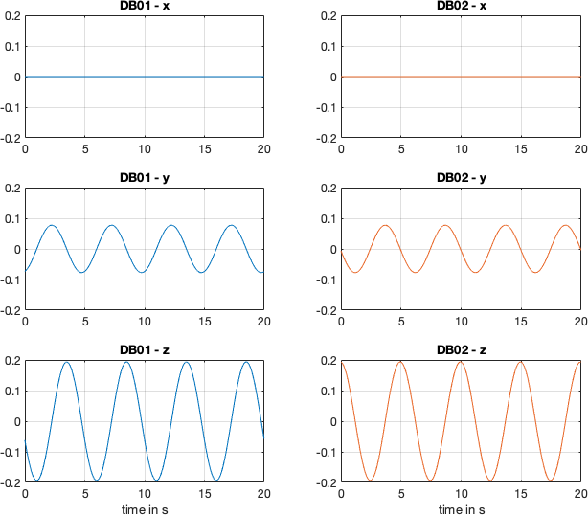
Three-component beamforming
DB02
DB01
phase shift across stations:
velocity + direction of noise
phase shift across components:
wave type (e.g. Rayleigh)
Imaging the BD transition zone using seismic noise
K. Löer, T. Toledo, G. Norini, X. Zhang, A. Curtis, E. H. Saenger
Notes:
The principle idea of the method is to compare phase shifts of the noise wavefield at different stations and on the three different components of each sensor.
Here is an example for a (synthetic) wavefield coming from the South.
The two plots show the recordings of the y-components at stations DB01 and DB02.
Since the wave arrives earlier at stations 1 than at station 2, a phase shift can be observed between the two stations.
This shift depends on the direction of the incoming wavefield, the wave velocity and the location of the stations.
Beamforming analyses the phase shifts between all stations simultaneously.
Additionally, the phase shifts between the three different components (E, N, Z) are analysed.
These are controlled by the wave type and describe particle motion.

Slide 7
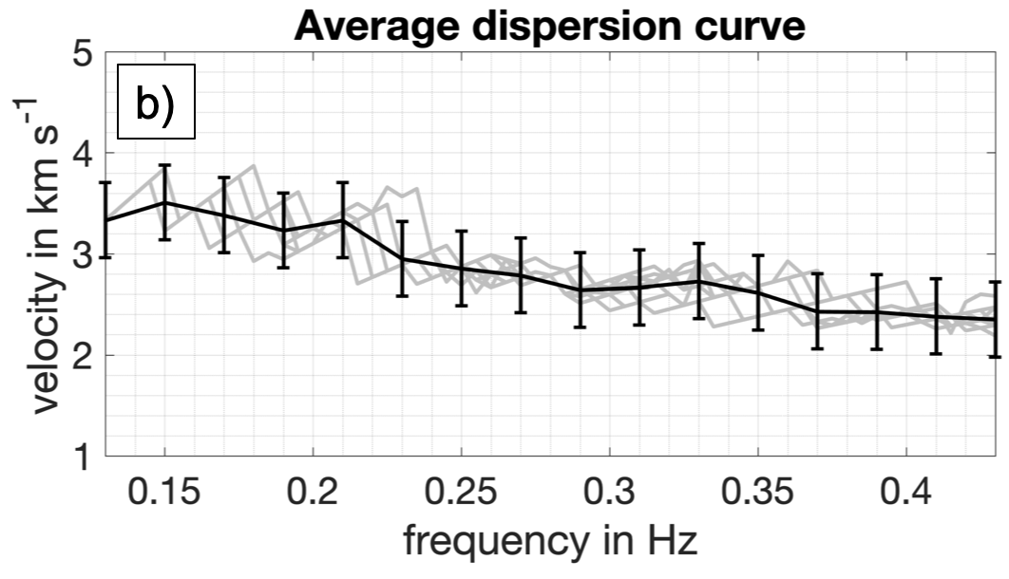
Three-component beamforming
For one time/frequency window:
velocity
propagation direction
wave type
DB02
Rayleigh waves
?
Seismic profile:
velocity
vs.
depth
DB01
Rayleigh waves
Imaging the BD transition zone using seismic noise
K. Löer, T. Toledo, G. Norini, X. Zhang, A. Curtis, E. H. Saenger
Notes:
This allows us to derive
velocity
propagation direction
wave type (surface or body…)
of the dominant wave within a given time and frequency window.
We sort this information by wave type, concentrate on Rayleigh waves only, and perform a statistical analysis of all time windows (here: 10 days).
In particular, we extract the measured phase velocities at different frequencies = DISPERSION CURVE
In the next step you will see how we convert the dispersion curve into a seismic profile
that gives us shear velocity as a function of depth

Slide 8
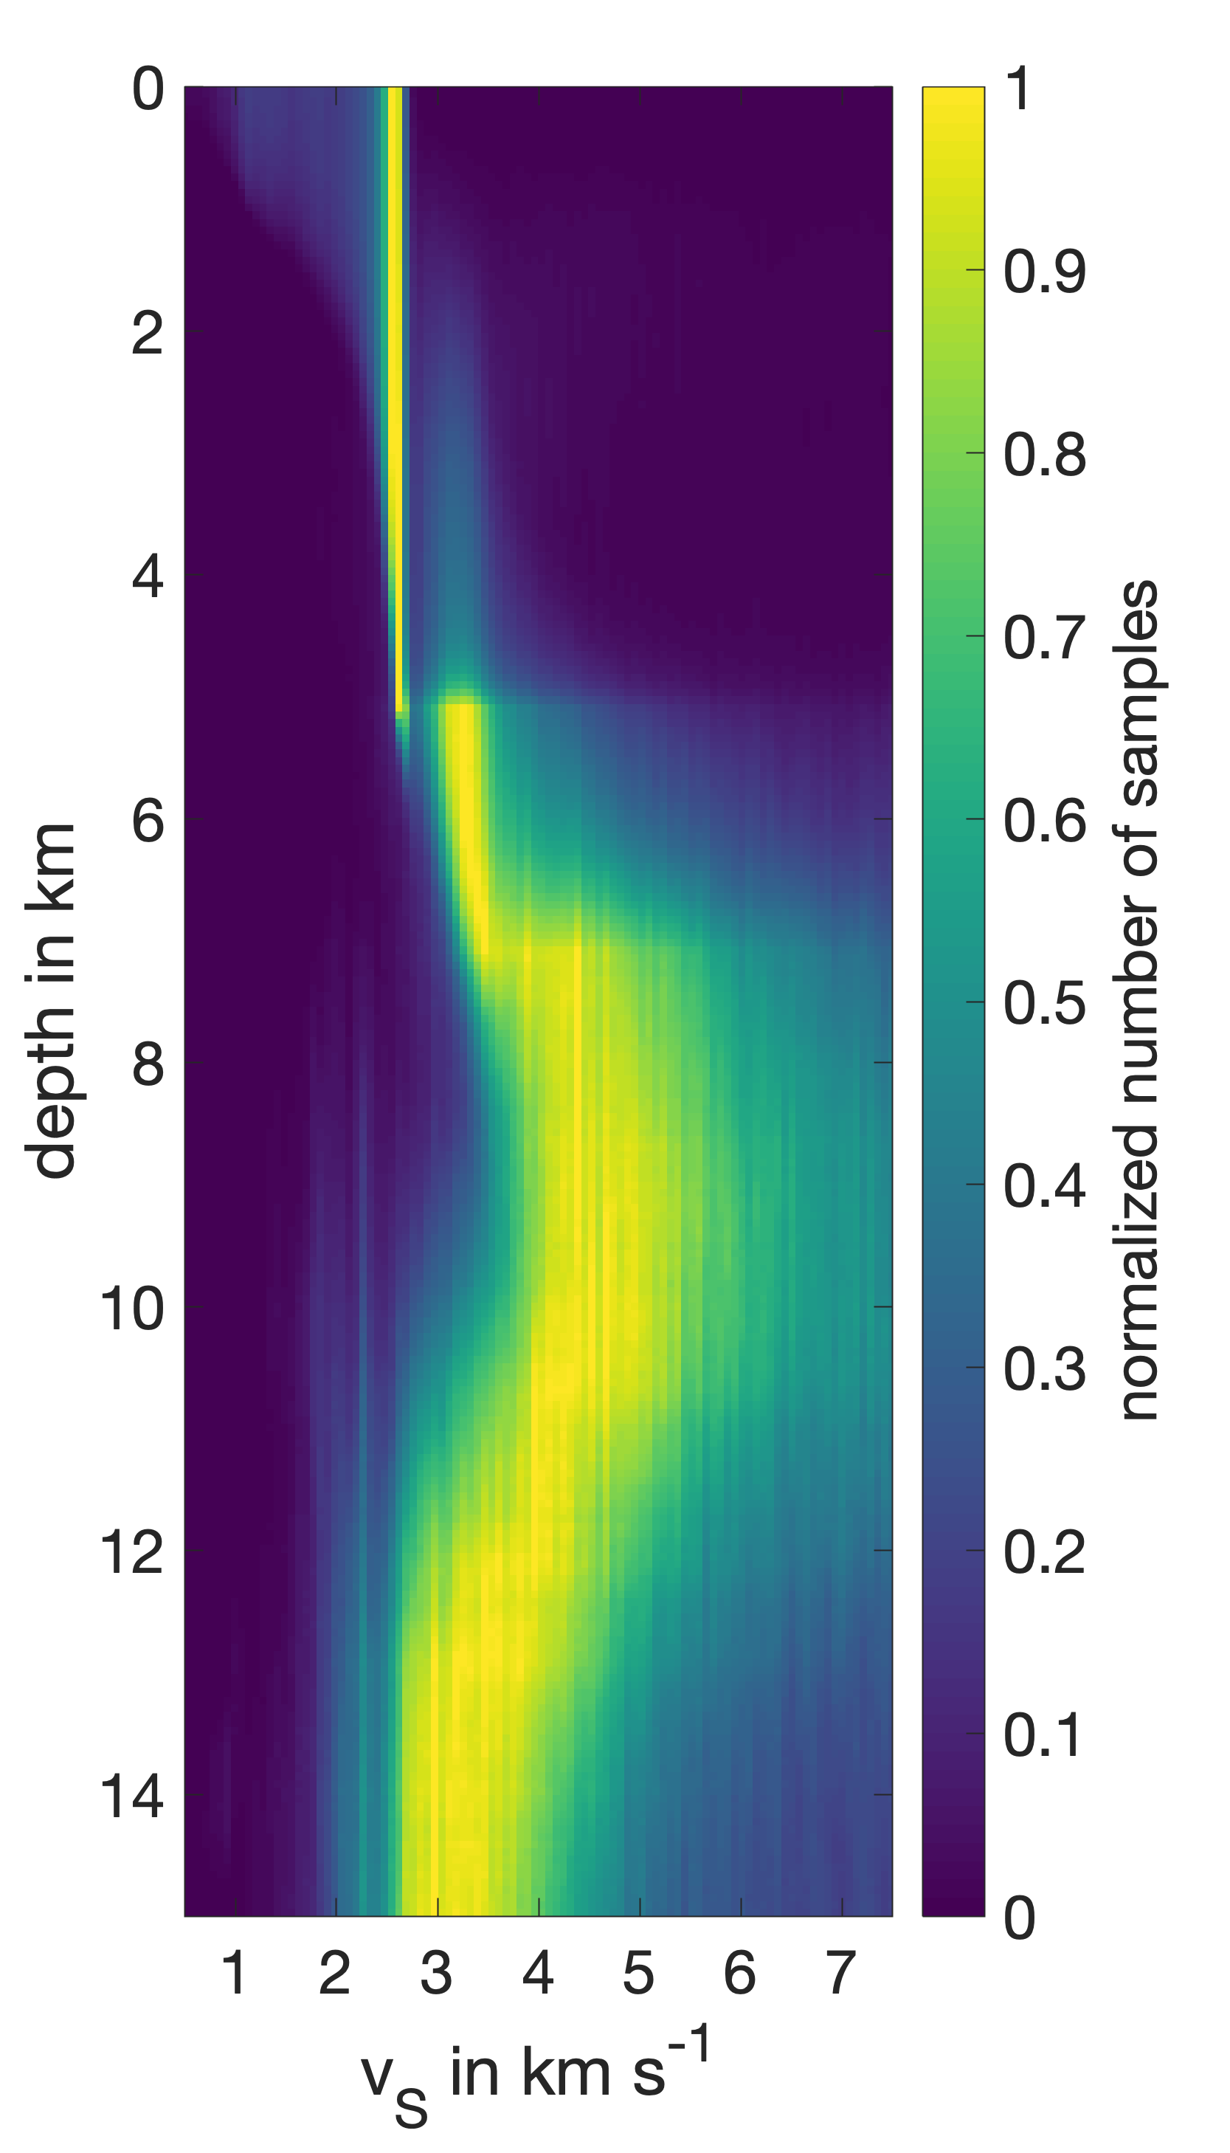
Inversion
Probability density function (PDF)
= distribution of models (velocity vs. depth) consistent with the data (dispersion curve)
Dispersion curve
reversible-jump Markov chain Monte Carlo
(rj-McMC)
inversion
Bodin & Sambridge, 2009, GJI
Imaging the BD transition zone using seismic noise
K. Löer, T. Toledo, G. Norini, X. Zhang, A. Curtis, E. H. Saenger
Notes:
Dispersion curve is input to inversion scheme
We use a Markov-chain Monte-Carlo algorithm, details of which can be found in Bodin & Sambridge
Result: PDF = distribution of models (velocity vs. depth) consistent with the data (dispersion curve)
Yellow: velocity with high probability
Blue: velocity with low probability
Idea: different models (subsurface structures) produce similar dispersion curves;
we do not choose one, but consider all simultaneously → likelihood for how the subsurface actually looks like

Slide 9
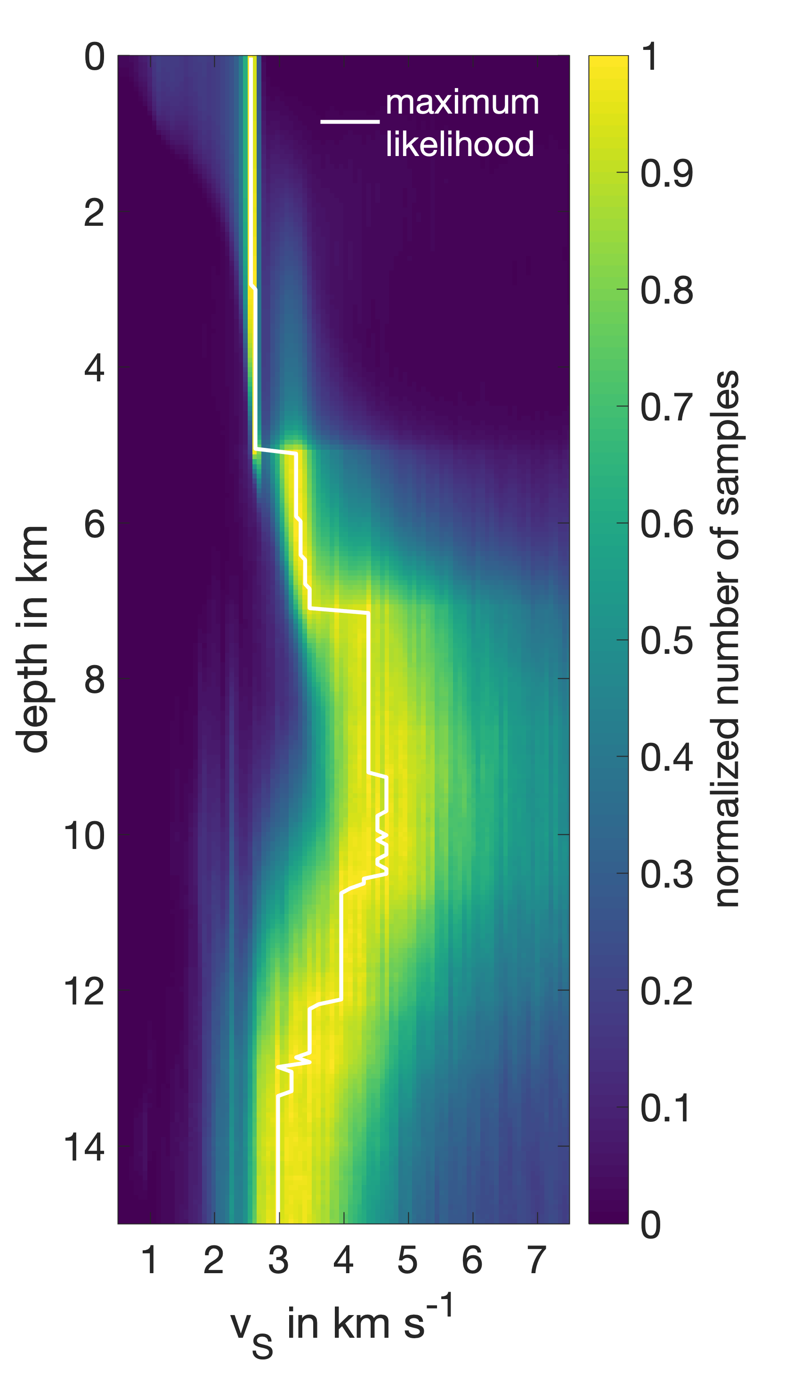
Inversion
Probability density function (PDF)
= distribution of models (velocity vs. depth) consistent with the data (dispersion curve)
→ 1D shear-velocity profile
Dispersion curve
reversible-jump Markov chain Monte Carlo
(rj-McMC)
inversion
Bodin & Sambridge, 2009, GJI
Imaging the BD transition zone using seismic noise
K. Löer, T. Toledo, G. Norini, X. Zhang, A. Curtis, E. H. Saenger
Notes:
maximum likelihood → seismic profile

Slide 10
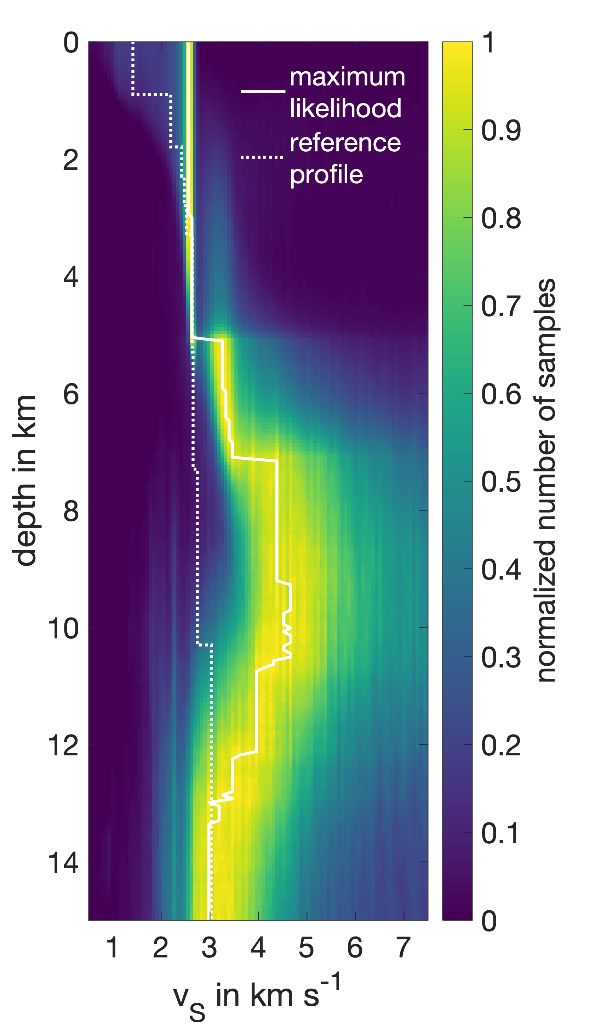
Inversion
Probability density function (PDF)
= distribution of models (velocity vs. depth) consistent with the data (dispersion curve)
→ 1D shear-velocity profile
Dispersion curve
reversible-jump Markov chain Monte Carlo
(rj-McMC)
inversion
Reference profile:
from local seismicity analysis
(Toledo et al. 2020)
Bodin & Sambridge, 2009, GJI
Imaging the BD transition zone using seismic noise
K. Löer, T. Toledo, G. Norini, X. Zhang, A. Curtis, E. H. Saenger
Notes:
Reference profile sensitive to upper 4 km
(here: sensitivity of beamforming is poor)

Slide 11
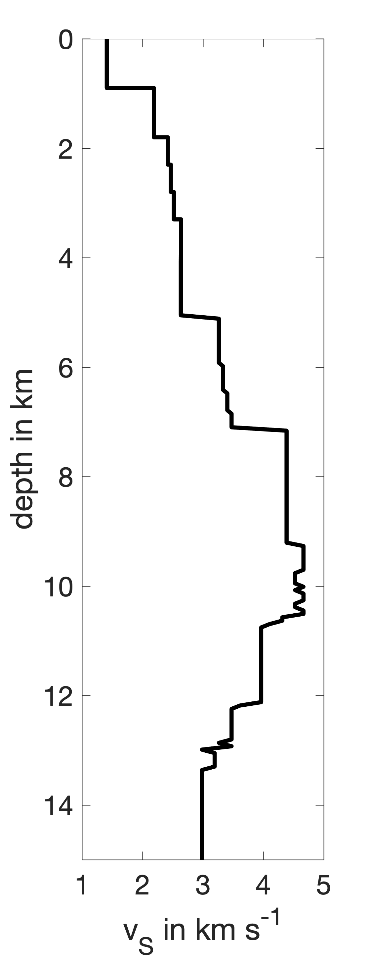
Inversion
Probability density function (PDF)
Combined profile
local seismicity
Dispersion curve
reversible-jump Markov chain Monte Carlo
(rj-McMC)
inversion
seismic noise
Bodin & Sambridge, 2009, GJI
Imaging the BD transition zone using seismic noise
K. Löer, T. Toledo, G. Norini, X. Zhang, A. Curtis, E. H. Saenger
Notes:
Construct combined profile that represent profile from local seismicity in the upper 4 km, and from seismic noise below 4 km

Slide 12
Geological interpretation
Combined profile
Imaging the BD transition zone using seismic noise
K. Löer, T. Toledo, G. Norini, X. Zhang, A. Curtis, E. H. Saenger
Notes:
For this profile, we now attempt a geological interpretation

Slide 13
Geological interpretation
Combined profile
seismic stations
Imaging the BD transition zone using seismic noise
K. Löer, T. Toledo, G. Norini, X. Zhang, A. Curtis, E. H. Saenger
Notes:
Take geological cross-section for comparison
Remember: profile is average over region covered by seismic stations

Slide 14
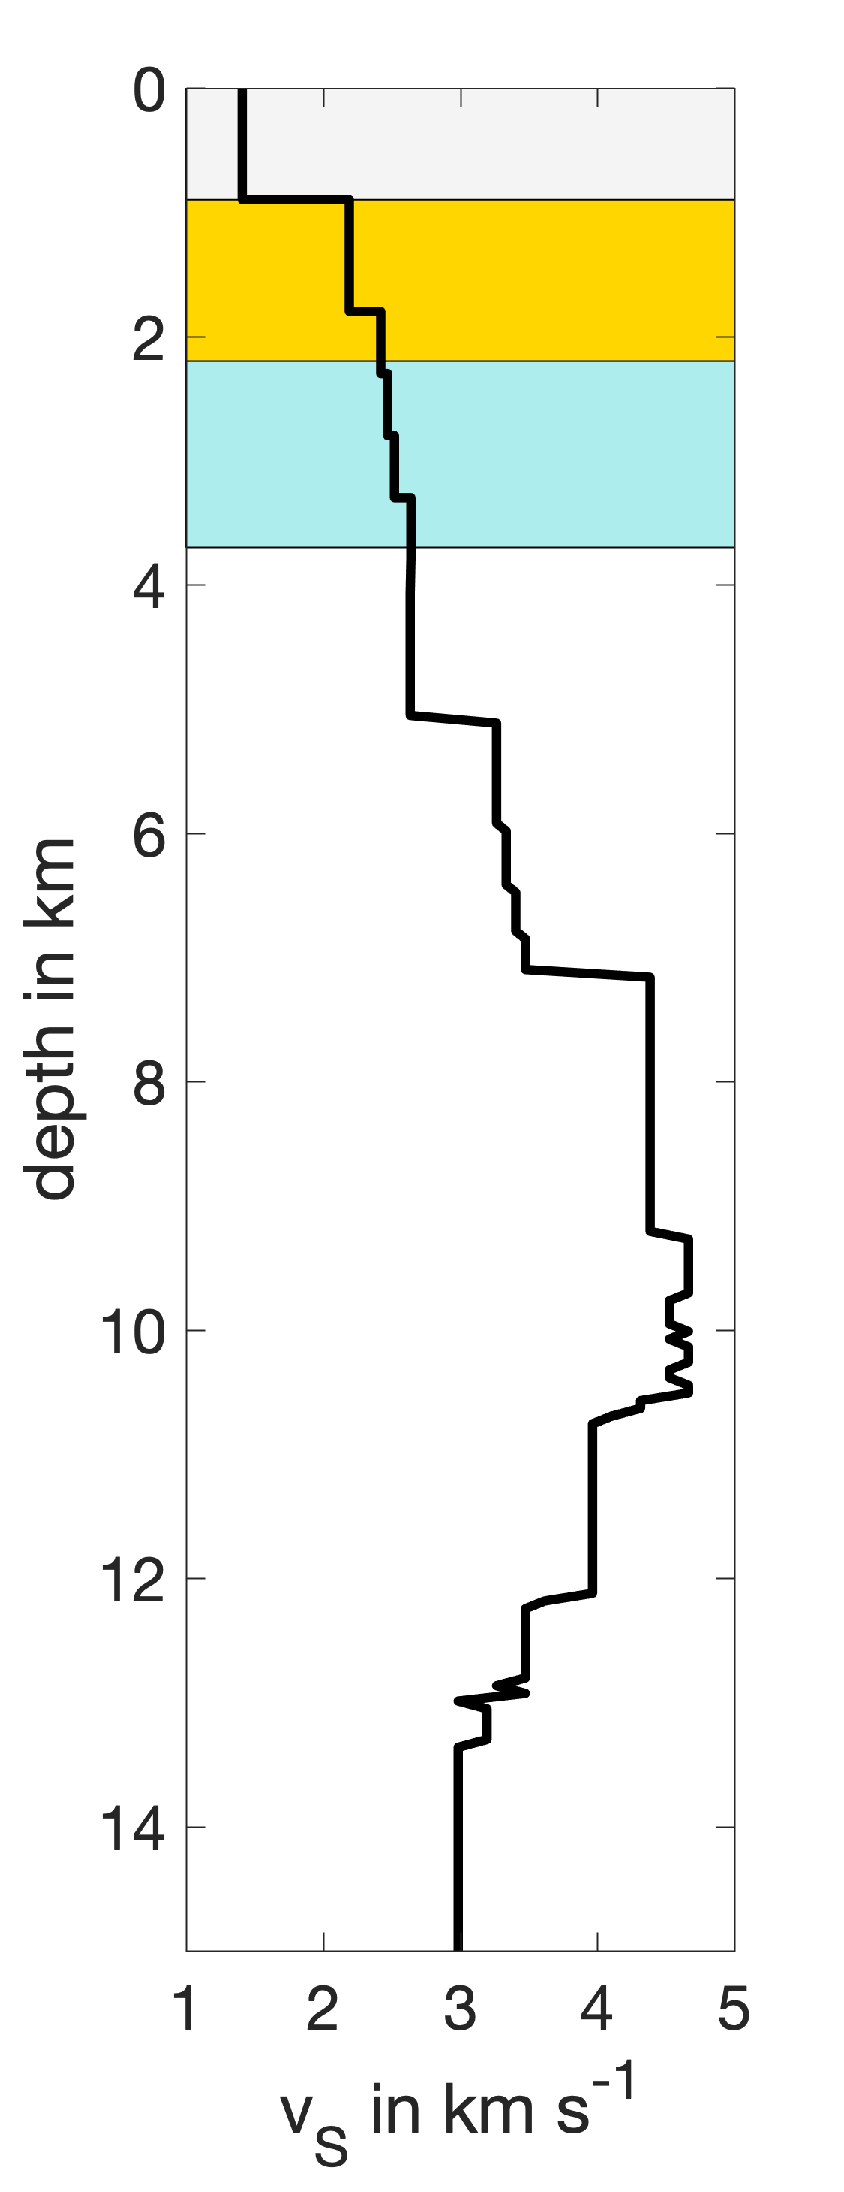
Geological interpretation
Combined profile
seismic stations
→ average transition depths from well logs
?
Imaging the BD transition zone using seismic noise
K. Löer, T. Toledo, G. Norini, X. Zhang, A. Curtis, E. H. Saenger
Notes:
We now display average transition depths from well logs.
They coincide nicely with discontinuities in the seismic profile.

Slide 15
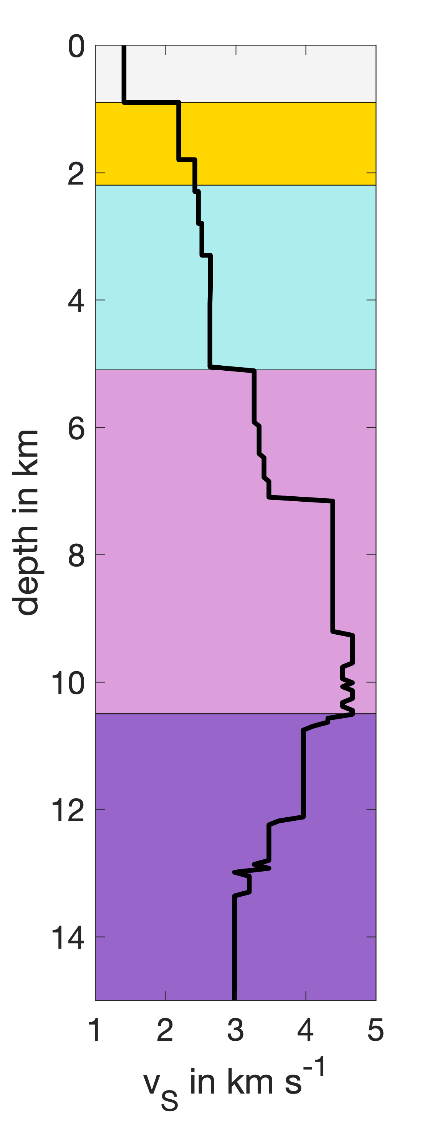
Geological interpretation
Combined profile
seismic stations
Shear strength (MPa)
→ average transition depths from well logs
+ seismic profile
Teziutlan Massif
BD transition
Depth (km)
brittle/ductile transition
after Imber et al., 2008, Geol. Soc., London
Imaging the BD transition zone using seismic noise
K. Löer, T. Toledo, G. Norini, X. Zhang, A. Curtis, E. H. Saenger
Notes:
We then interpret deeper discontinuities in the seismic profile:
1) Using geological information, e.g., from outcrops, we conclude that the velocity jump at 5 km corresponds to the transition from the sedimental to the crystalline basement.
2) Secondly, we infer that the decrease of shear velocity marks the onset of the BD transition
BD transition zone: decrease of shear strength → decrease of shear velocity

Slide 16
Conclusions
Combined profile
good agreement between well logs, local seismicity + noise analysis
→ validation of method
new geological information
(crystalline basement)
Deeper than expected:
larger rock volume for geothermal exploitation
maximum depth of brittle structures (secondary permeability)
Imaging the BD transition zone using seismic noise
K. Löer, T. Toledo, G. Norini, X. Zhang, A. Curtis, E. H. Saenger
Notes:
In summary, we have shown the following, namely that
we get a good agreement between the structures inferred from well logs, local seismicity and noise analysis in the upper 4 km
→ validation of our method
we can derive new geological information by estimating the average depth of the crystalline basement below the caldera
we can restrict the maximum depth of brittle structures by identifying the BD transition zone
This is the maximum depth to which fractures can occur and secondary permeability is possible.
Given that we are in a volcanic area exhibiting a positive thermal anomaly, the transition occurs deeper than expected!
In theory, this increases the potential rock volume available for geothermal exploitation.
IMPORTANT: Profile gives lateral average! That is, local low velocity zones may well exist, however, on average velocities begin to decline around 10 km depth

Slide 17
Acknowledgments
We acknowledge the Comision Federal de Electricidad (CFE) for kindly providing access to their geothermal fields and to the seismic data and for granting us permission to publish.
We also acknowledge our Mexican and European colleagues for setting up the seismic network.
This project has received funding from the German Research Foundation (DFG) under Project number 298820846 and from the European Union’s Horizon 2020 research and innovation programme under grant agreement No. 727550 and the Mexican Energy Sustainability Fund CONACYT-SENER, project 2015-04-68074
The content of this presentation reflects only the authors’ view. The Innovation and Networks Executive Agency (INEA) is not responsible for any use that may be made of the information it contains.
Imaging the BD transition zone using seismic noise
K. Löer, T. Toledo, G. Norini, X. Zhang, A. Curtis, E. H. Saenger

