Slide 1
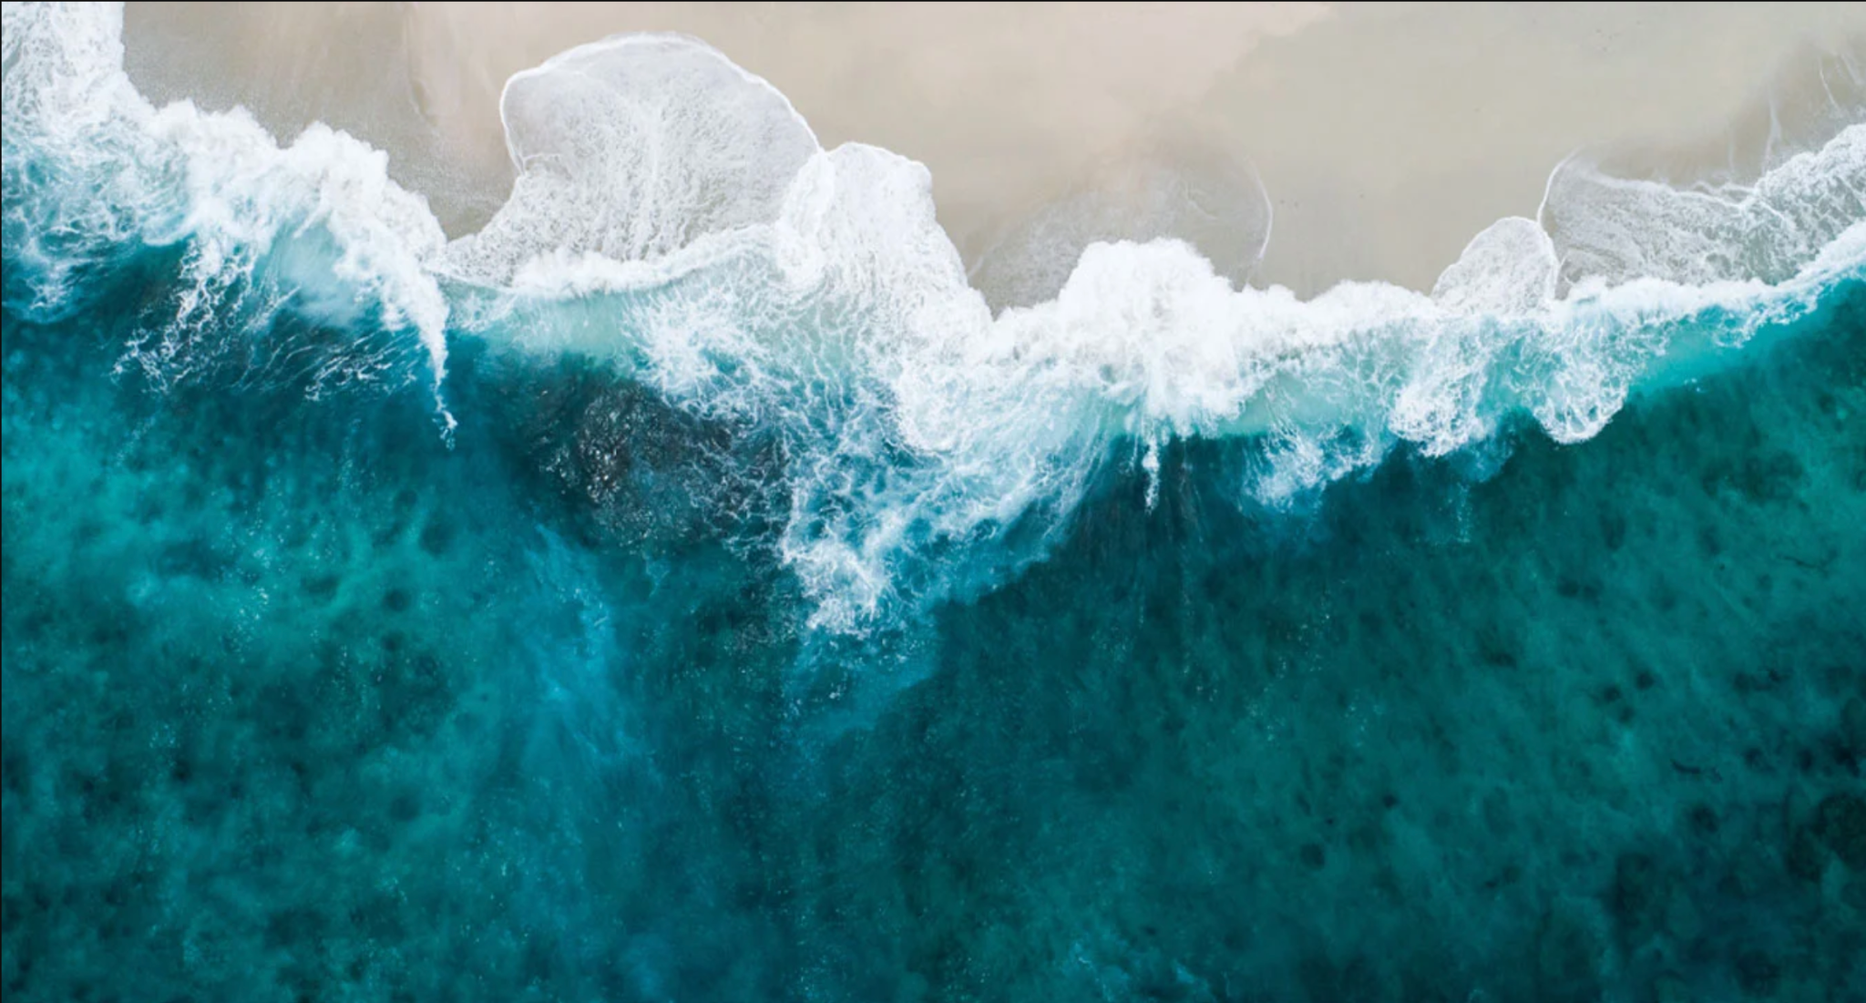
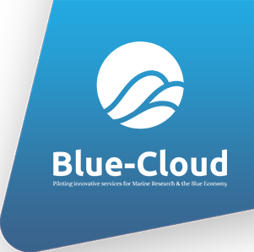

DECODE THE OCEAN!
Kick-off Live Event · Ideation Warm Up
17 January 2022
Introducing Blue-Cloud
Dick M.A. Schaap – MARIS (Blue-Cloud Technical Coordinator)

Slide 2
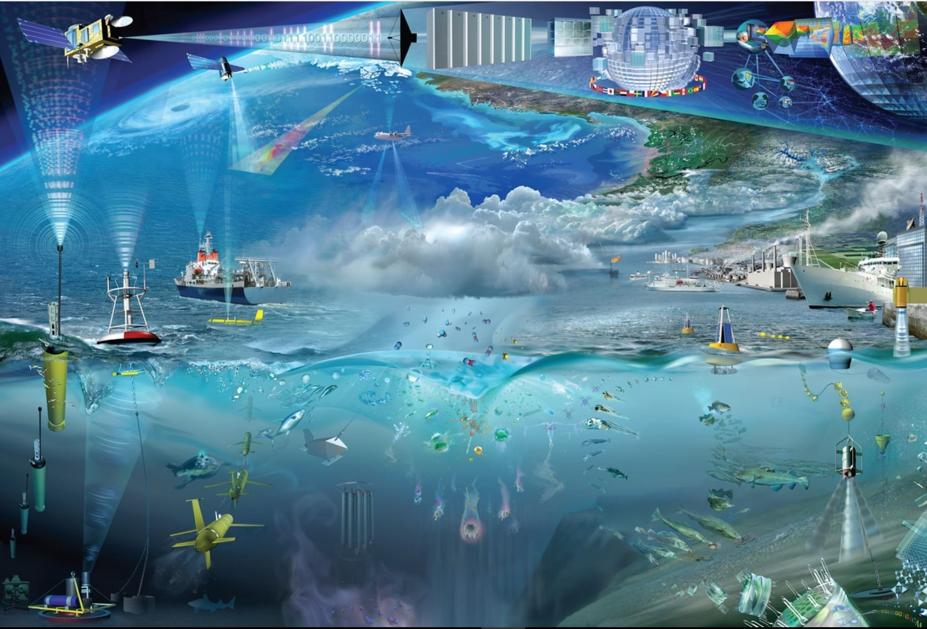
Acquisition of marine and ocean data
Scientific Research to gain knowledge and insight
Modelling (including hindcast, nowcast, forecast)
Economic activities: shipping, offshore industry, dredging industry, fisheries, tourism, engineering ..
Environmental Management: monitoring and assessment (water quality, climate status, stock assessment)
Marine Conventions and Directives, in Europe: Water Framework Directive (WFD), Marine Strategy (MSFD), Marine Spatial Planning (MSP), Coastal Zone Management
EU Strategies, such as Green Deal, Blue Environment, Blue Economy
In Europe we spent circa 1.4 Billion Euro a year in marine data acquisition
(1.0 BE in-situ; 0.4 BE remote sensing)
(According to EMODnet study)

Slide 3
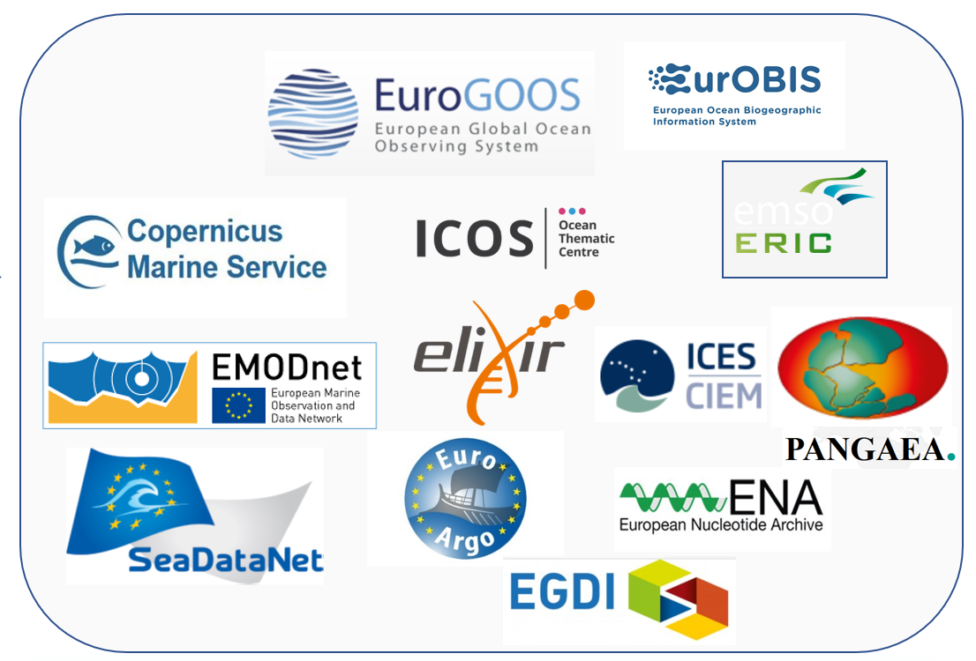
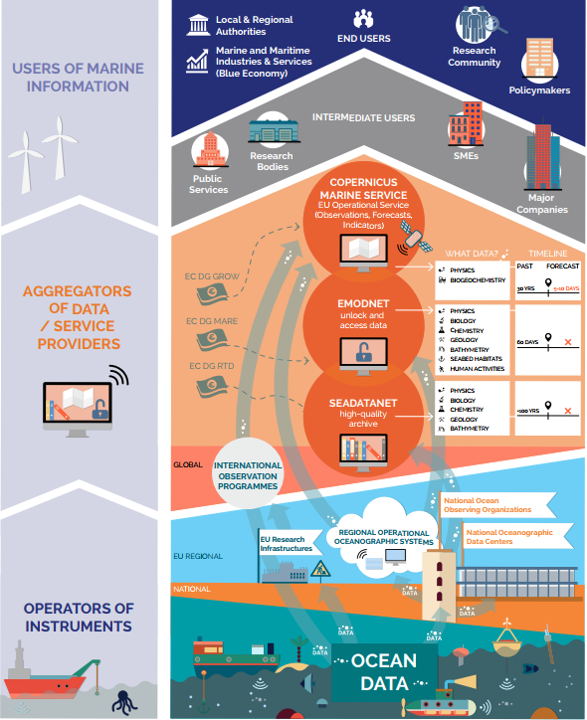

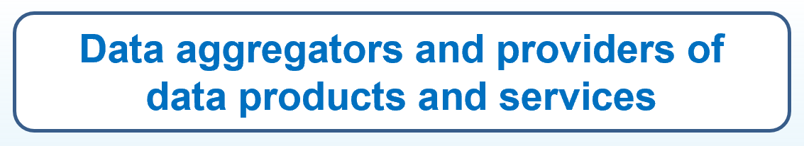
European landscape of marine data management

Slide 4


Demonstrating the potential of Open Science in the marine domain
EU H2020 Blue-Cloud project ‘Future of Seas and Oceans Flagship Initiative’
October 2019 – September 2022; 20 partners
Marine thematic contribution to European Open Science Cloud (EOSC)
Blue-Cloud aims “to promote the sharing of data, processes and research findings in the marine domain by delivering a collaborative web-based environment that enables open science, underpinned by simplified access to an unprecedented wealth of marine data resources and interoperable added-value services and products”

Slide 5
Blue-Cloud overarching concept
Added-value services and Applications
VRE – Cloud Platform
Downstream services
Developing and deploying Virtual Research Environment (VRE) withan array of services for configuring and running Virtual Labs for specific analytical workflows, use cases, and demonstrators
Standards
OGC, ISO, W3C
Vocabularies
Applying common standards and interoperability solutions for providing harmonized metadata and data
Developing and deploying harmonized discovery and access to established European marine data management and processing infrastructures
Upstream services
Discovery and Access to data
sets from many resources

Slide 6
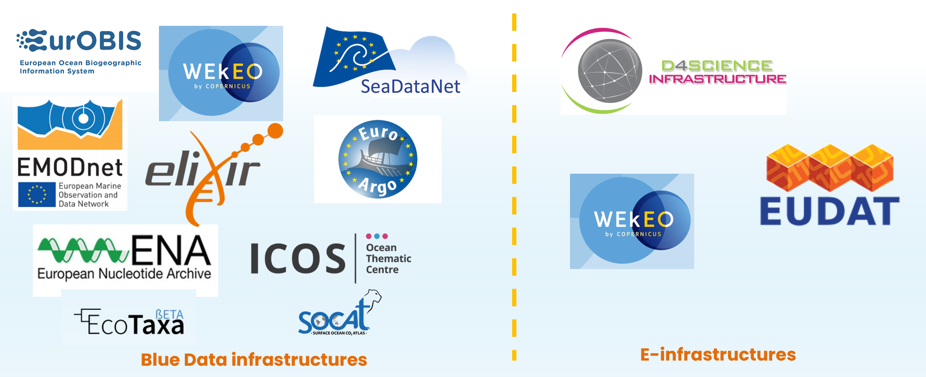
Federation of major European infrastructures
In Europe we spent circa 1.4 Billion Euro a year in marine data acquisition
(1.0 BE in-situ; 0.4 BE remote sensing)
(According to EMODnet study)

Slide 7

Illustrations of data types and coverage
EMODnet Chemistry
EcoTaxa
SeaDataNet
EurOBIS
Argo - EuroArgo
WEkEO (CMEMS)

Slide 8






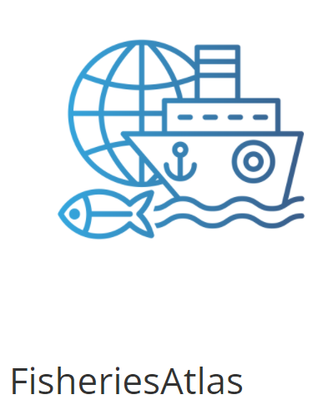
Blue-Cloud Key Products & Services
Blue-Cloud Data Discovery & Access service, federating key European data management infrastructures, to facilitate users in finding and retrieving multi-disciplinary datasets from multiple repositories
Blue-Cloud Virtual Research Environment infrastructure to provide a range of services and to facilitate orchestration of computing and analytical services for constructing, hosting and operating Virtual Labs for specific applications
Blue-Cloud Virtual Labs, configured with specific analytical workflows to serve as Demonstrators, which can be adopted and adapted for other inputs and analyses

Slide 9
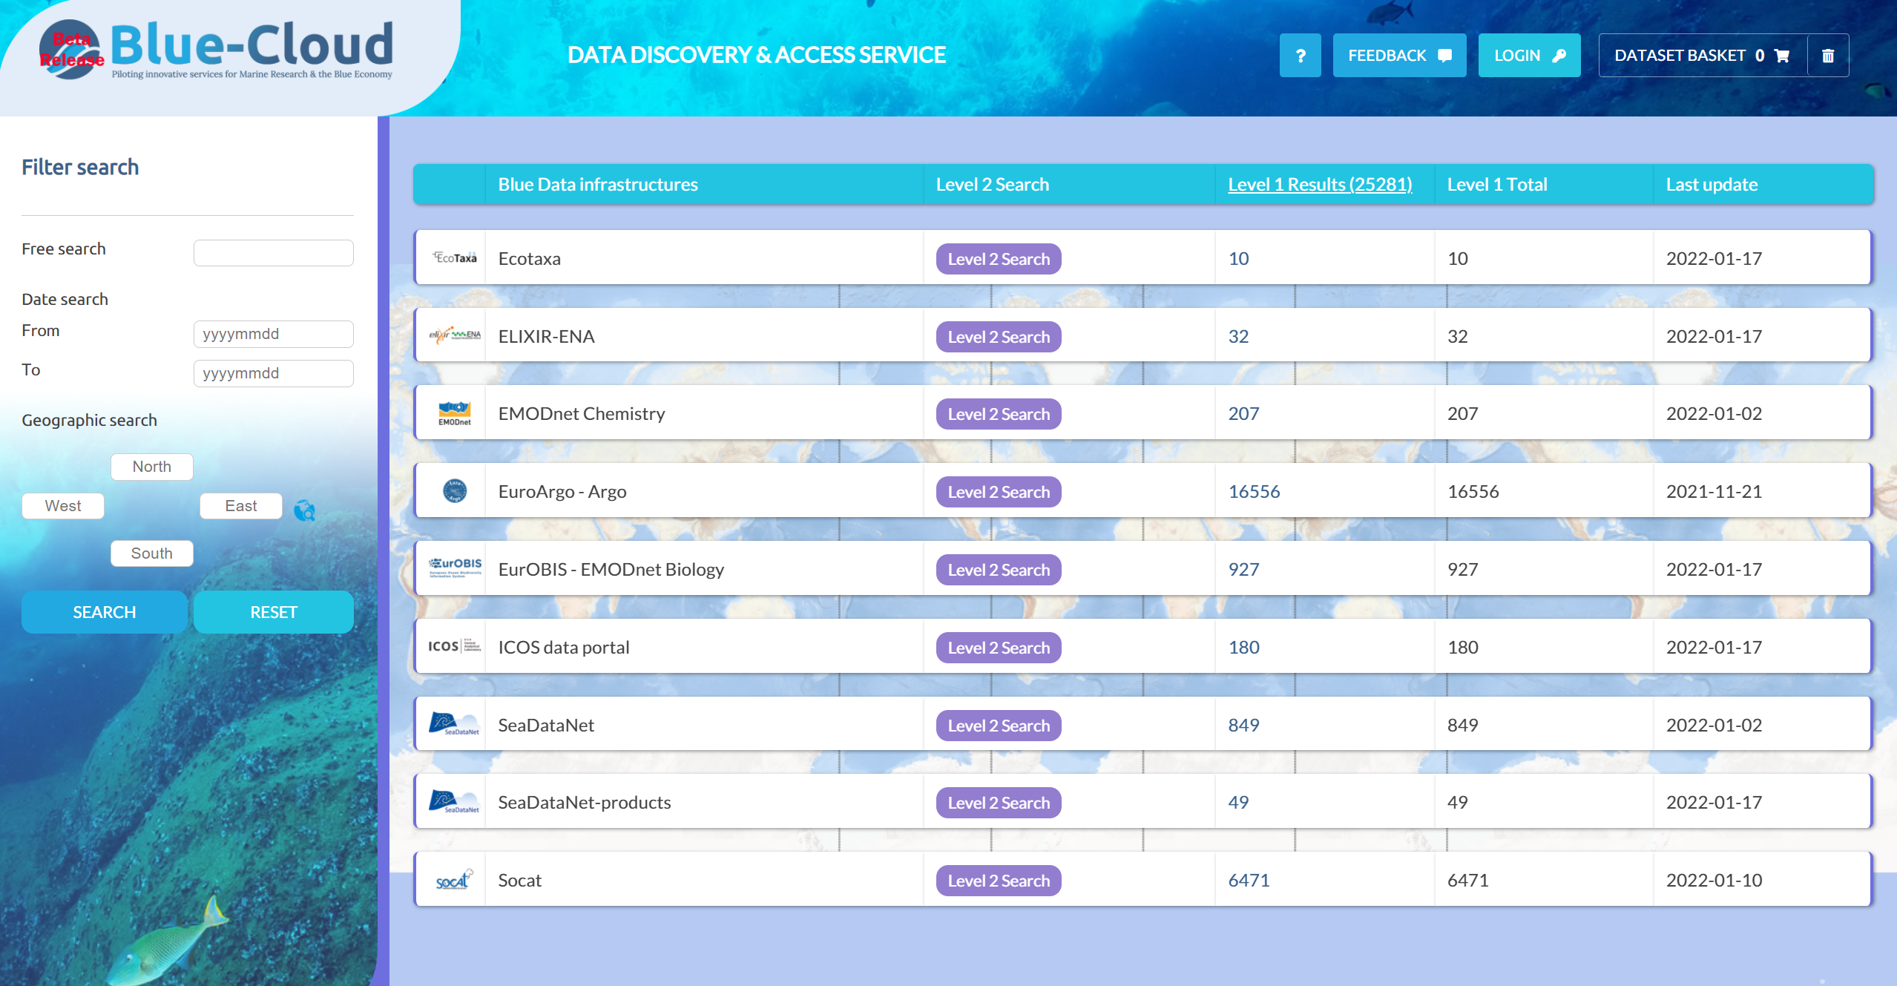
Blue-Cloud Data Discovery & Access Service
2 level search approach
      Shopping basket
      Data Broker
      Download metadata and data
      Transfer to VRE

Slide 10
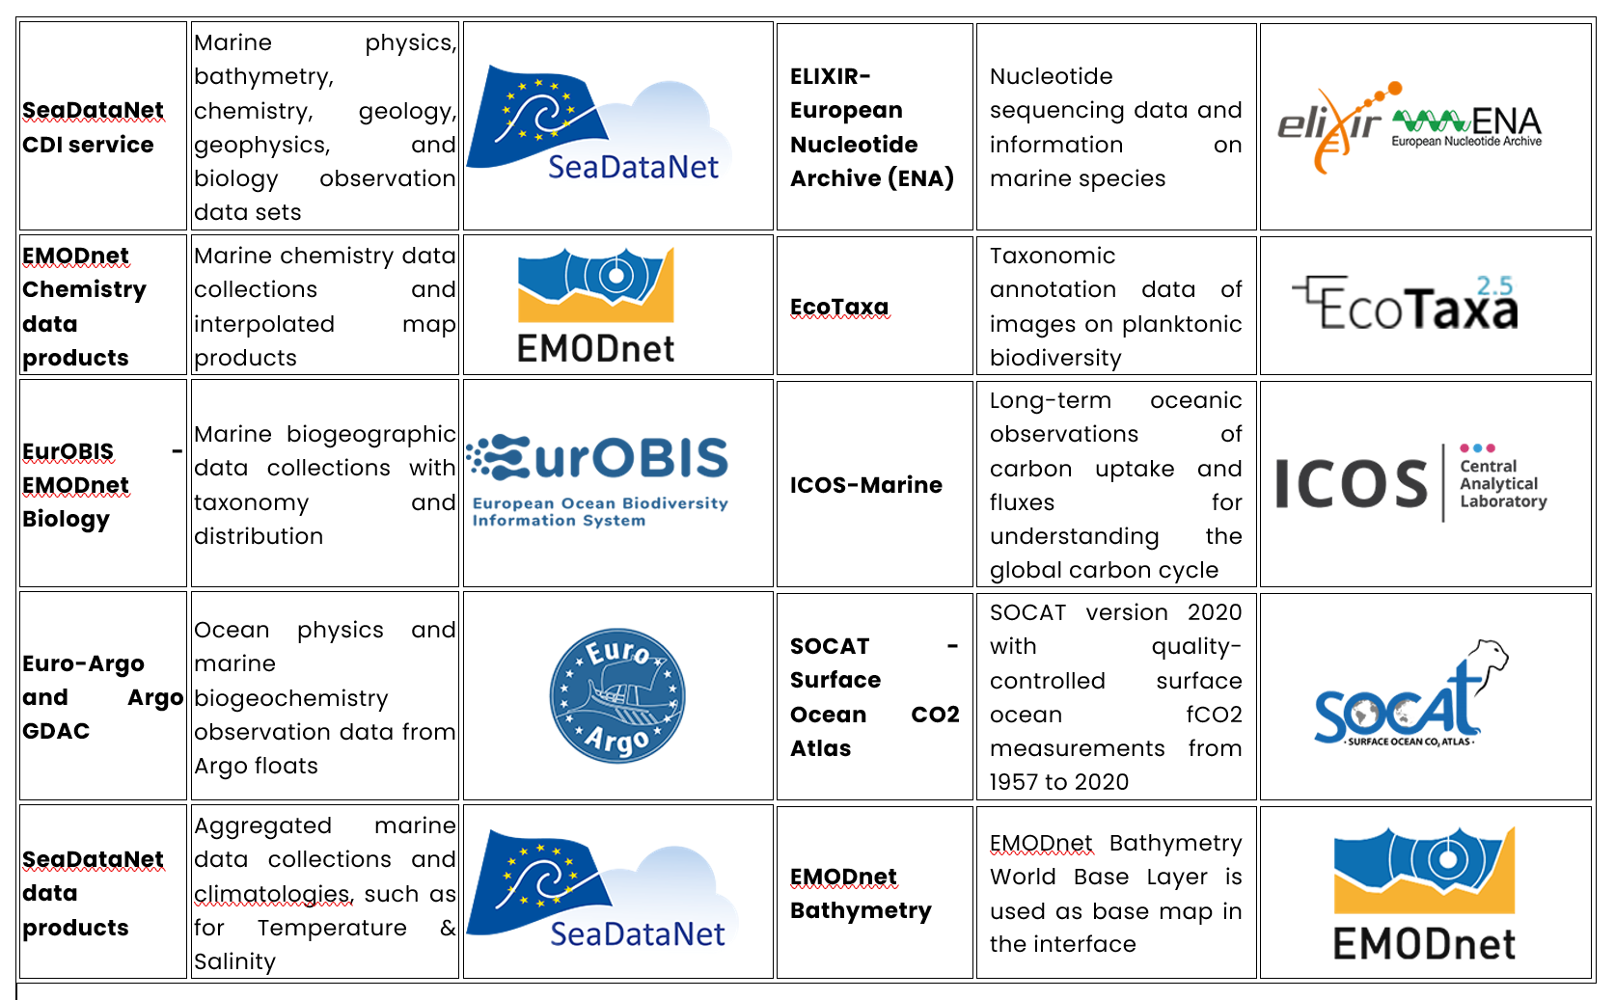
Data Discovery & Access Service
More than 10 Million open data sets and thousands of data products!

Slide 11
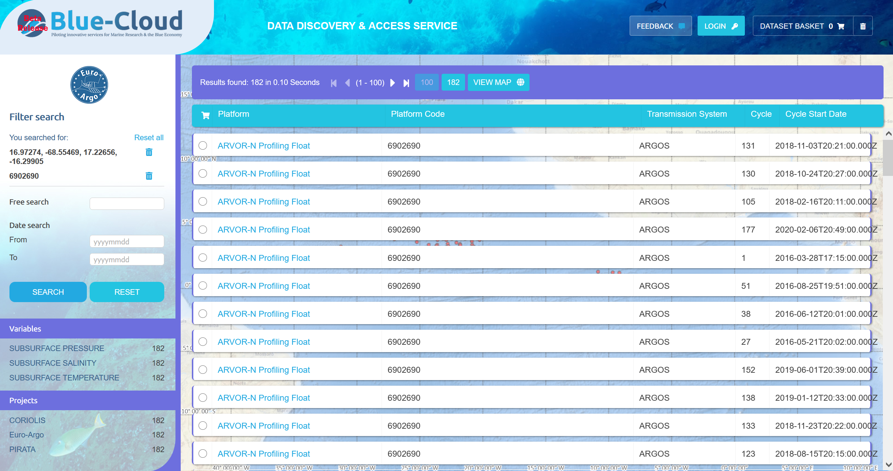
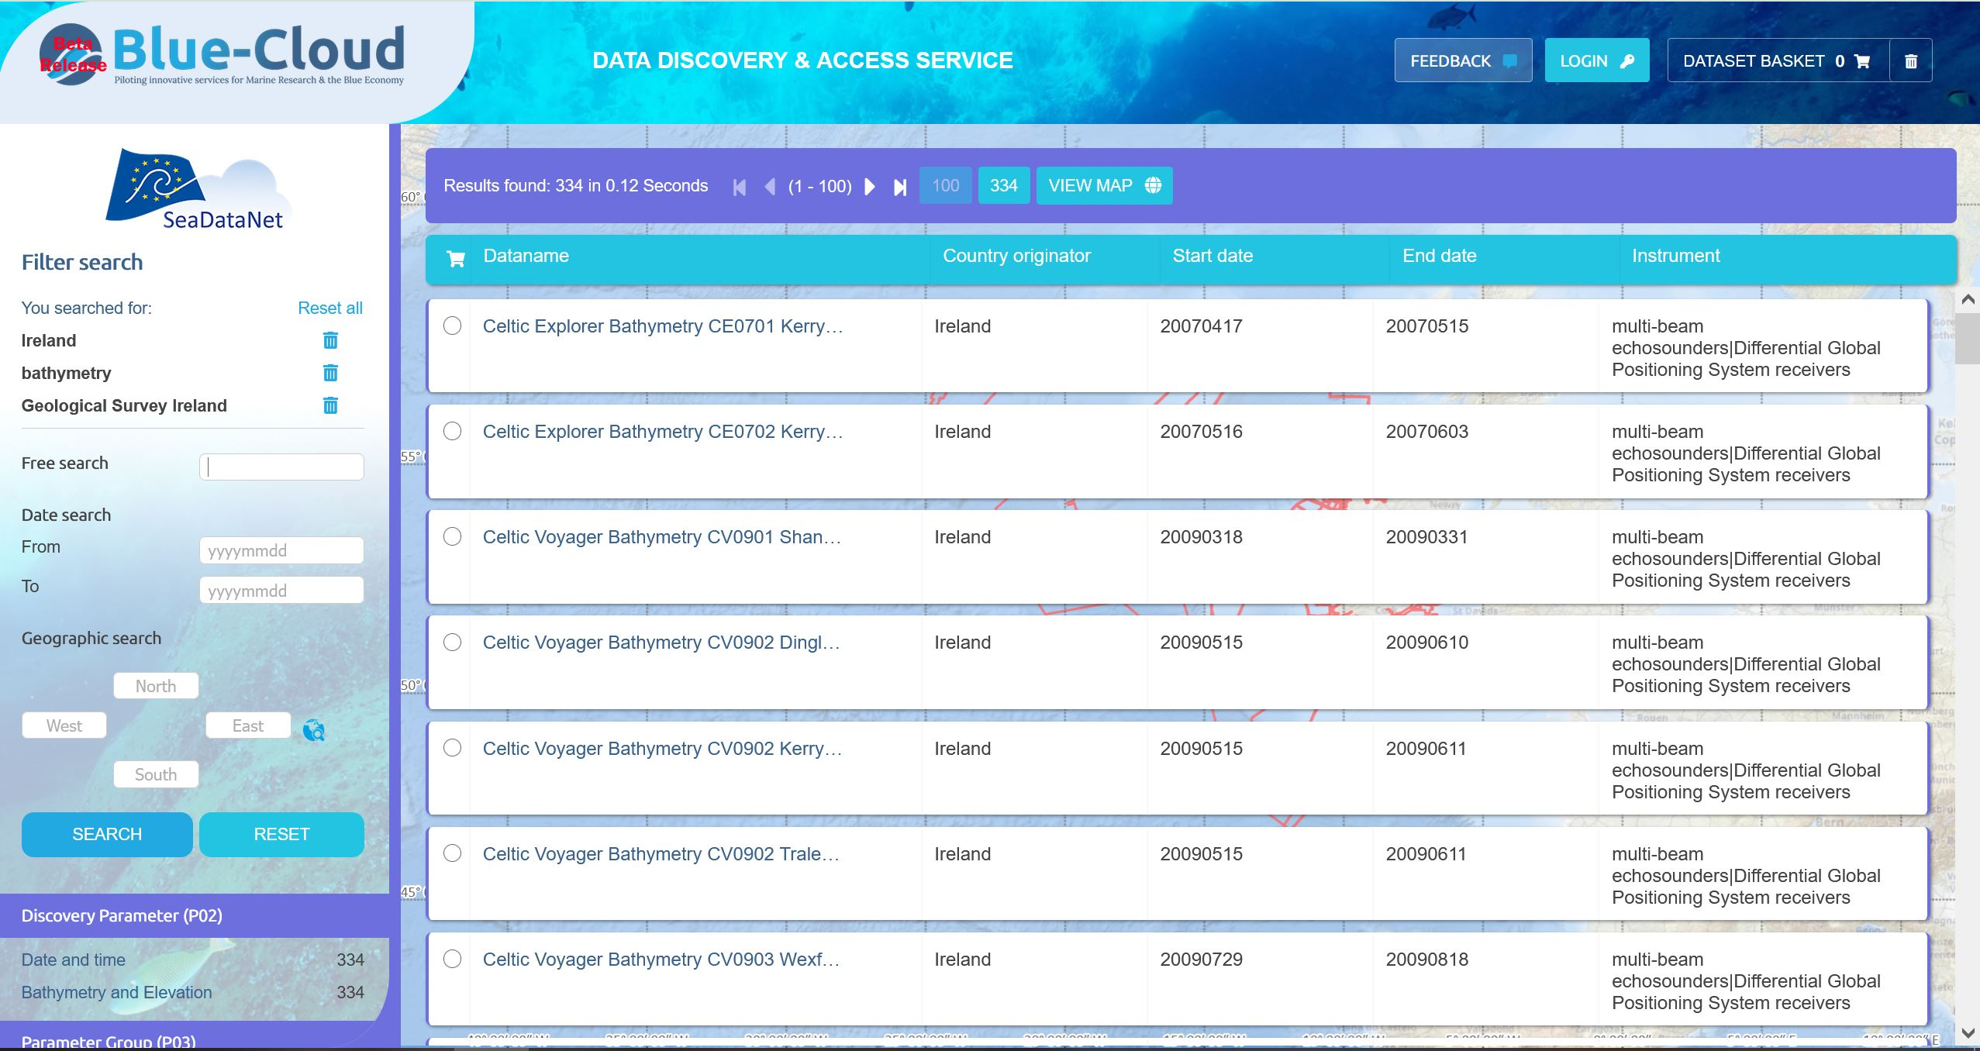
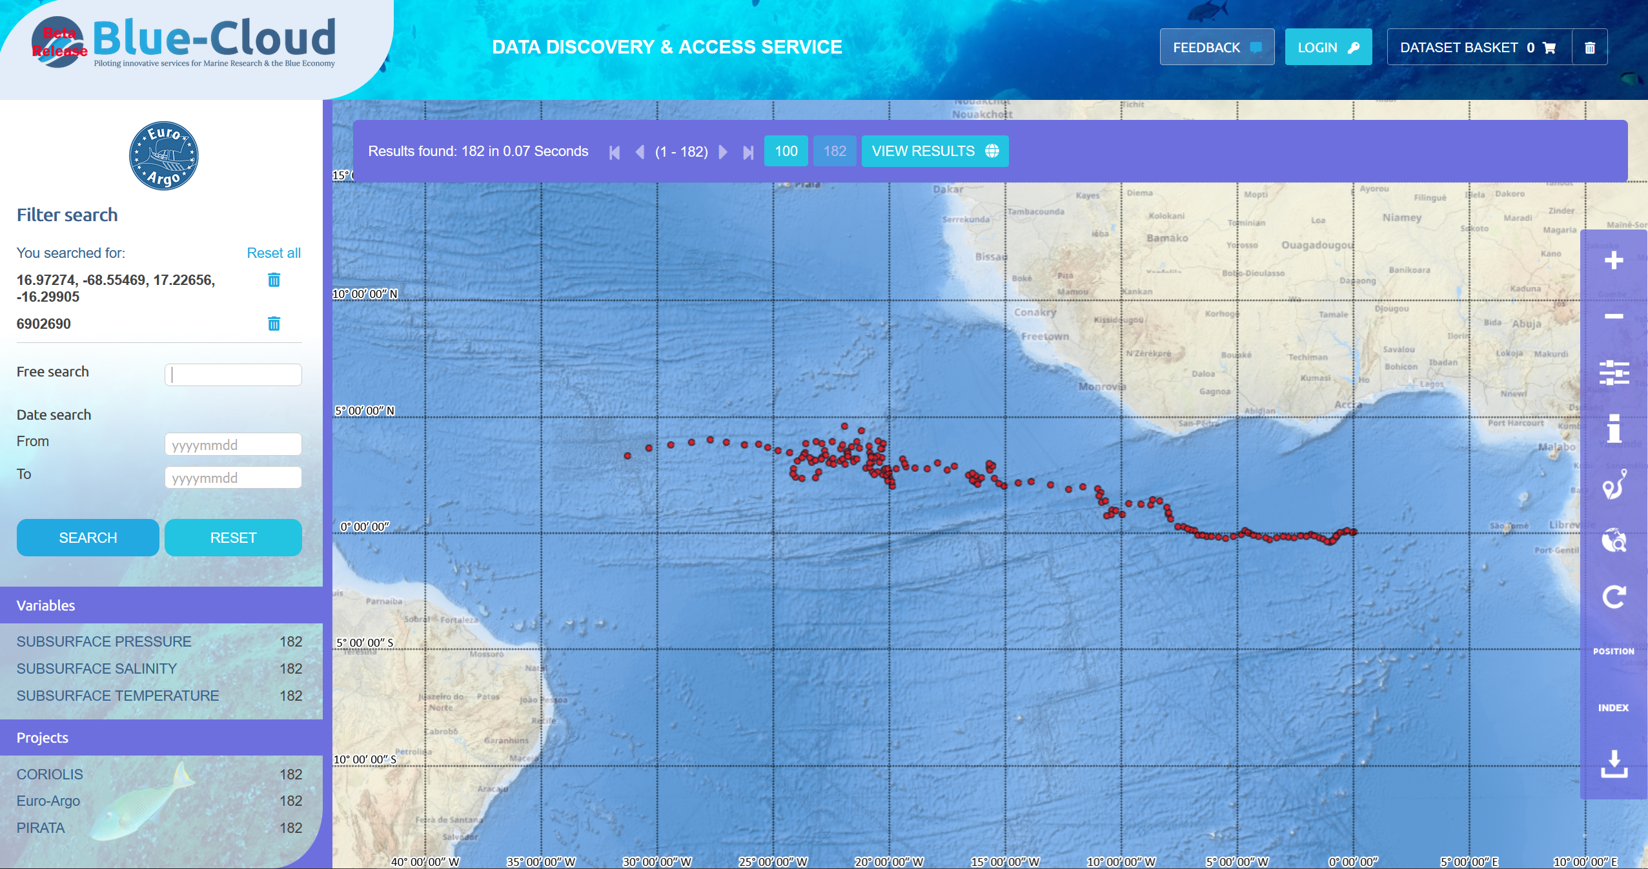
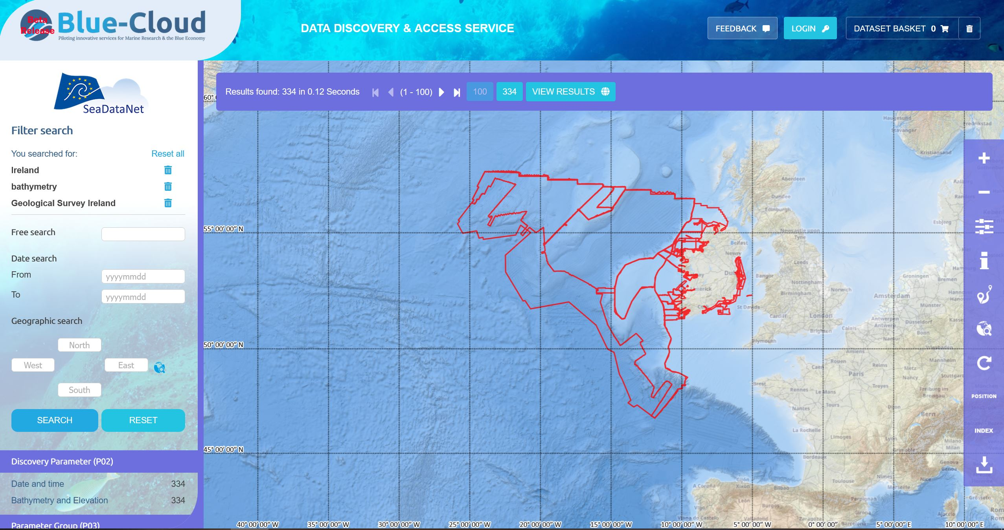
Examples of searches for Argo floats and SeaDataNet CDIs

Slide 12
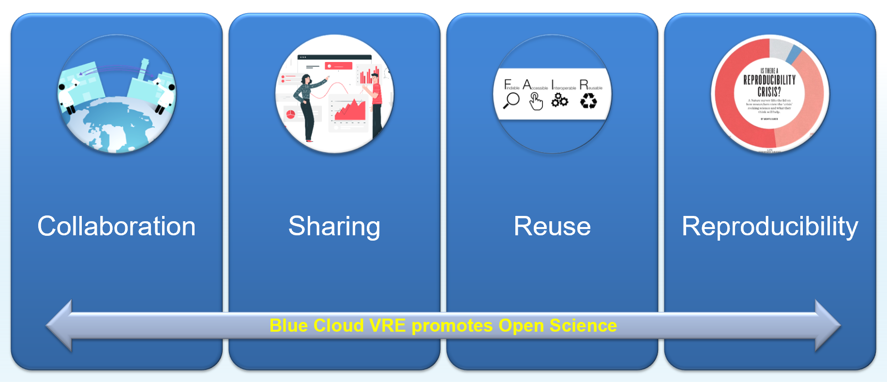

Blue-Cloud Virtual Research Environment infrastructure

Slide 13
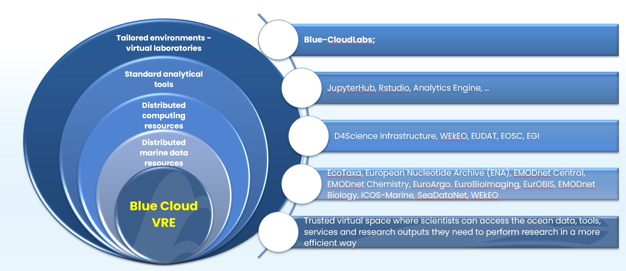
Blue-Cloud Virtual Research Environment infrastructure

Slide 14




Virtual Labs open for use in the Hackathon

Slide 15
DECODE THE OCEAN!
7, 8 and 9 February 2022
Ideation Warm Up: 17 January - 4 February 2022

