Slide 1






The Los Humeros Superhot Geothermal Resource in Mexico: Results from an Extensive Resistivity Survey
Ásdís Benediktsdóttir, Claudia Arango Galván, Gylfi Páll Hersir, Sebastian Held, José Manuel Romo Jones, José Luis Salas, Thalia Avilés, Diego Ruíz Aguilar, Arnar Már Vilhjálmsson
This project has received funding from the European Union’s Horizon 2020 research and innovation programme under grant agreement No. 727550 and the Mexican Energy Sustainability Fund CONACYT-SENER, project 2015-04-68074.
www.gemex-h2020.eu

Slide 2
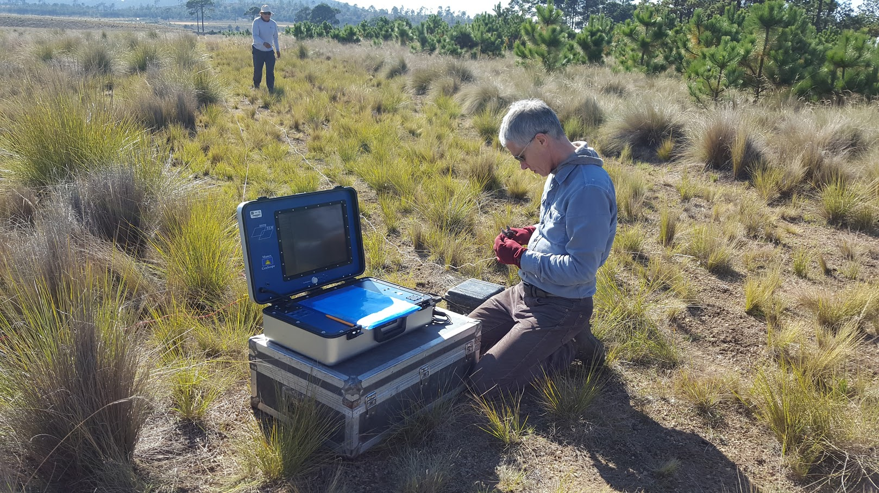
Motivation and goals
To understand the Los Humeros system better, from a geothermal point of view
Resistivity methods to understand the shape and extend of the system
Los Humeros: Resistivity survey
Ásdís Benediktsdóttir et al.

Slide 3
Why resistivity?
Árnason, et al. 1987
Los Humeros: Resistivity survey
Ásdís Benediktsdóttir et al.

Slide 4
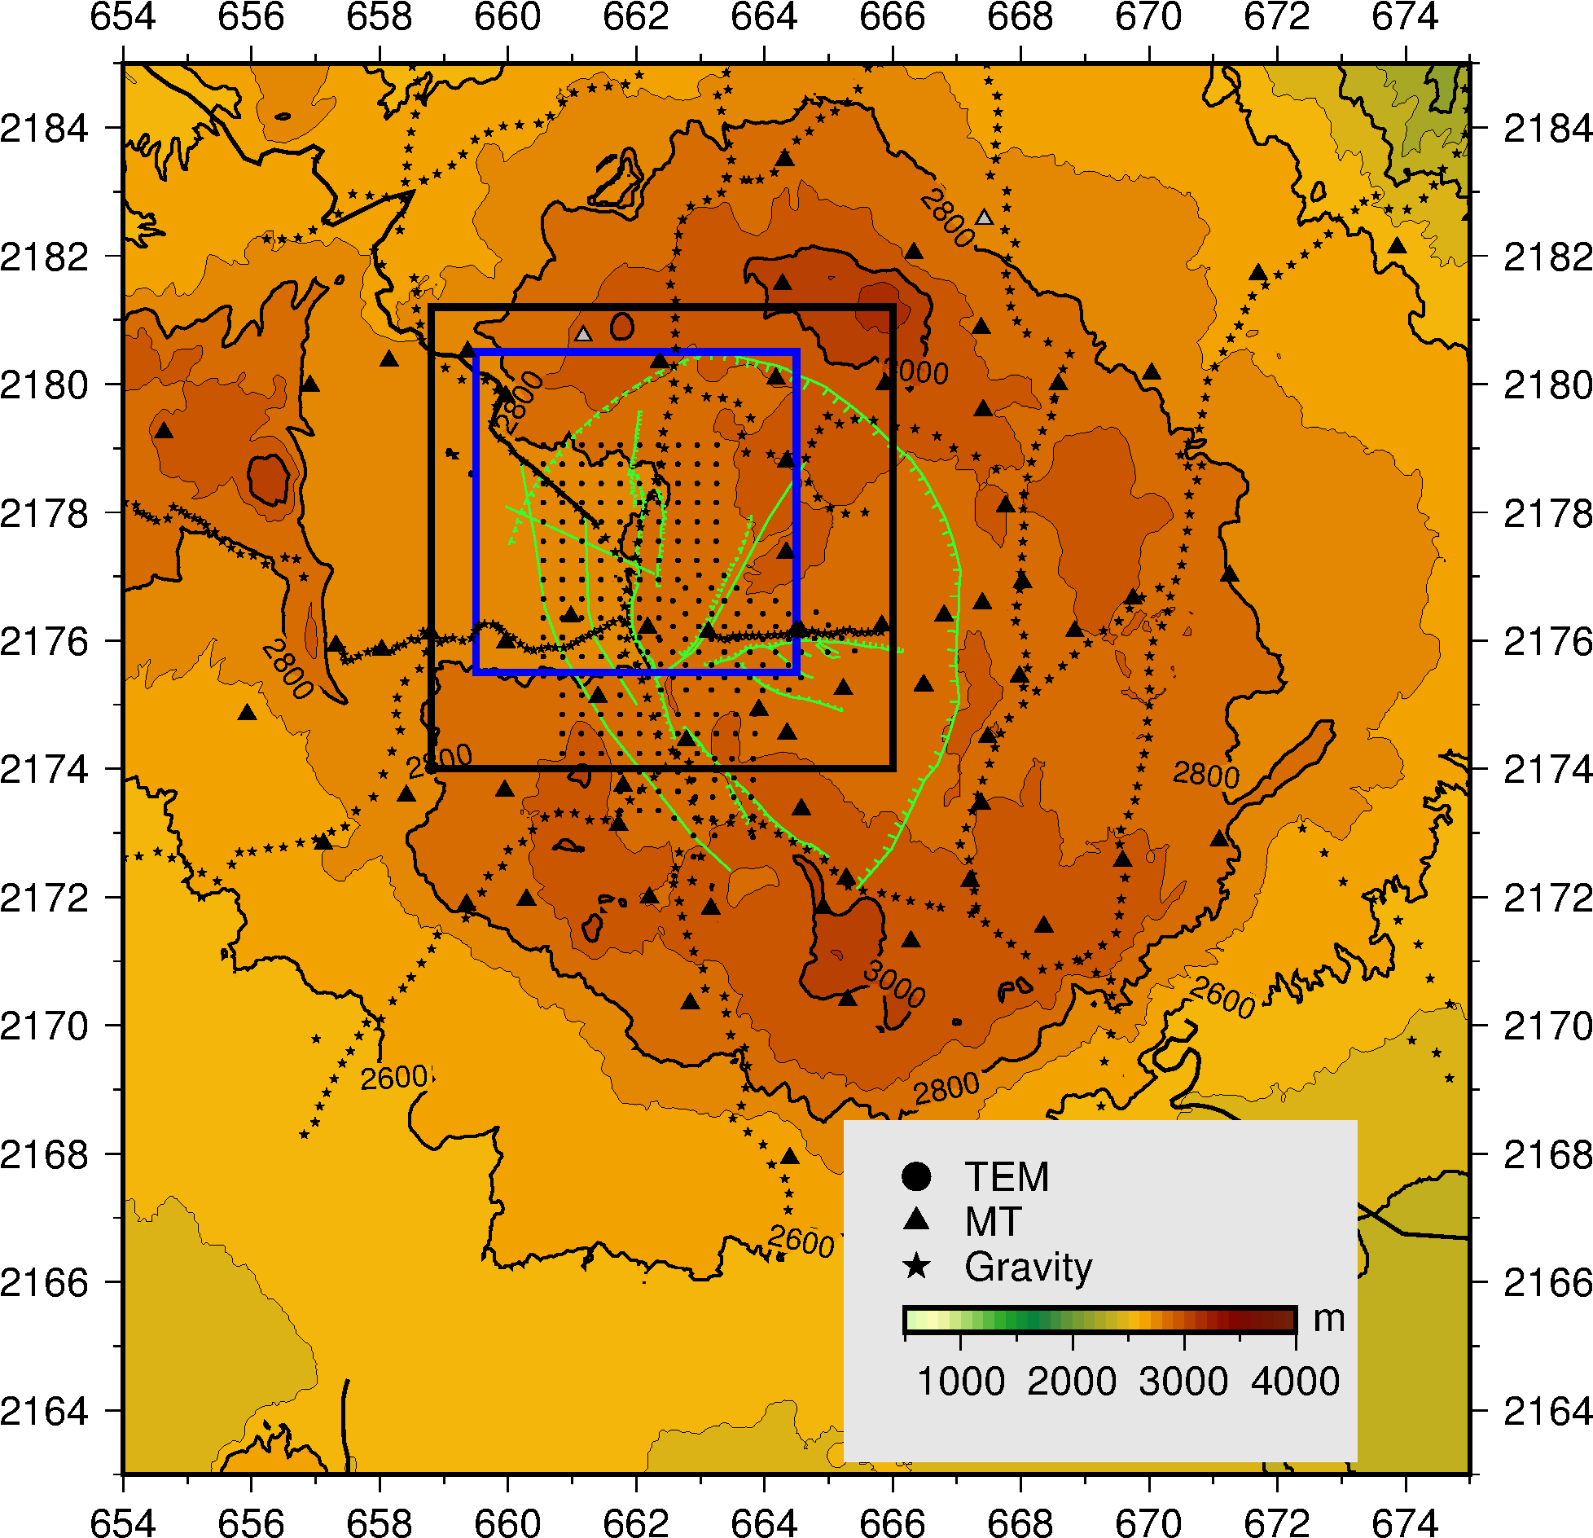
Survey design for Los Humeros
Los Humeros: Resistivity survey
Ásdís Benediktsdóttir et al.

Slide 5
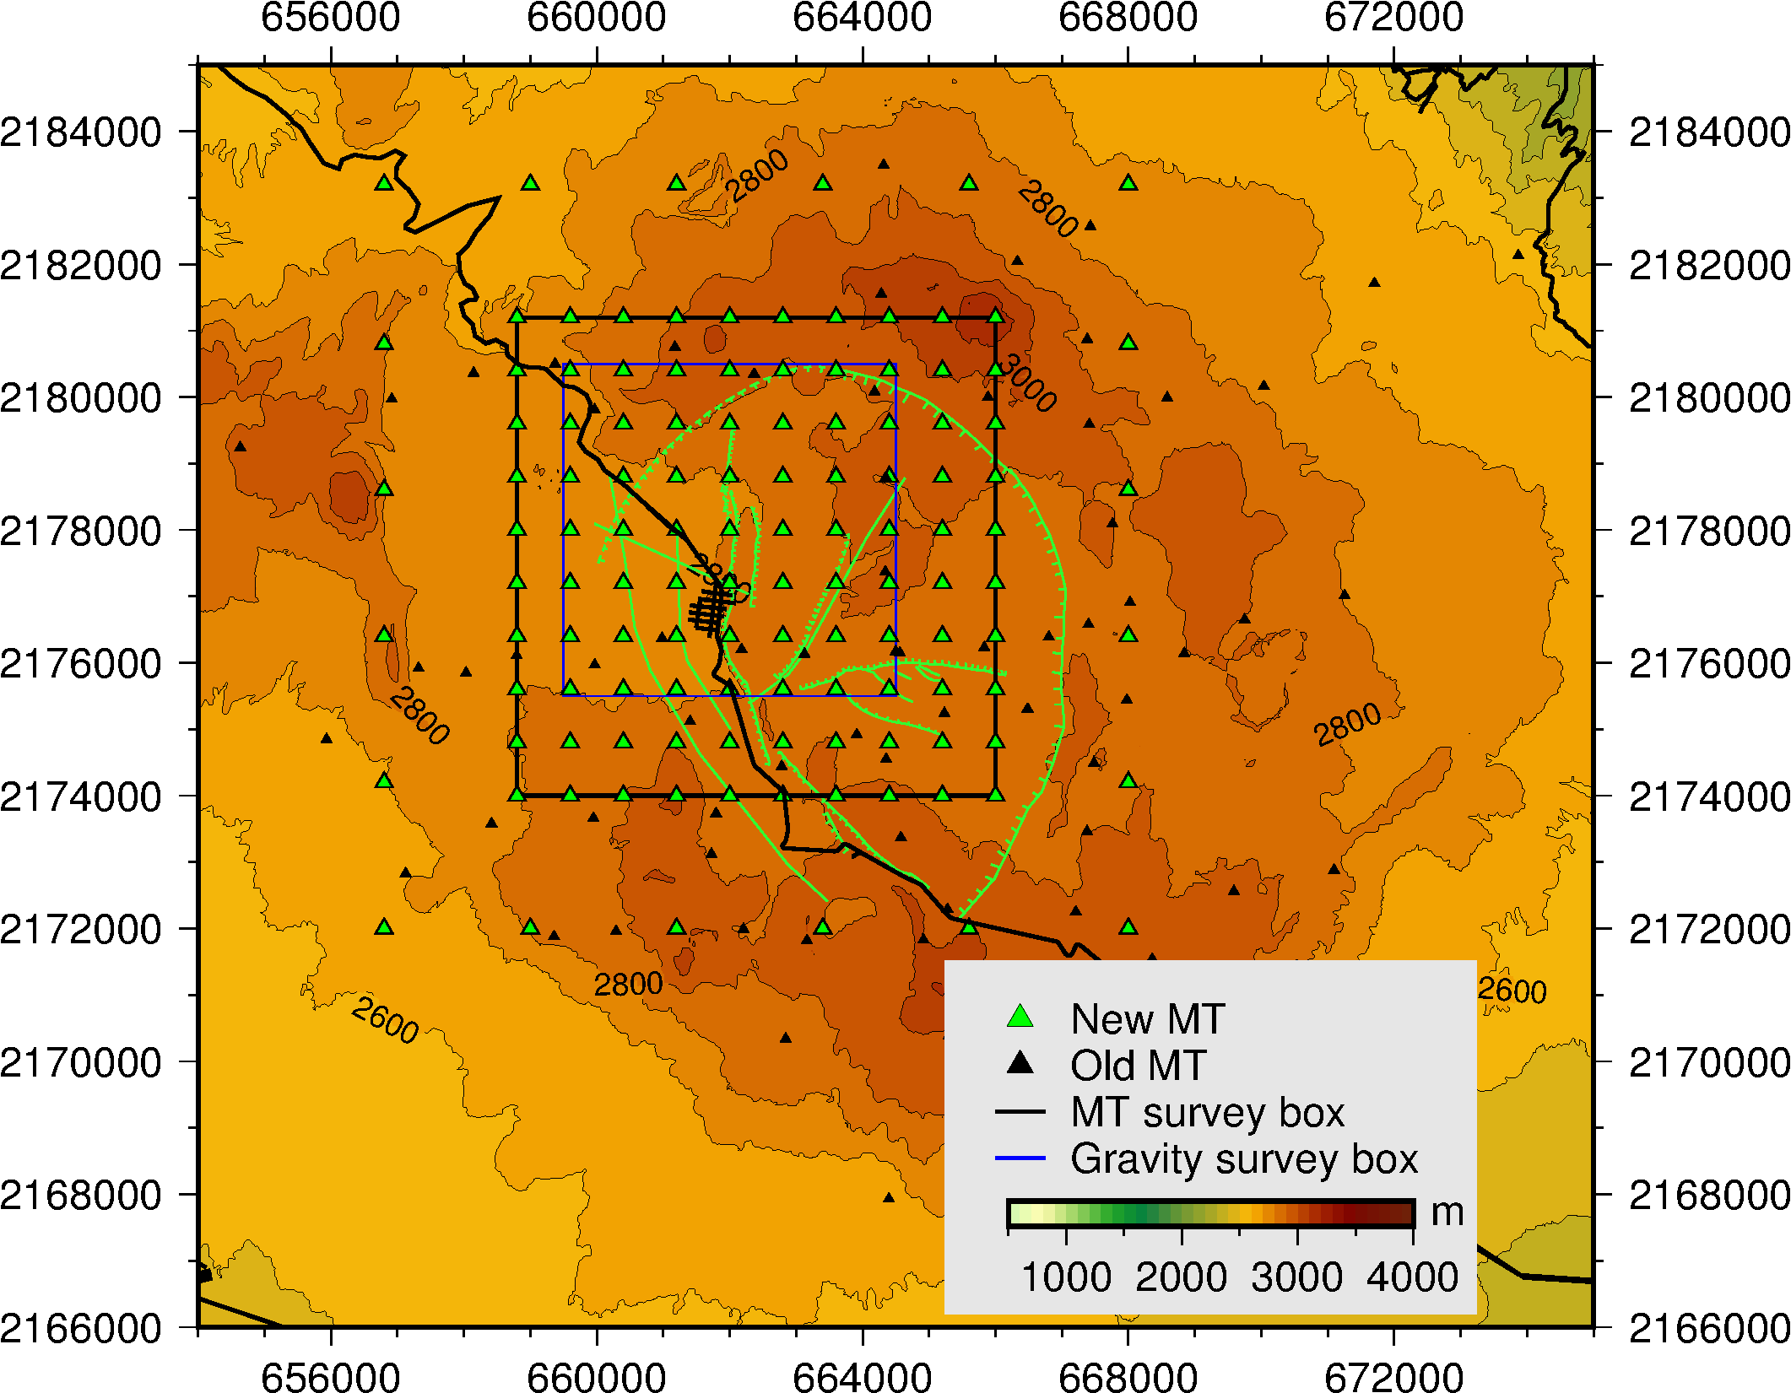
Survey design
Los Humeros: Resistivity survey
Ásdís Benediktsdóttir et al.

Slide 6
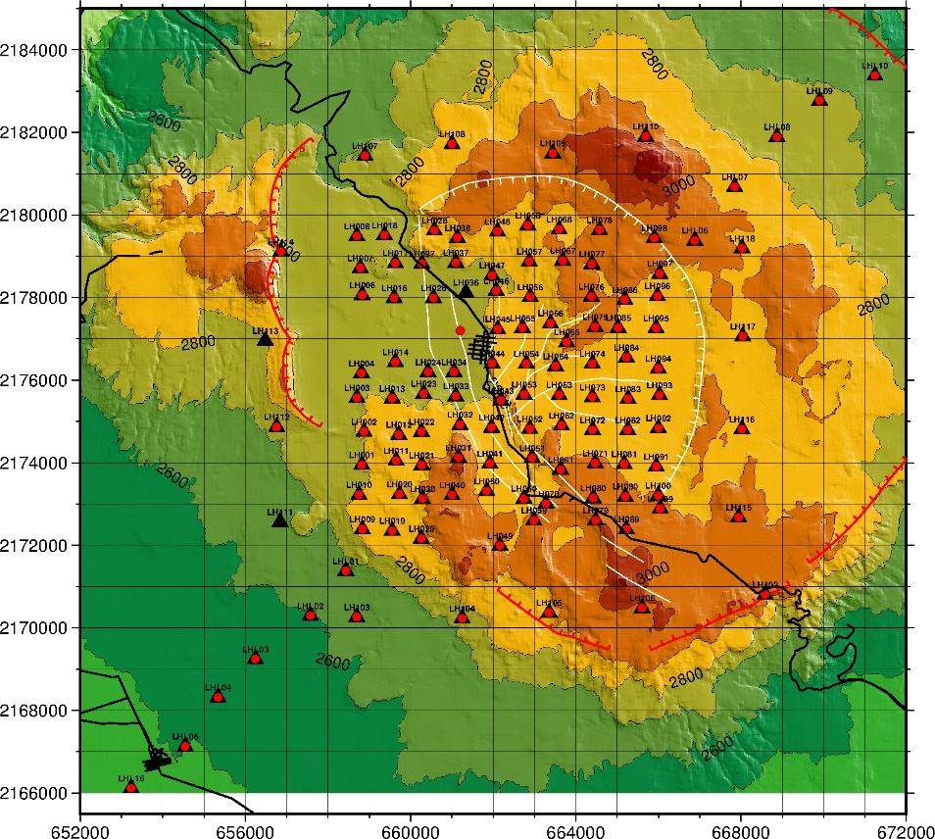
Survey design
122 MT soundings and 120 co-located TEM soundings were performed
720 m between soundings
A long profile, where gravity was done as well
Three MT sounding sites were not accessible to measure the TEM, because a crop had been planted there.
Los Humeros: Resistivity survey
Ásdís Benediktsdóttir et al.

Slide 7
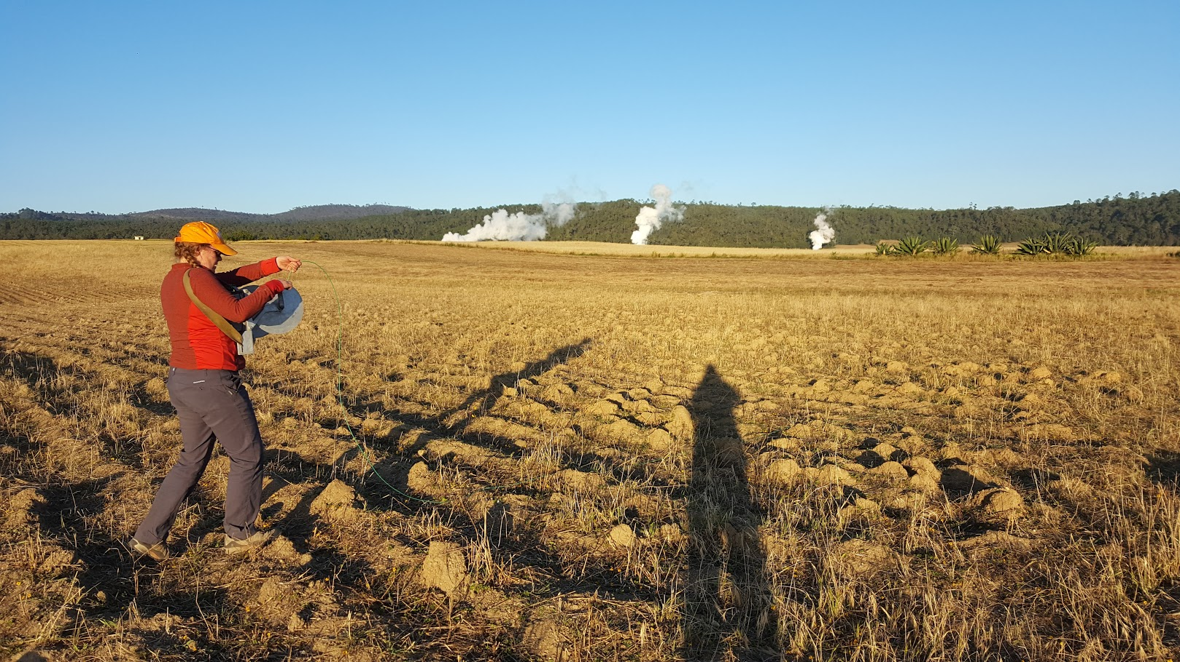
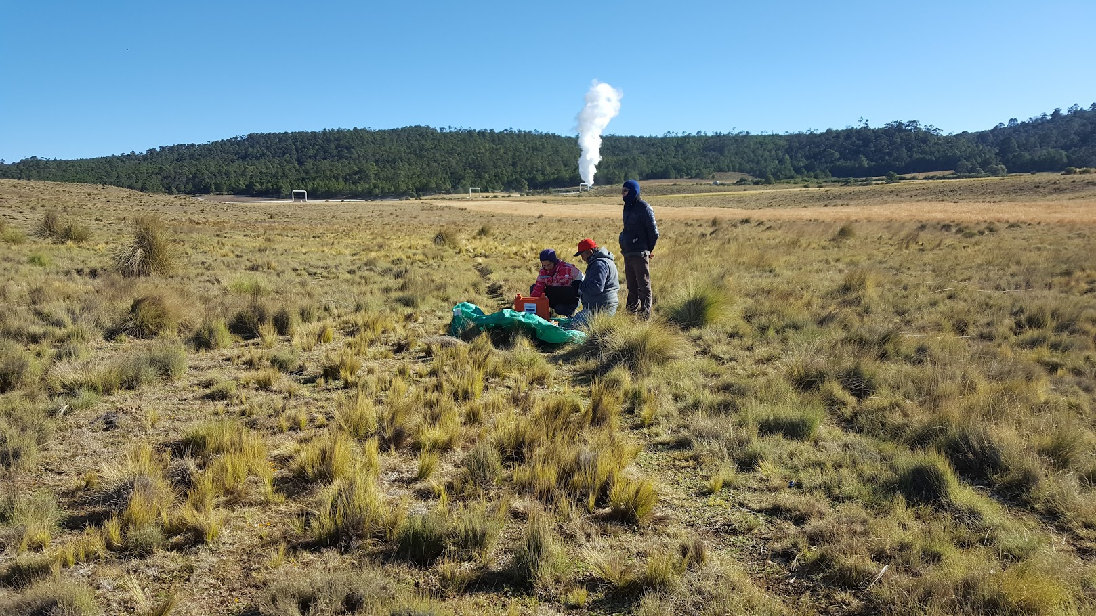
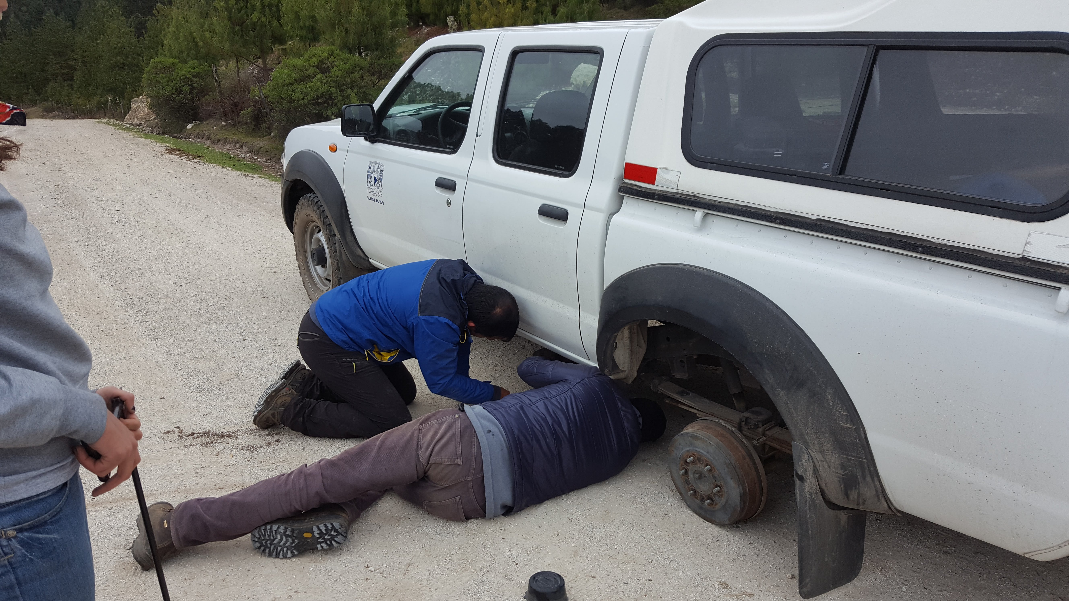
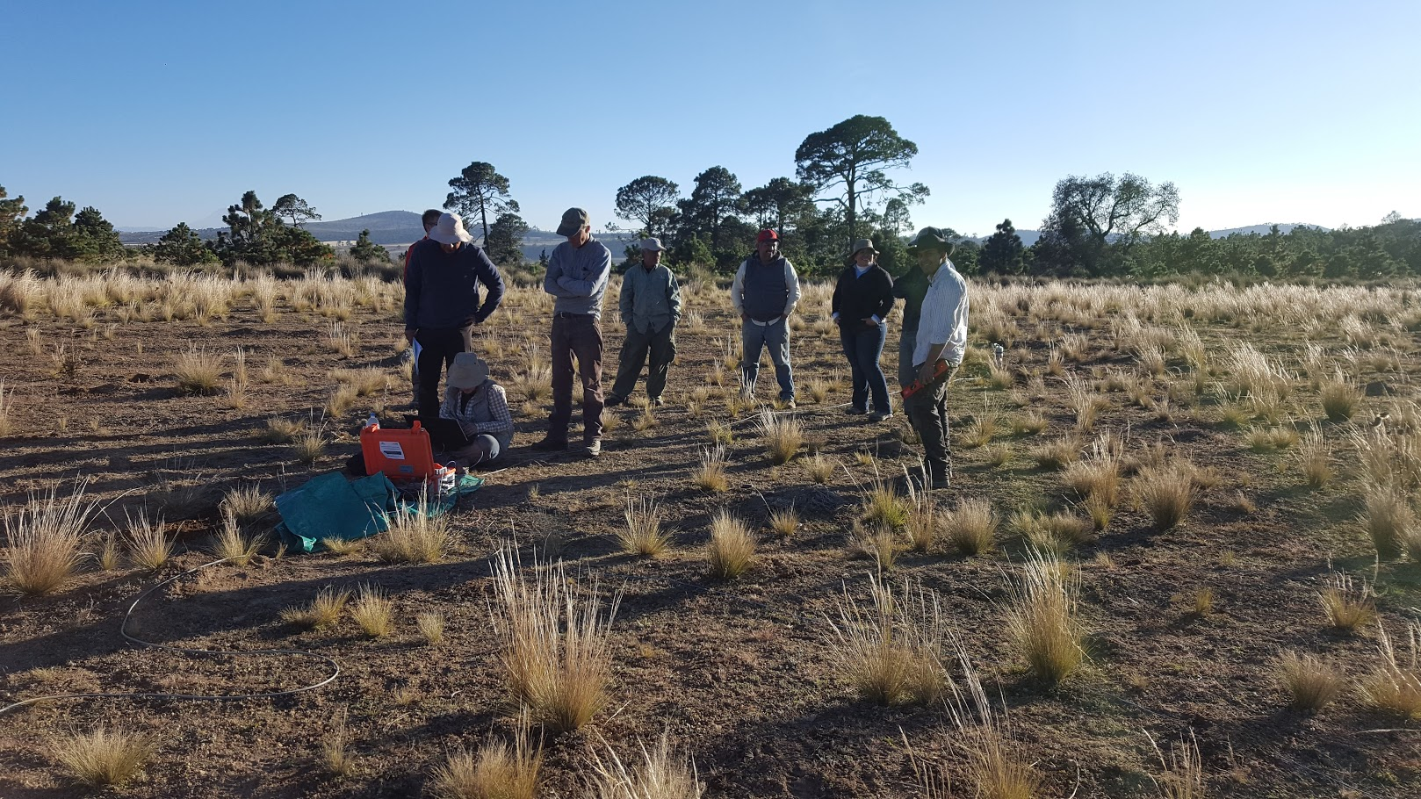
Field work
Los Humeros: Resistivity survey
Ásdís Benediktsdóttir et al.
Notes:
This work was most enjoyable. The collaboration between the Mexican and EU side was very good and it is the collaboration and friendship that stands out after a little more than three years of working together.

Slide 8
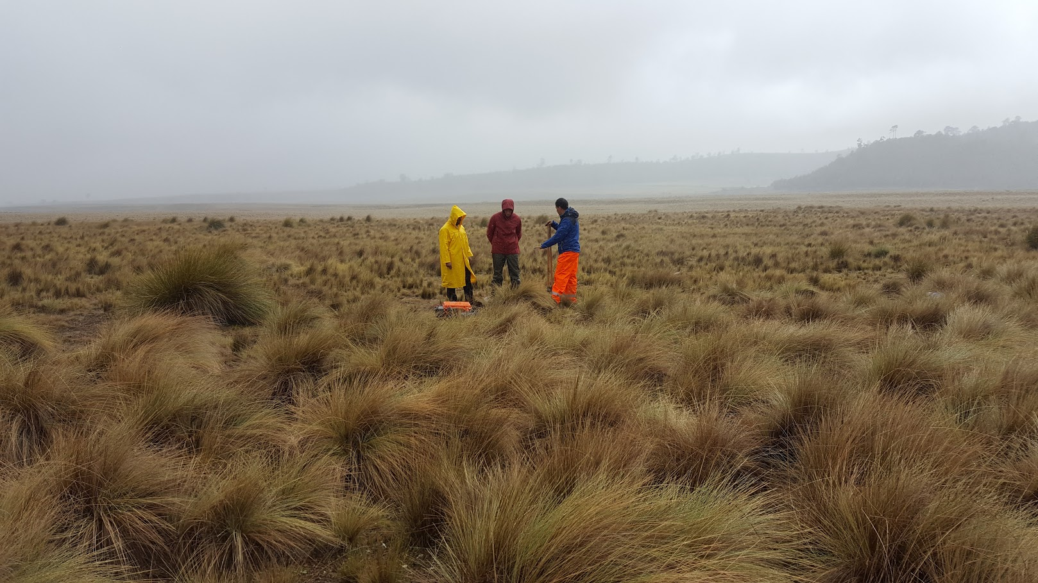
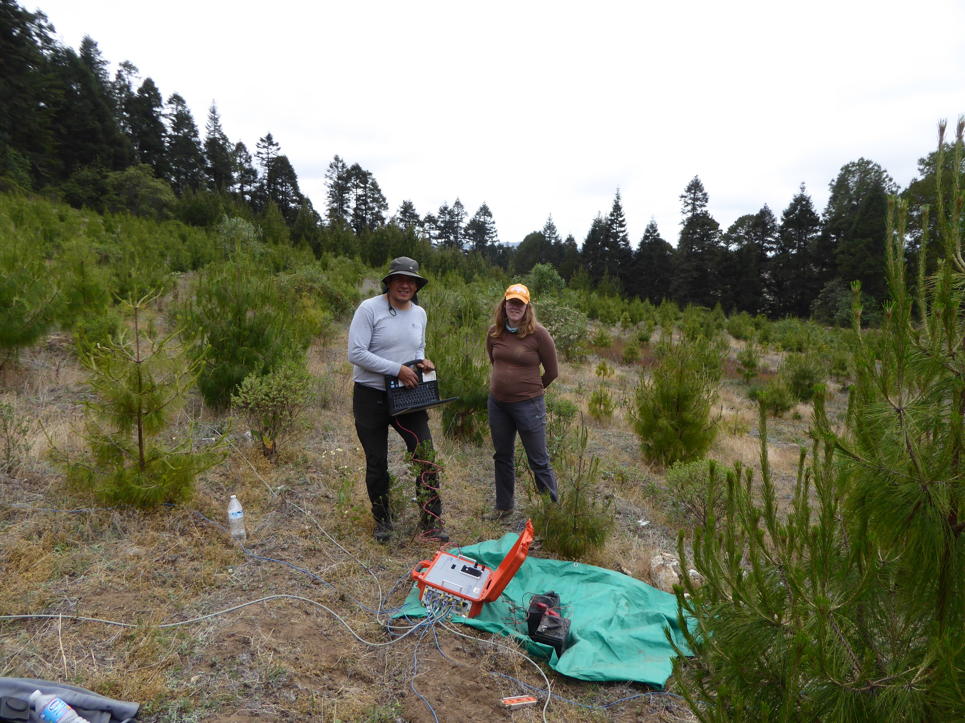
Results from 3D inversion
Mexican partners show results from 3D inversion of the same data using a different computer code in a poster presented by Diego Ruiz-Aguilar yesterday!
Los Humeros: Resistivity survey
Ásdís Benediktsdóttir et al.

Slide 9
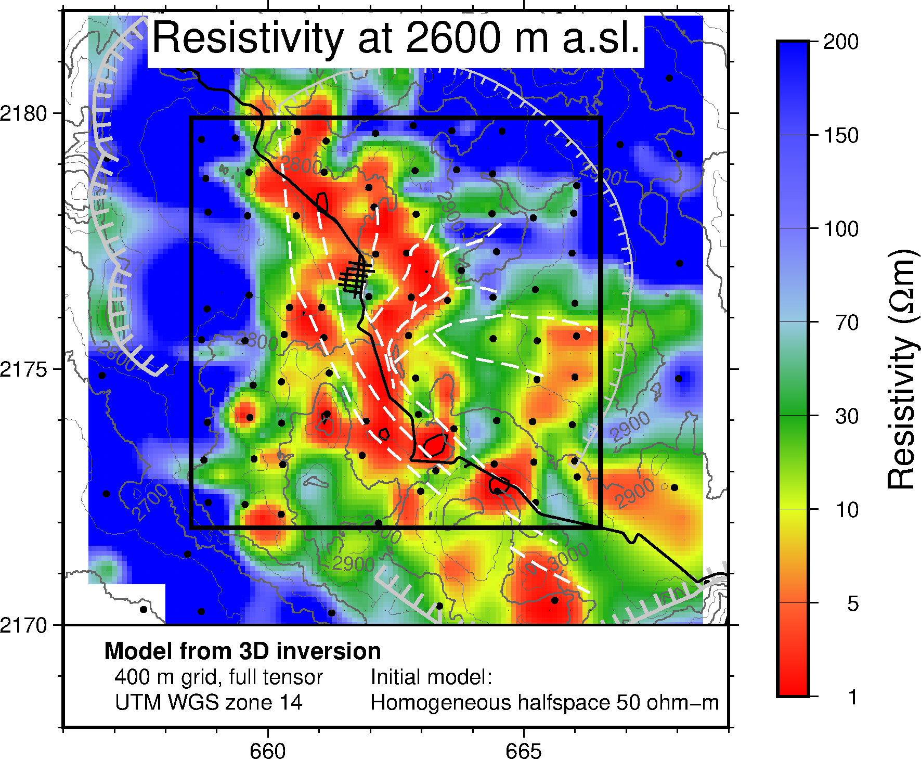
Results from 3D inversion
Los Humeros: Resistivity survey
Ásdís Benediktsdóttir et al.

Slide 10
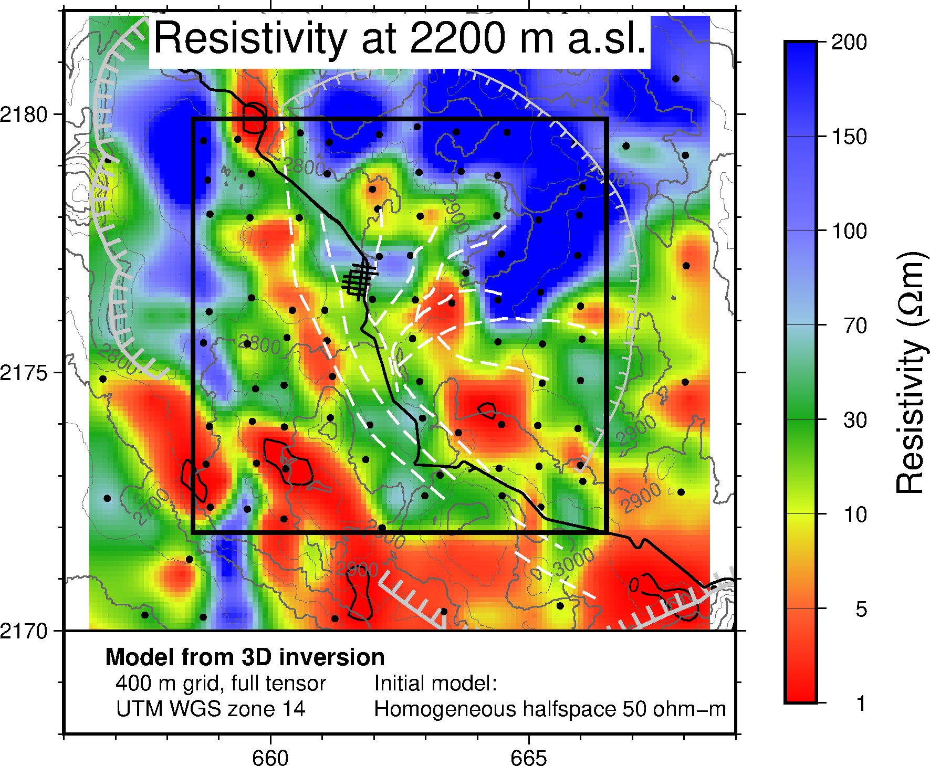
Results from 3D inversion
Los Humeros: Resistivity survey
Ásdís Benediktsdóttir et al.

Slide 11
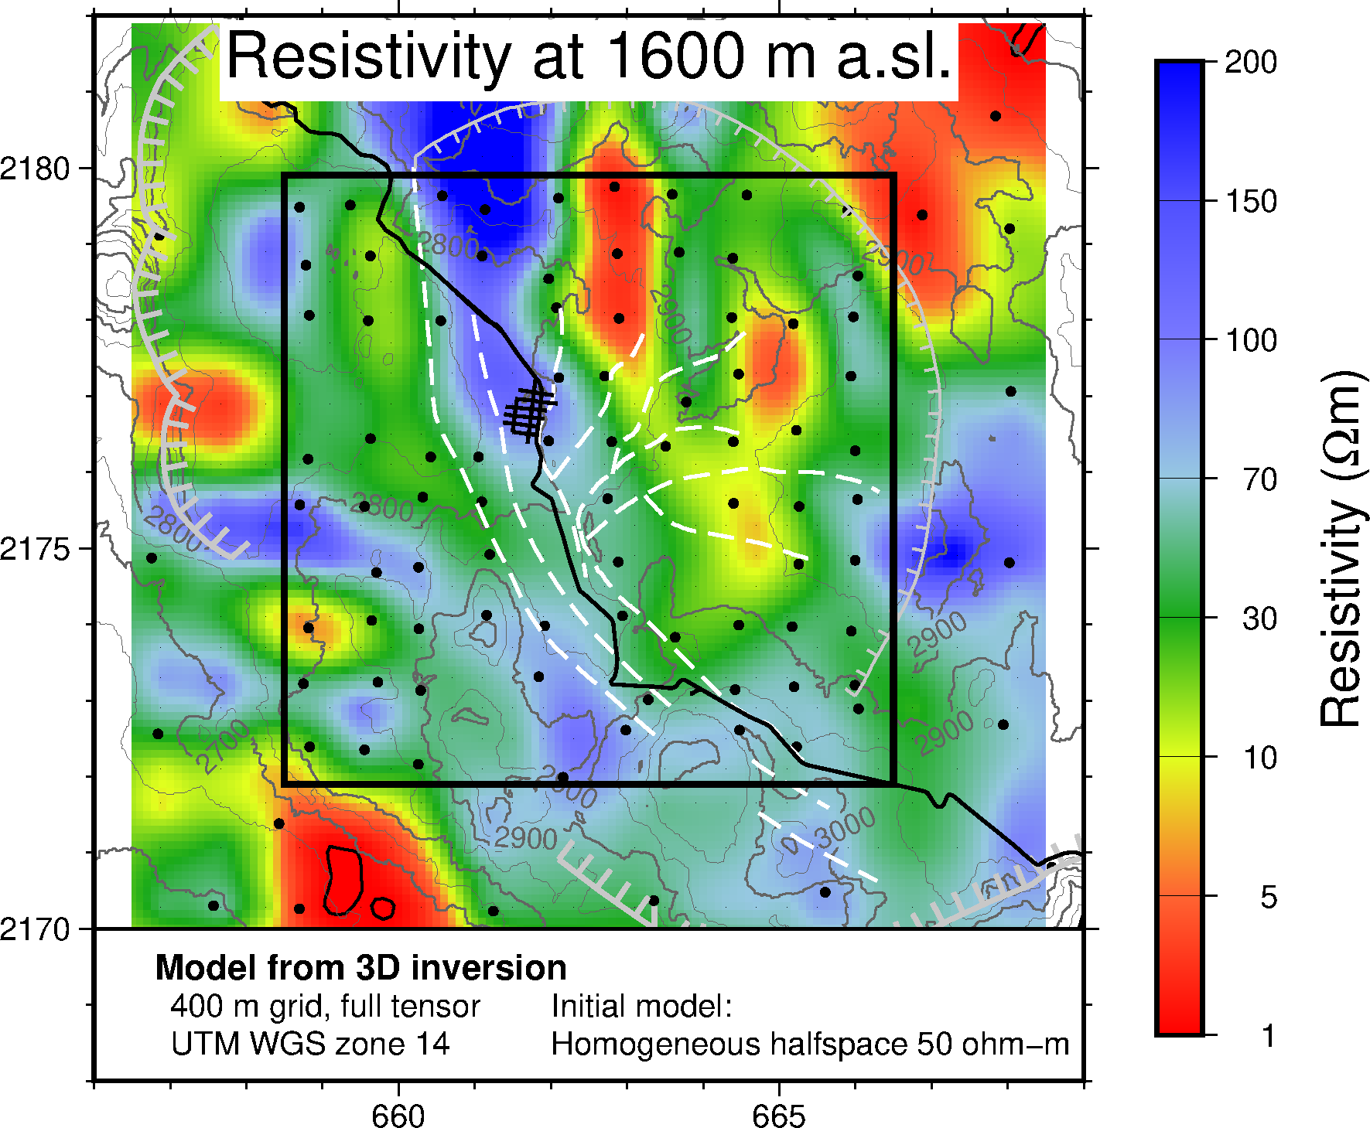
Results from 3D inversion
Los Humeros: Resistivity survey
Ásdís Benediktsdóttir et al.

Slide 12
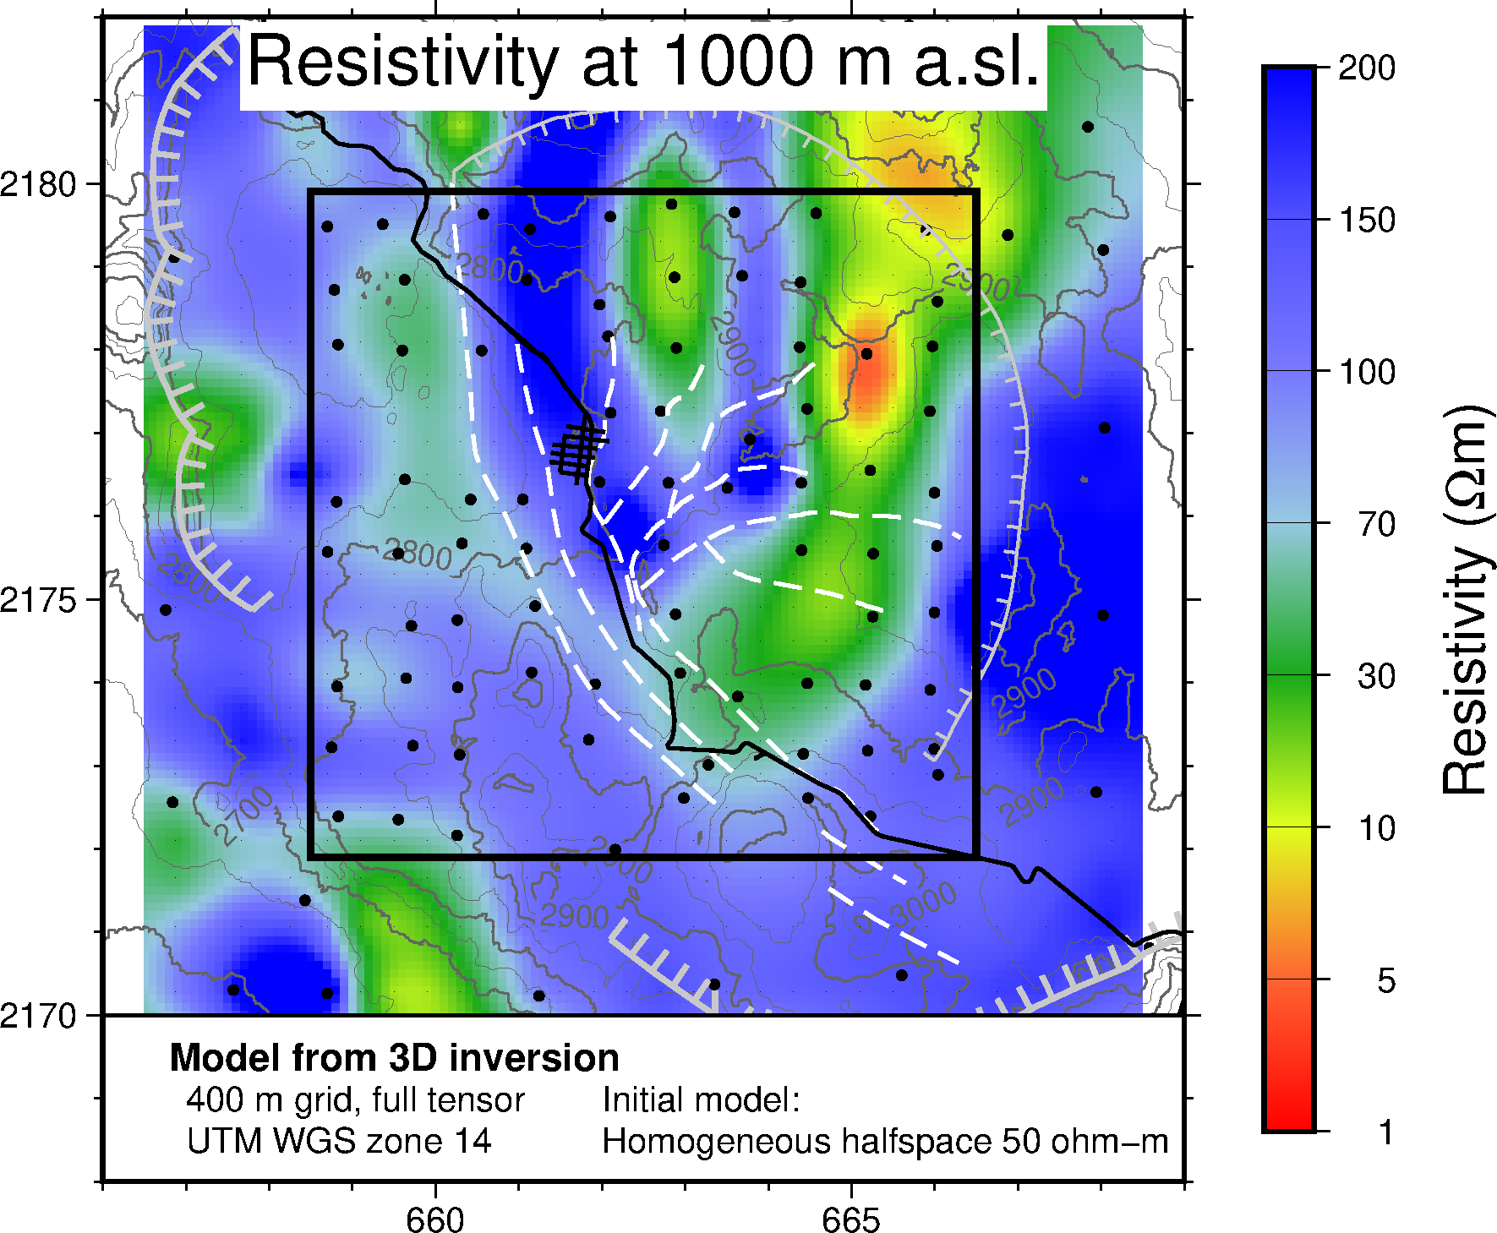
Results from 3D inversion
Los Humeros: Resistivity survey
Ásdís Benediktsdóttir et al.

Slide 13
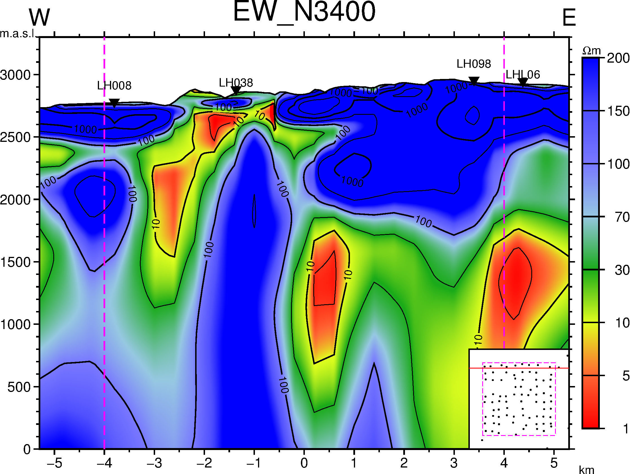
Results from 3D inversion
Los Humeros: Resistivity survey
Ásdís Benediktsdóttir et al.

Slide 14
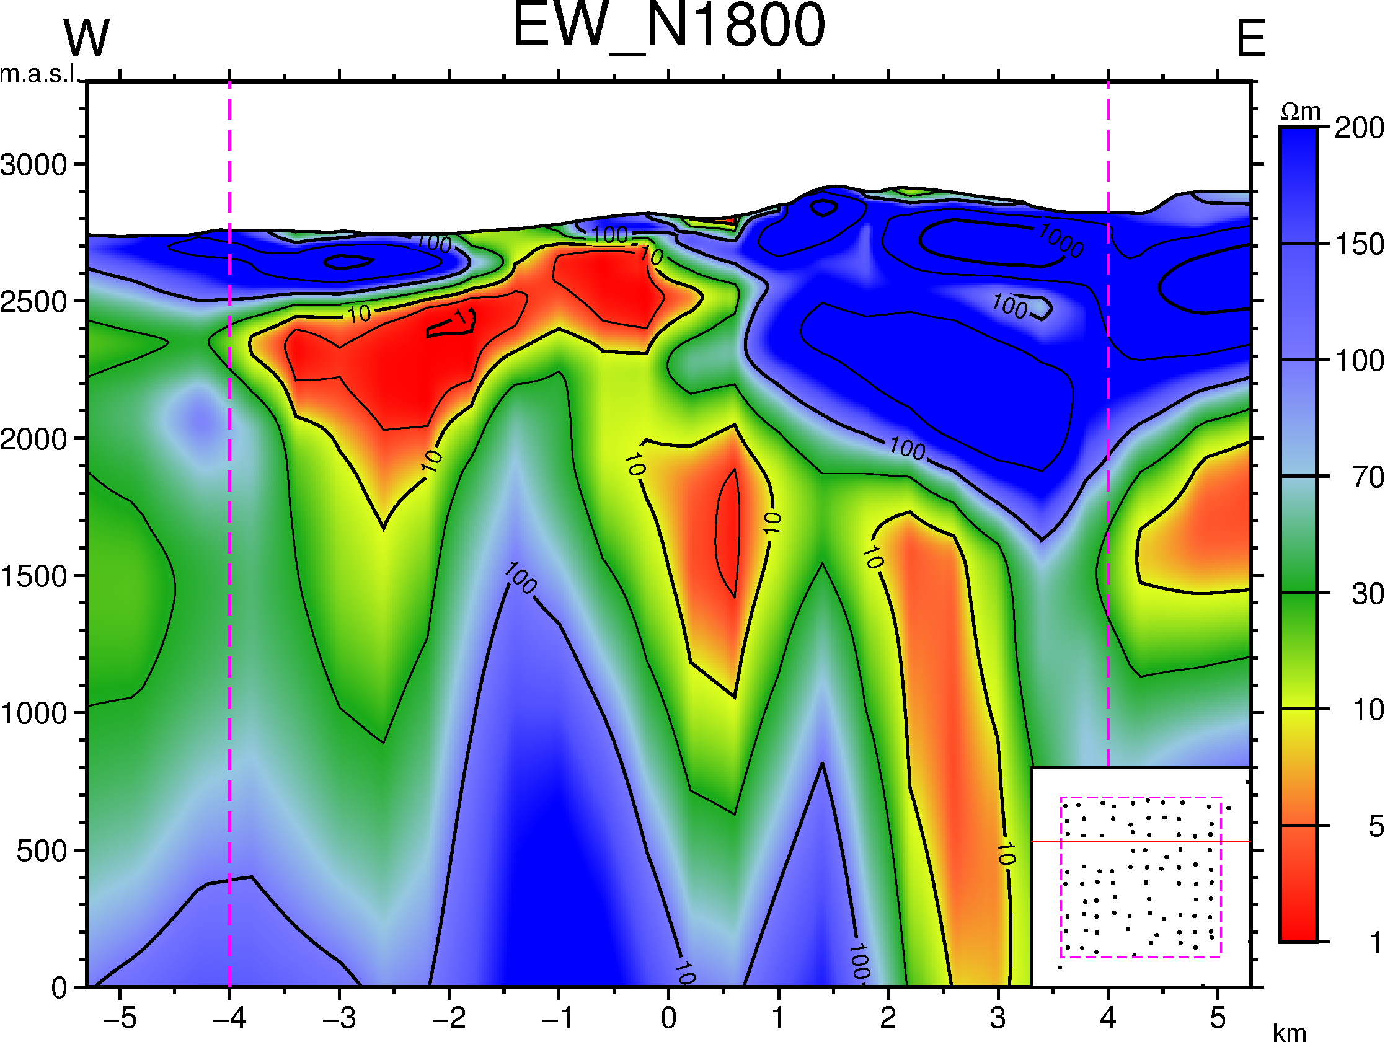
Results from 3D inversion
Los Humeros: Resistivity survey
Ásdís Benediktsdóttir et al.

Slide 15
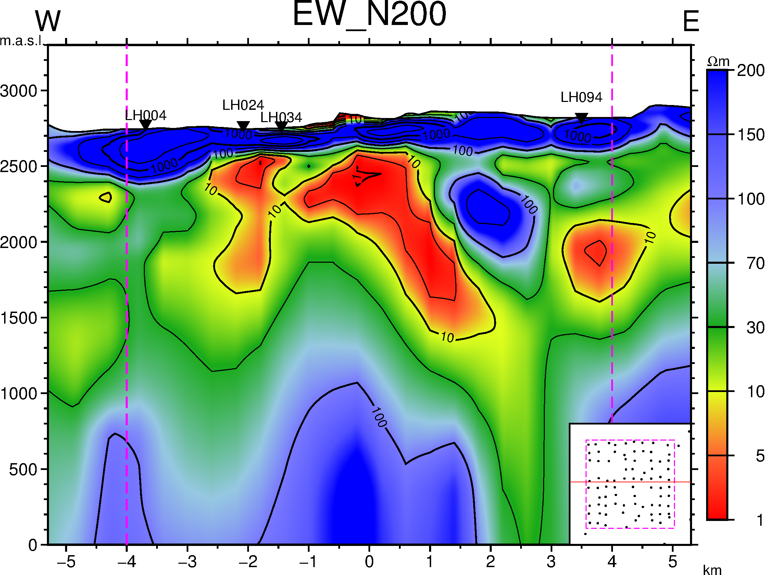
Results from 3D inversion
Los Humeros: Resistivity survey
Ásdís Benediktsdóttir et al.

Slide 16
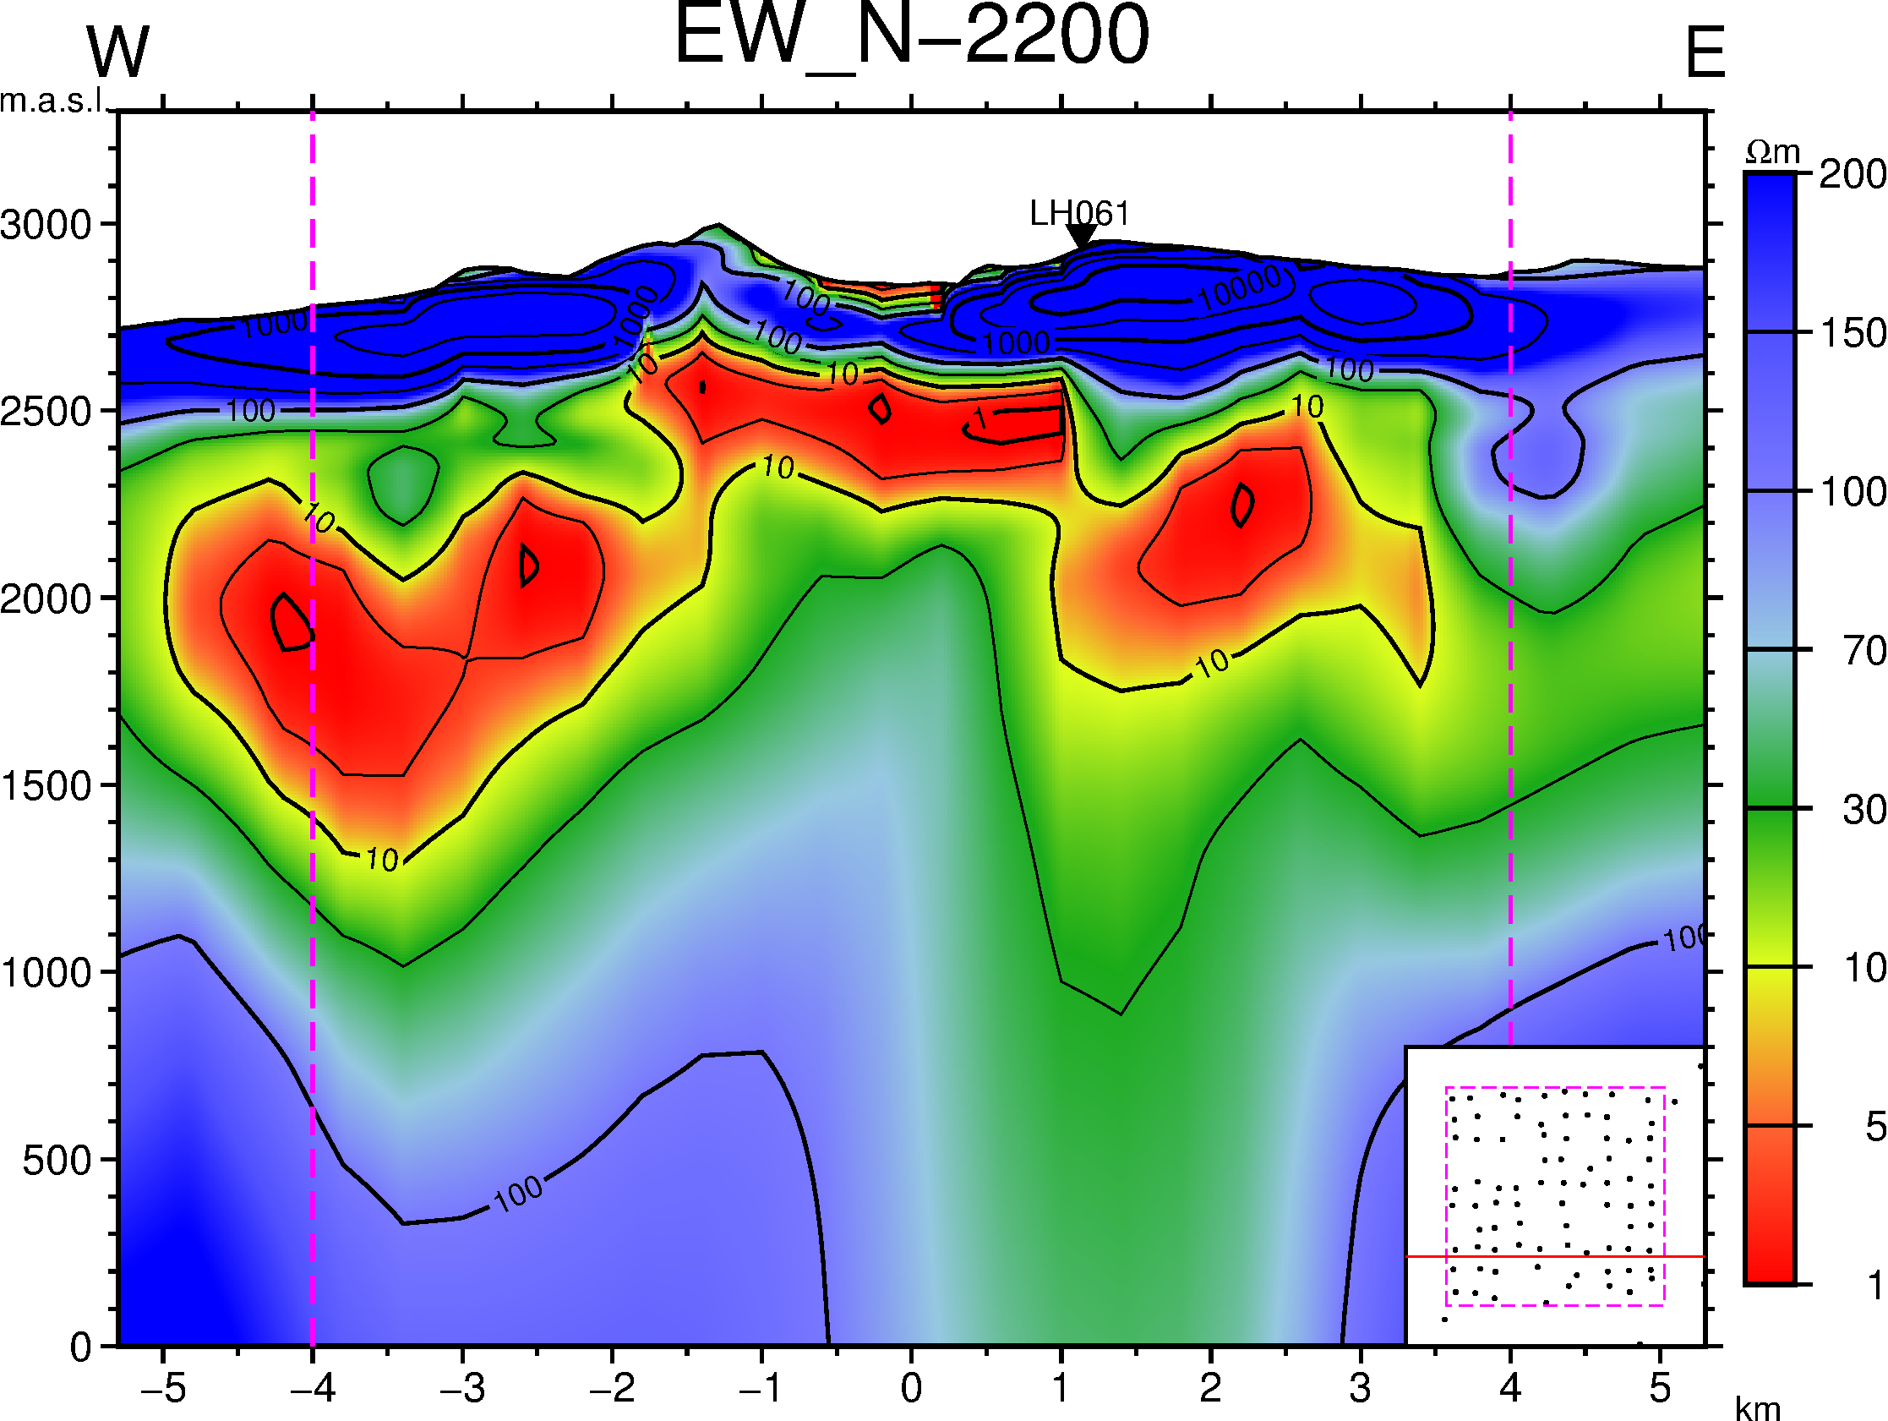
Results from 3D inversion
Los Humeros: Resistivity survey
Ásdís Benediktsdóttir et al.

Slide 17
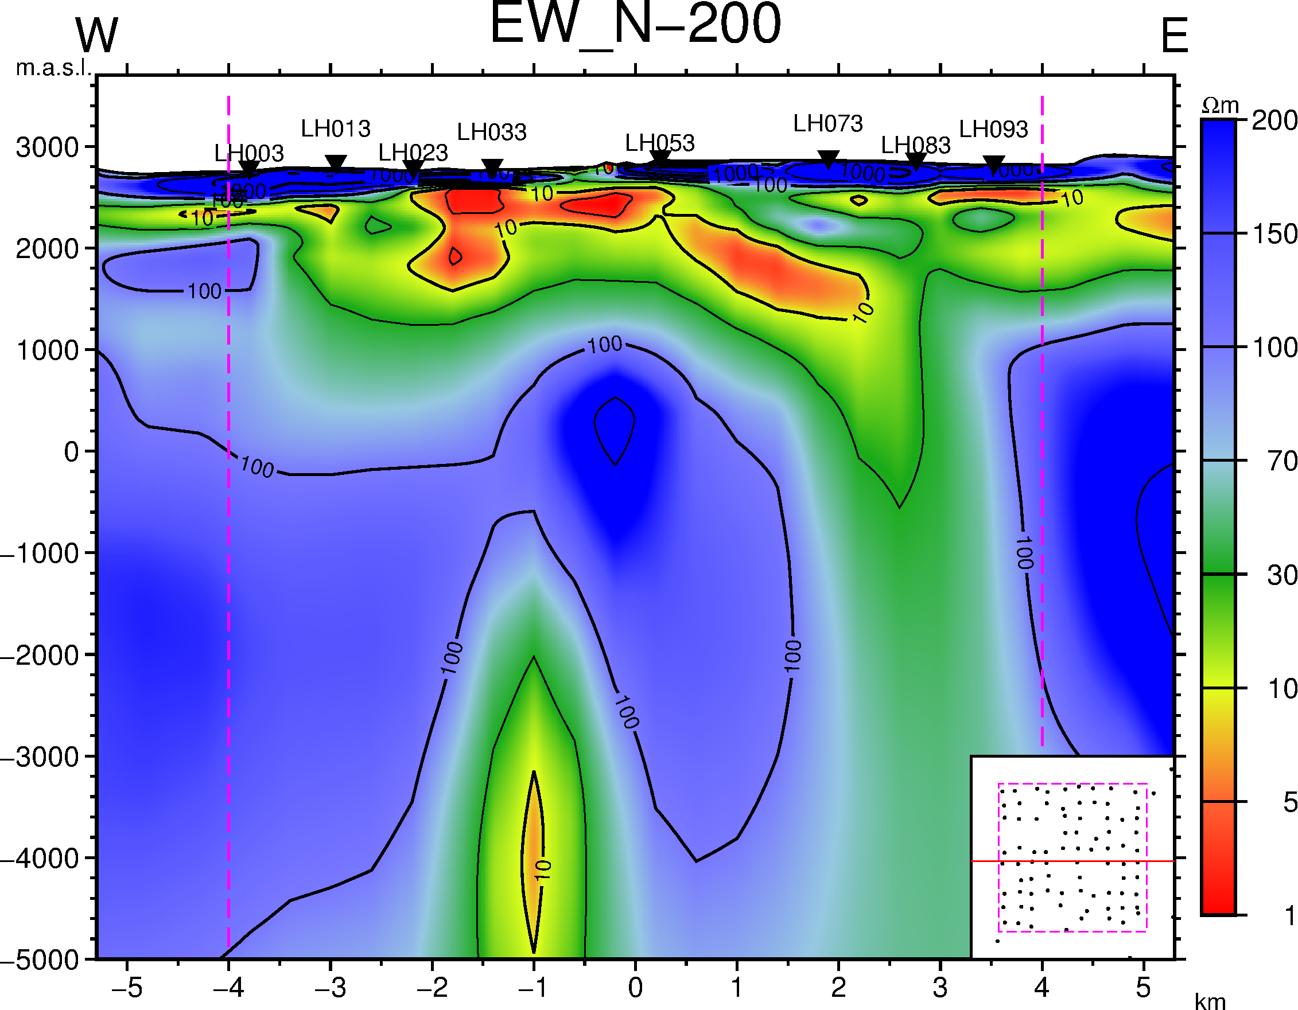
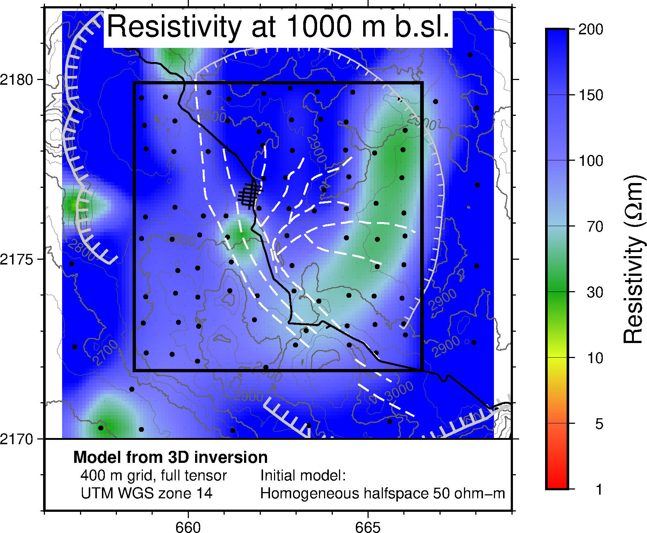
Deep-lying low-resistivity anomaly
Los Humeros: Resistivity survey
Ásdís Benediktsdóttir et al.
Notes:
The difference between the Krafla resolution experiment and the deep low-resistivity anomaly at Los Humeros lies in the dimensionality; the anomaly at Los Humeros is a 5 km tall and 1.5 km wide cylinder; a volume of 8 km³

Slide 18
Deep-lying low-resistivity anomaly
Low resistivity cap screens what is below
Large period waves penetrate deep => lateral resolution decreases with depth
Data quality at poor > 100 s
Recalculating the model, after removing the deep anomaly, did not change the misfit significantly
  Likely an artefact
?
Los Humeros: Resistivity survey
Ásdís Benediktsdóttir et al.
Notes:
The difference between the Krafla resolution experiment and the deep low-resistivity anomaly at Los Humeros lies in the dimensionality; the anomaly at Los Humeros is a 5 km tall and 1.5 km wide cylinder; a volume of 8 km³

Slide 19
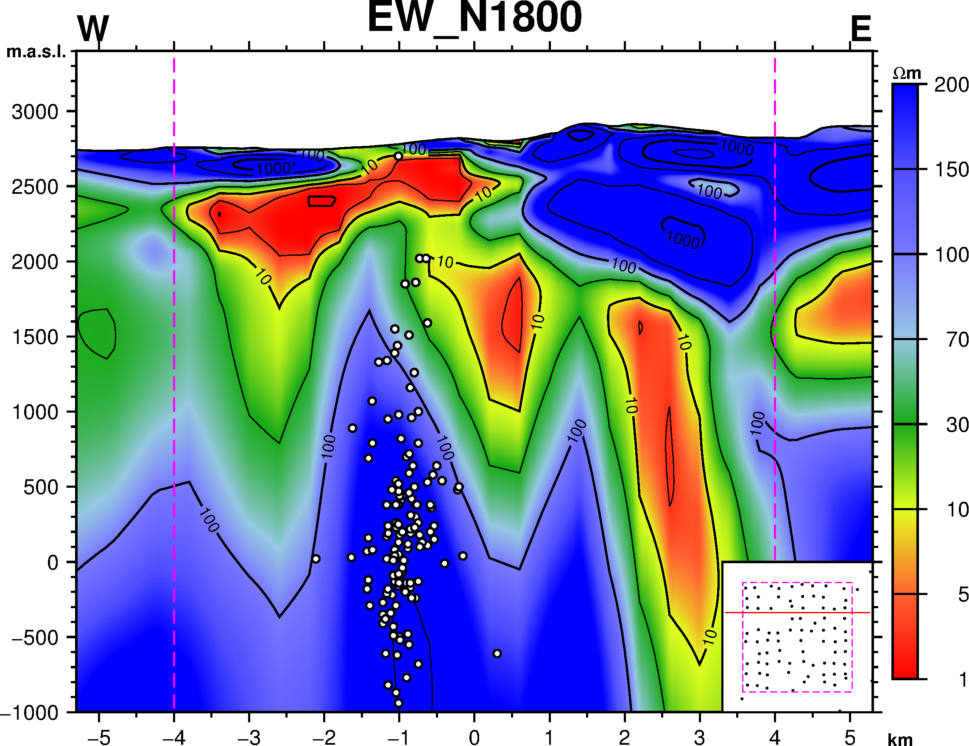
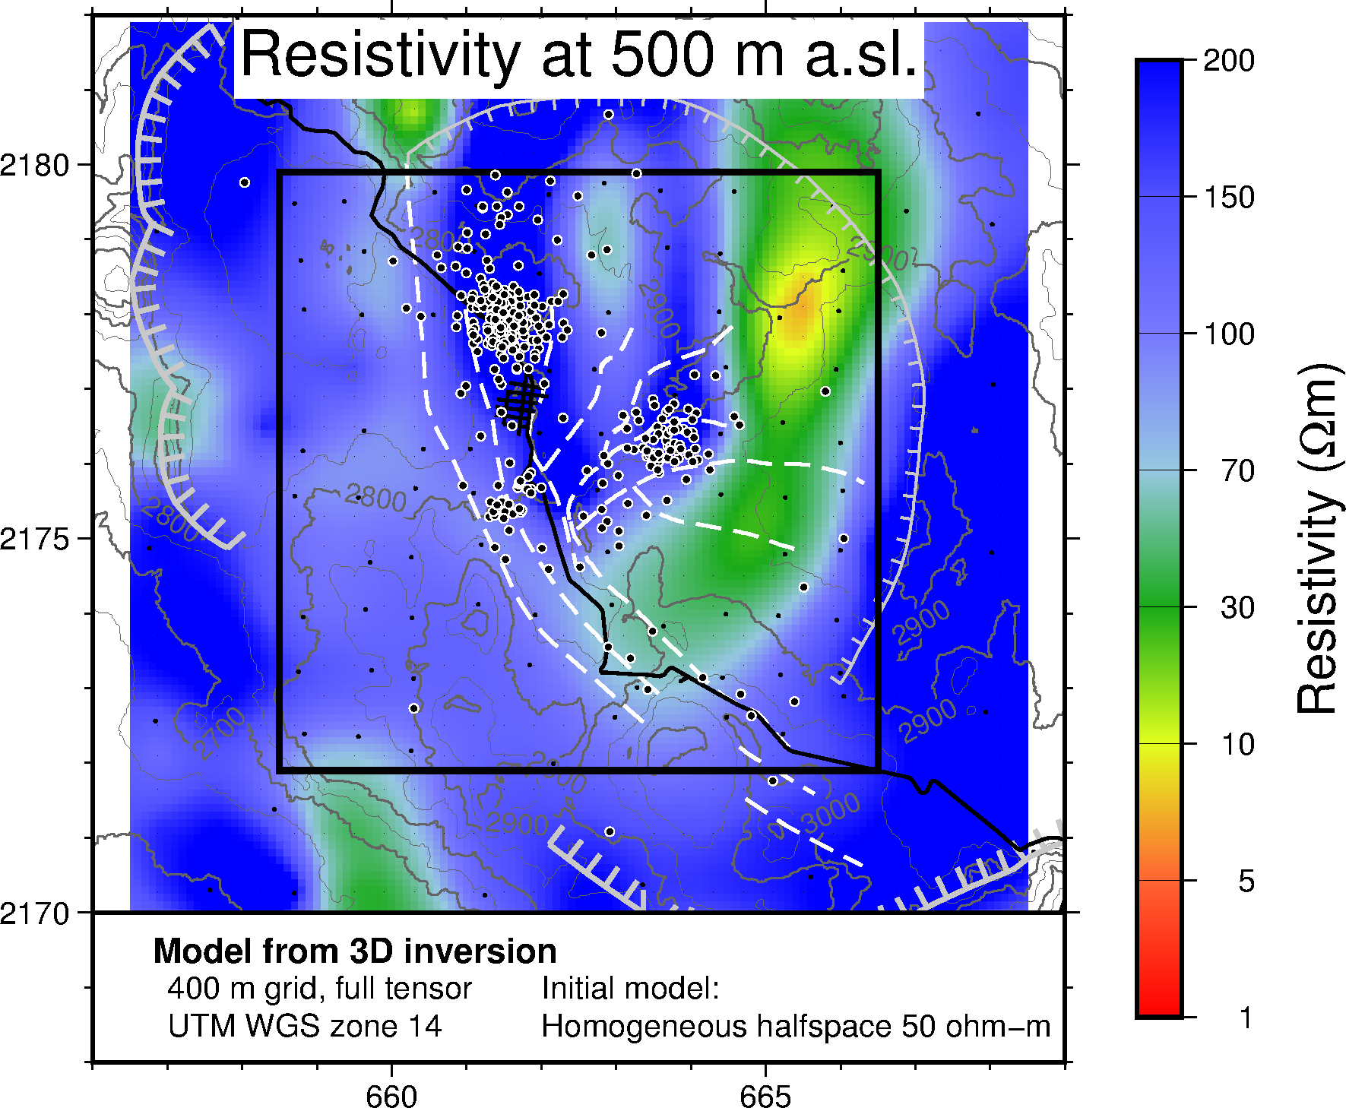
Resistivity and earthquake location
Los Humeros: Resistivity survey
Ásdís Benediktsdóttir et al.
Notes:
The difference between the Krafla resolution experiment and the deep low-resistivity anomaly at Los Humeros lies in the dimensionality; the anomaly at Los Humeros is a 5 km tall and 1.5 km wide cylinder; a volume of 8 km³

Slide 20
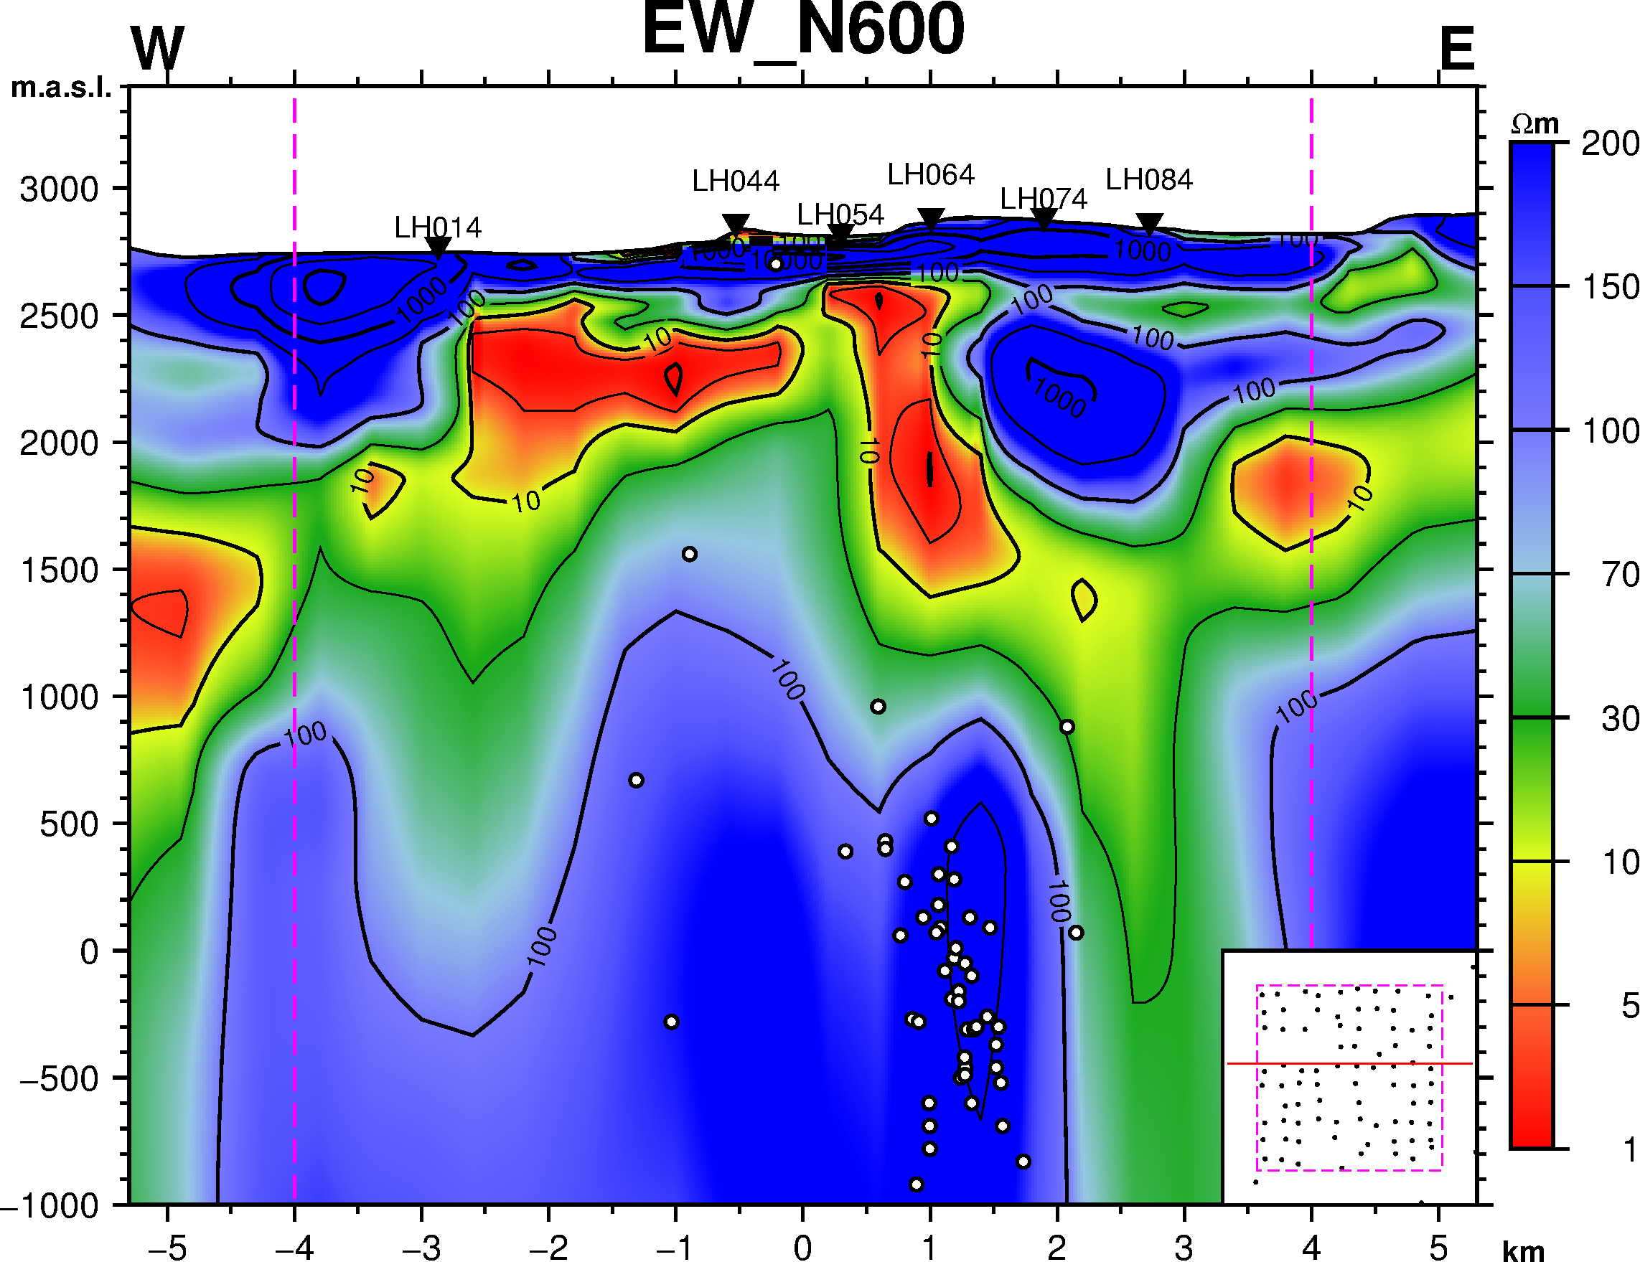
Resistivity and earthquakes
Los Humeros: Resistivity survey
Ásdís Benediktsdóttir et al.

Slide 21
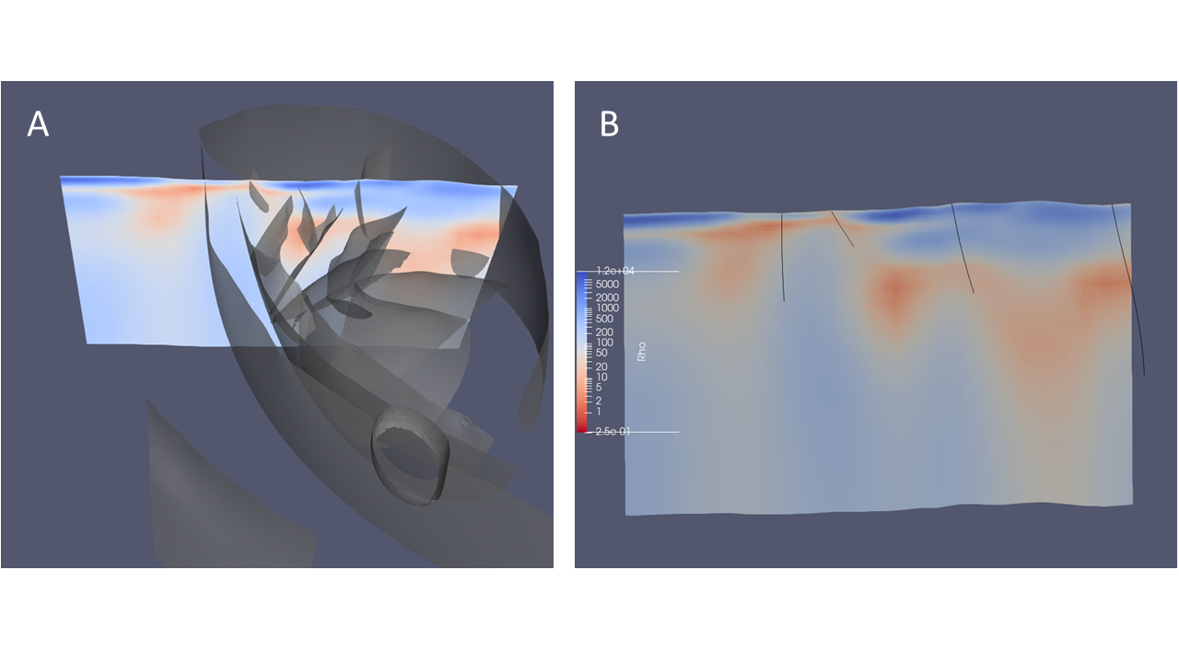
Resistivity in Paraview
Los Humeros: Resistivity survey
Ásdís Benediktsdóttir et al.

Slide 22
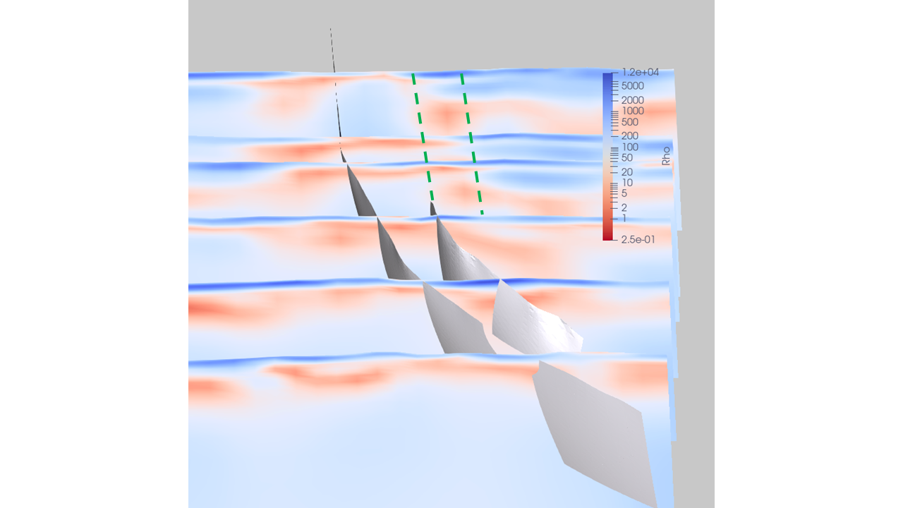
Resistivity in Paraview
Los Humeros: Resistivity survey
Ásdís Benediktsdóttir et al.

Slide 23
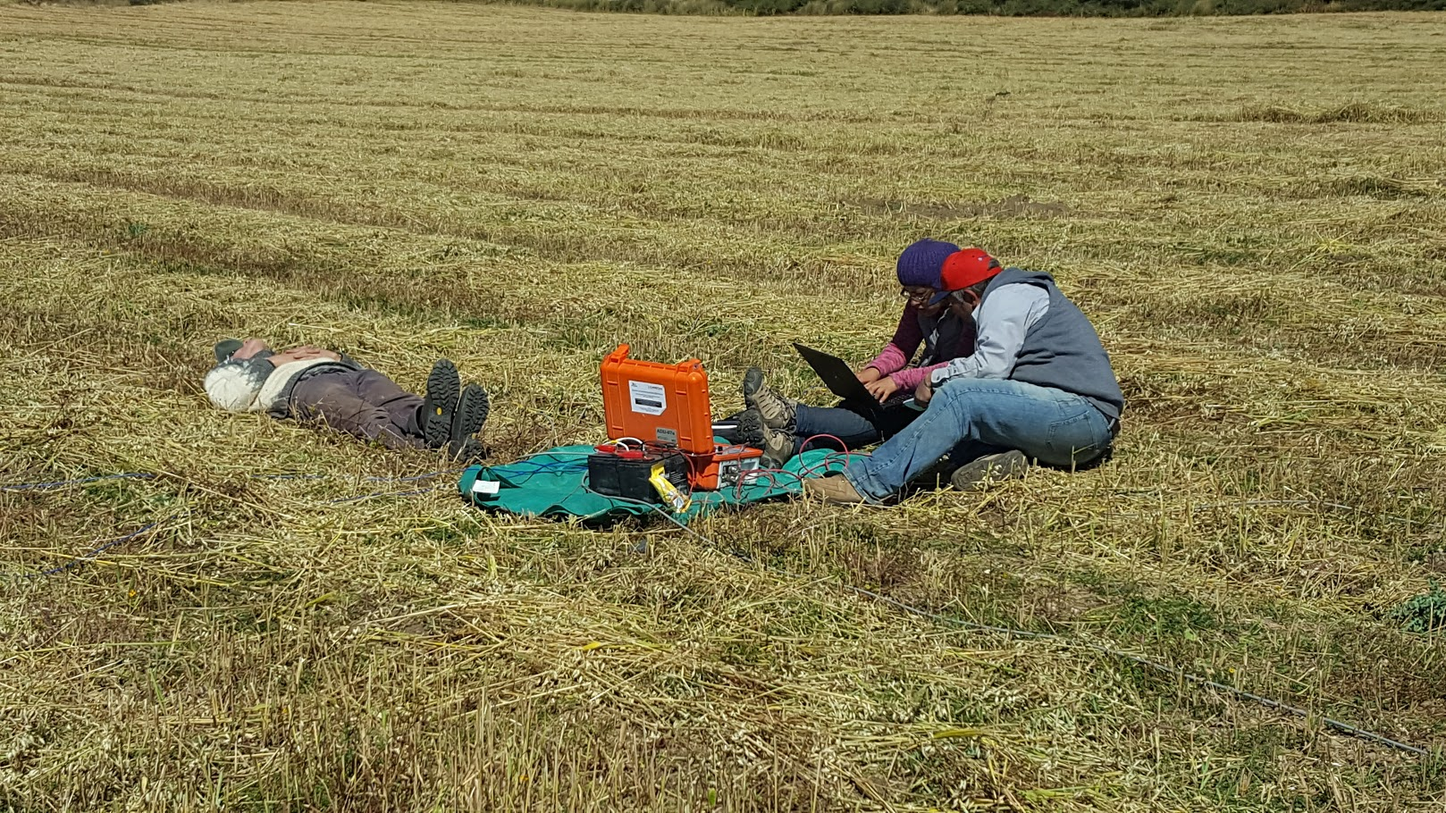
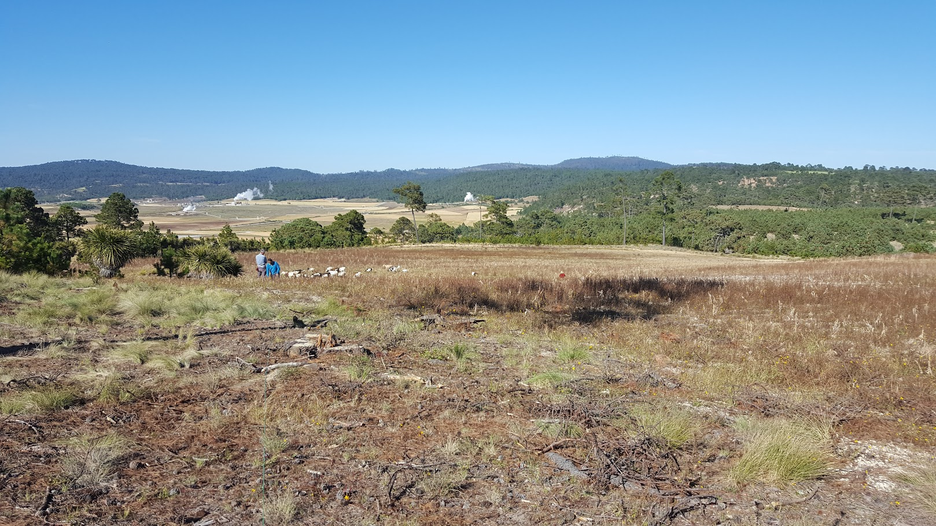
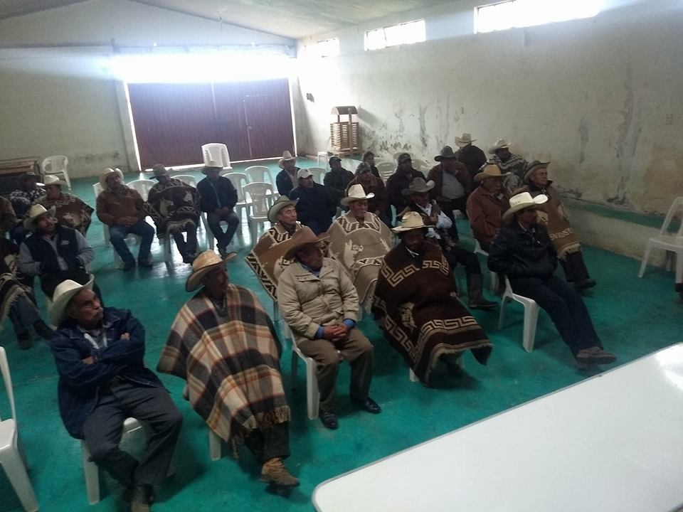


Acknowledgements
This project has received funding from the European Union’s Horizon 2020 research and innovation programme under grant agreement No. 727550 and the Mexican Energy Sustainability Fund CONACYT-SENER, project 2015-04-68074
The content of this presentation reflects only the authors’ view. The Innovation and Networks Executive Agency (INEA) is not responsible for any use that may be made of the information it contains.
<Short title, which should not extend one line>
<Author 1, author 2, author 3>
Should be replaced by your logo

