Slide 1




Gravity and morpho-structural analysis in Los Humeros: insights for super-hot geothermal fluids location
Cornejo N.^{1,2}, Schill E.^{1,2}, Piccardi L.³, Brogi A.⁴, Liotta D.⁴, Garduño V.H. ⁶
Perez M.⁵, Carrillo J.⁵,
¹ KIT, Karlsruhe, Germany,
² TU Darmstadt, Darmstadt, Germany,
³ CNR-IGG, Florence, Italy,
⁴ University of Bari, Italy,
⁵ CICESE, Ensenada, B.C., México,
⁶ Michoachan University, Morelia, Mexico
This project has received funding from the European Union’s Horizon 2020 research and innovation programme under grant agreement No. 727550 and the Mexican Energy Sustainability Fund CONACYT-SENER, project 2015-04-68074.
www.gemex-h2020.eu

Slide 2

Introduction
Objective
Using different approaches, we studied the regional structures of the eastern sector of the TMVB and the Los Humeros geothermal field, in order to establish insights for the geothermal fluids location:
Structural analysis of the exhumed system Las Minas.
Morpho-structural analysis of the eastern sector of the TMVB.
Gravity data analysis in the Los Humeros geothermal field.
Gravity and morpho-structural analysis in Los Humeros
Cornejo N., Schill E., Piccardi L., Brogi A., Liotta D., Garduño V.H., Perez M., Carrillo J.

Slide 3
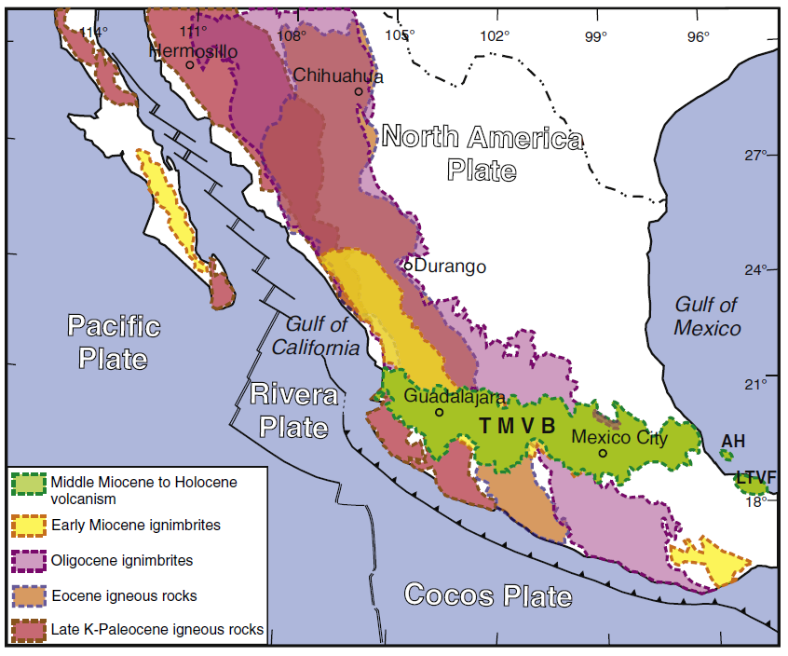
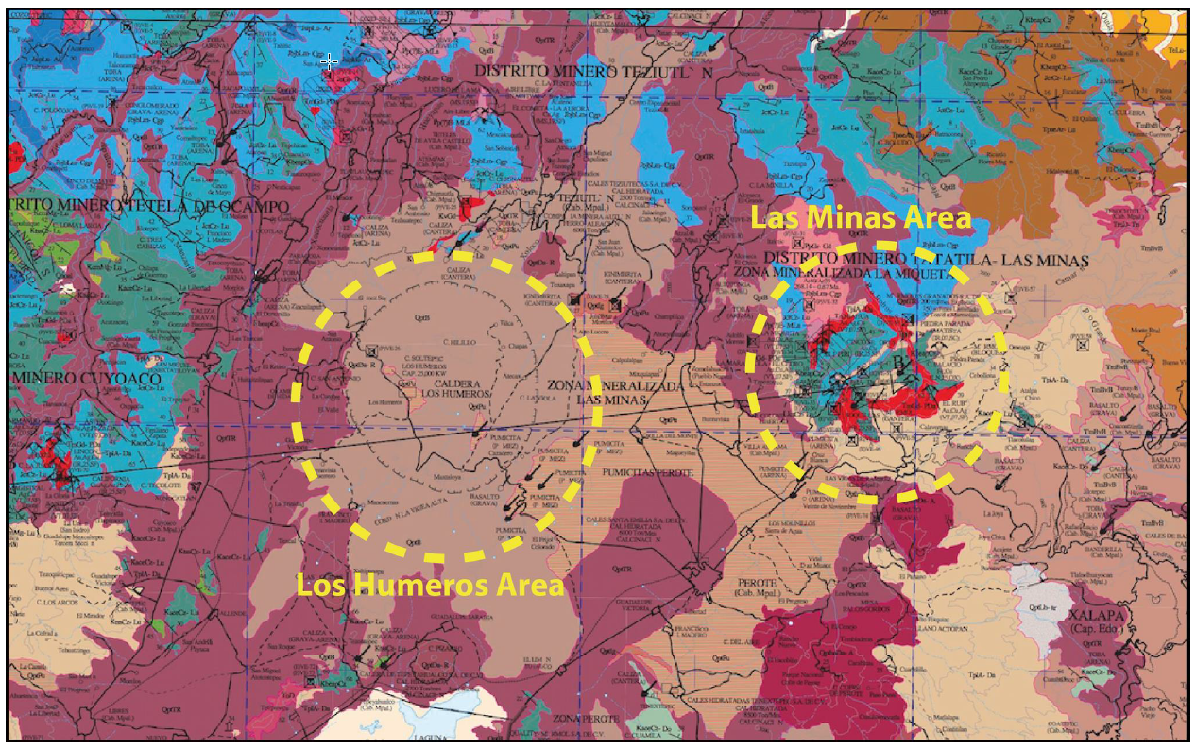
Geodynamic and geological setting
Figure 1. Geodynamic setting and main continental magmatic provinces of Mexico, based on Ferrari et al., 2007 and Ferrari et al., 2012.
Figure 2. Location of the Las Minas and Los Humeros areas (SGM). Violet and bronwish: volcanic rocks and deposits. Light and deep blue: calcareous rocks.
Gravity and morpho-structural analysis in the Los Humeros
Cornejo N., Schill E., Piccardi L., Brogi A., Liotta D., Garduño V.H., Perez M., Carrillo J.

Slide 4
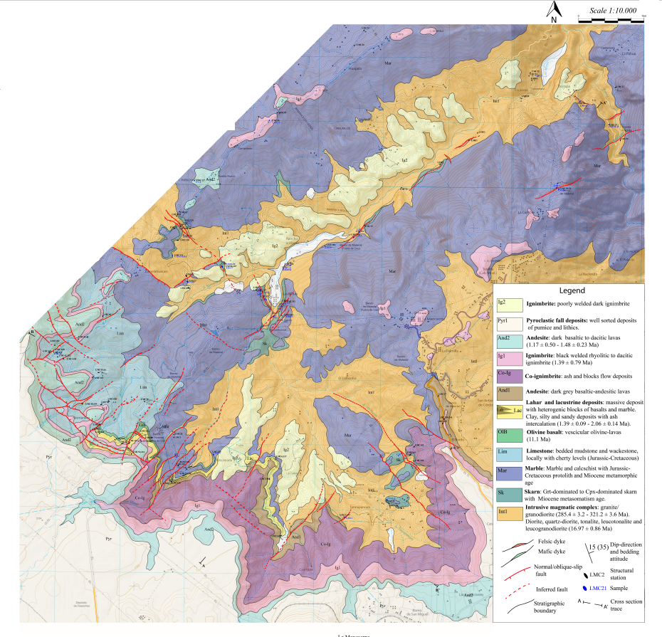
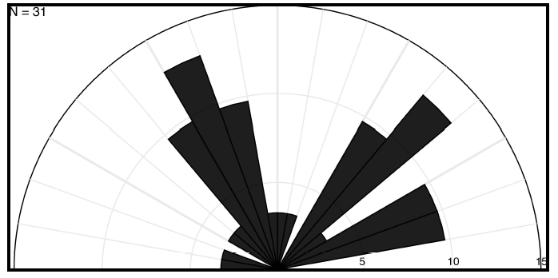
Exhumed system Las Minas
Figure 3. Two families of faults have been recognized: NW-SE and NE-SW. Task 4.1.
Figure 2. Geological map performed during GEMex, Task 4.1.
Gravity and morpho-structural analysis in the Los Humeros
Cornejo N., Schill E., Piccardi L., Brogi A., Liotta D., Garduño V.H., Perez M., Carrillo J.

Slide 5
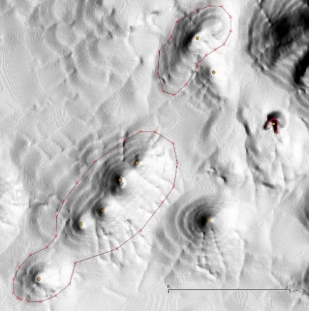
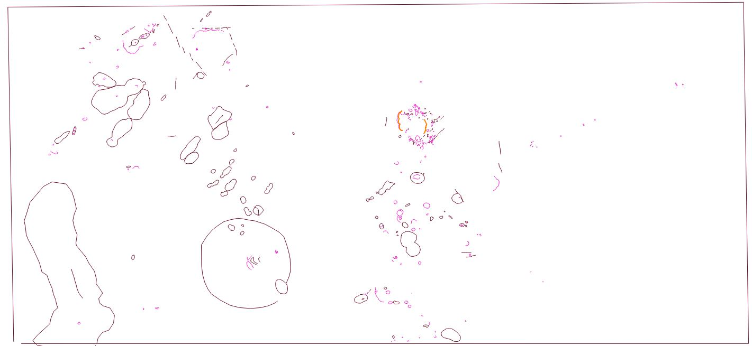
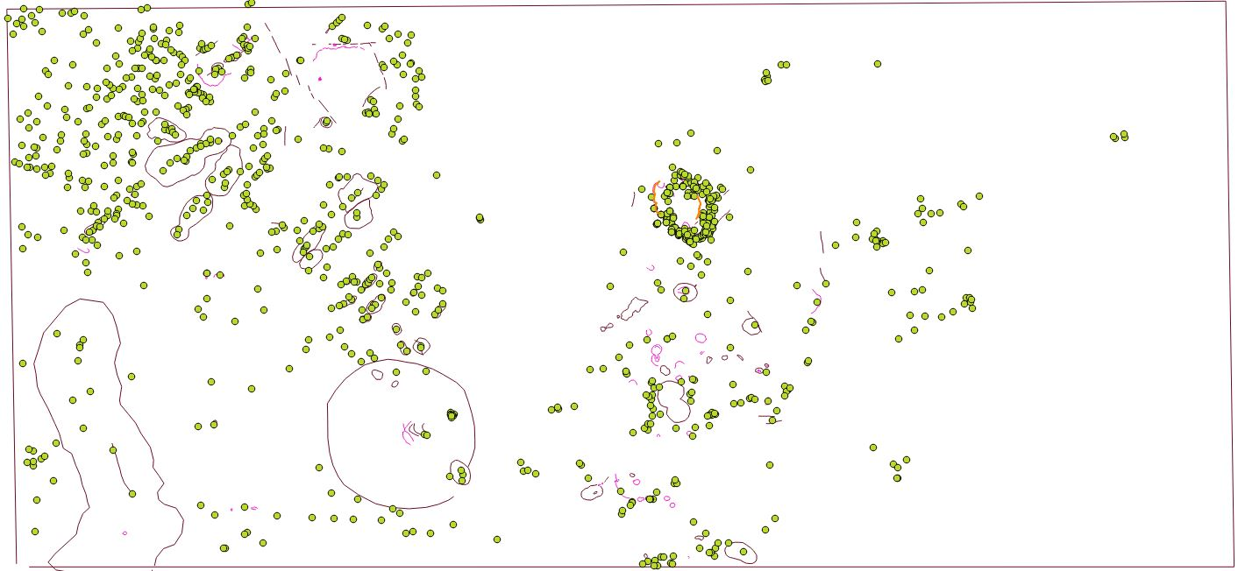
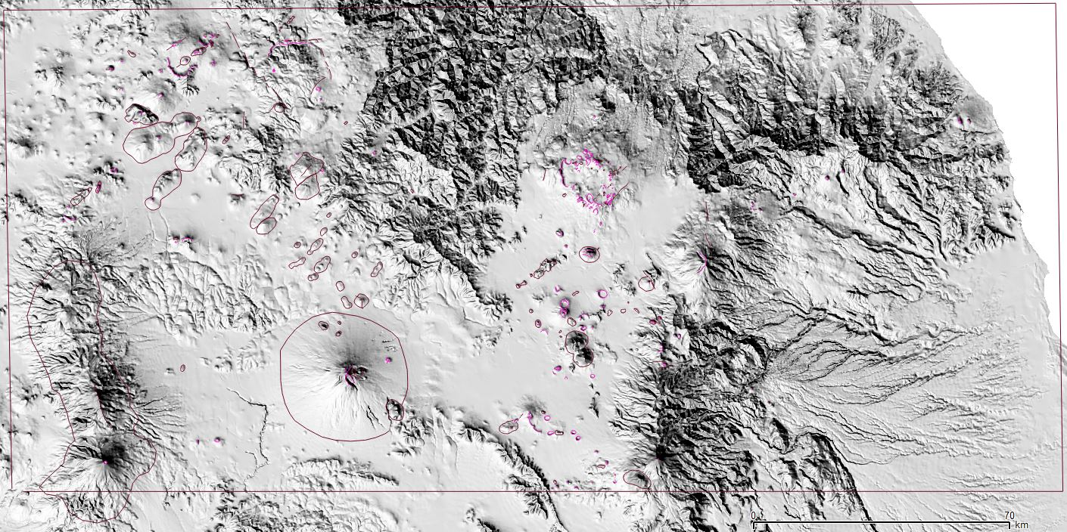
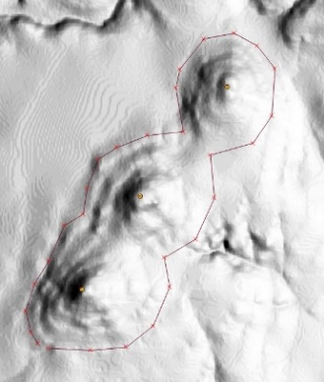
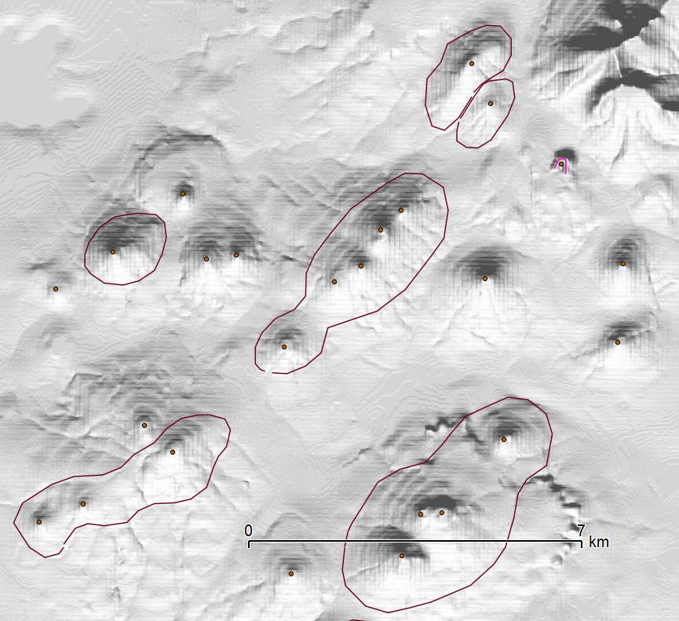
Morpho-structural approach
Acoculco
Acoculco
Acoculco
Los Humeros
Las Minas
Los Humeros
Los Humeros
Pico de Orizaba
Popocatepetl
Pico de Orizaba
Popocatepetl
Pico de Orizaba
Figure 5. Eastern sector of the TMVB analyzed by remote sensing techniques and tectonic geomorphology criteria.
Gravity and morpho-structural analysis in the Los Humeros
Cornejo N., Schill E., Piccardi L., Brogi A., Liotta D., Garduño V.H., Perez M., Carrillo J.

Slide 6
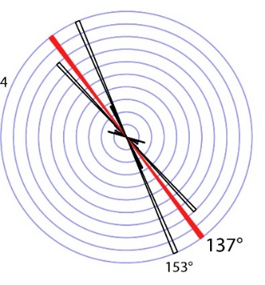
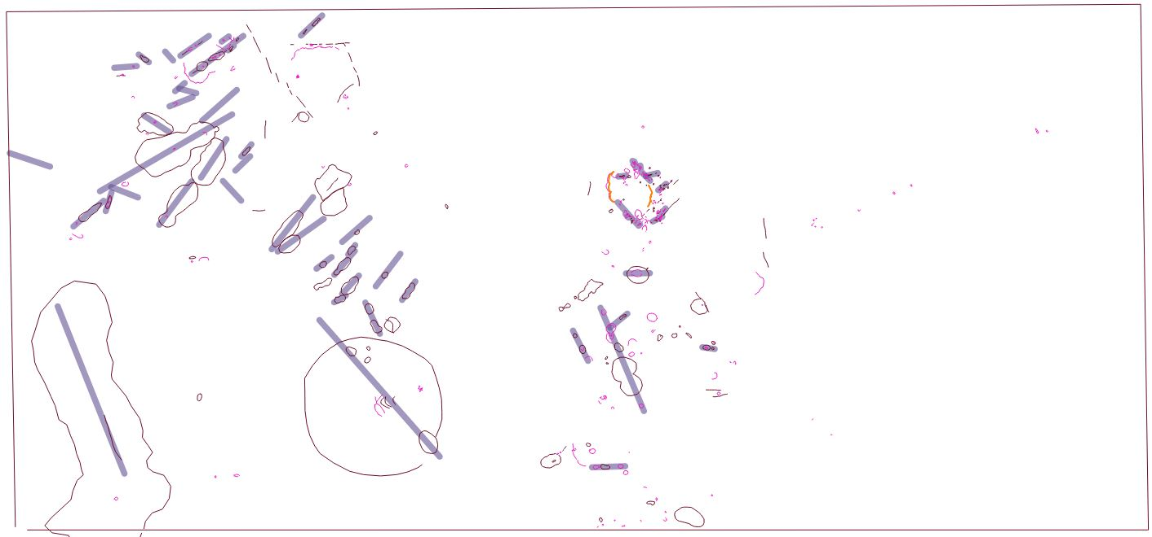
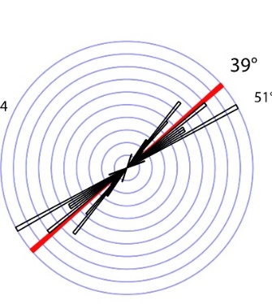
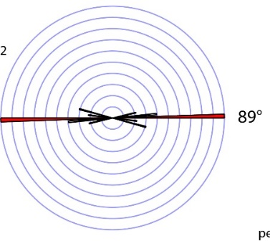
Morpho-structural approach
Acoculco
Los Humeros
Popocatepetl
Pico de Orizaba
Figure 6. Eastern sector of the TMVB analyzed by remote sensing techniques and tectonic geomorphology criteria.
Gravity and morpho-structural analysis in the Los Humeros
Cornejo N., Schill E., Piccardi L., Brogi A., Liotta D., Garduño V.H., Perez M., Carrillo J.

Slide 7
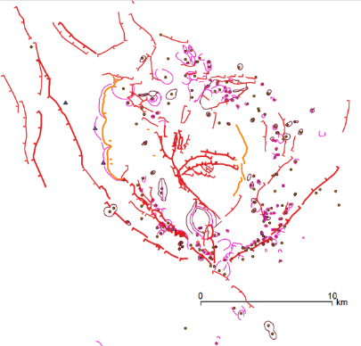
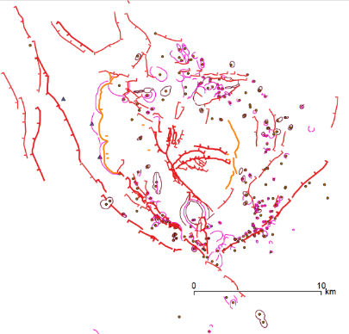

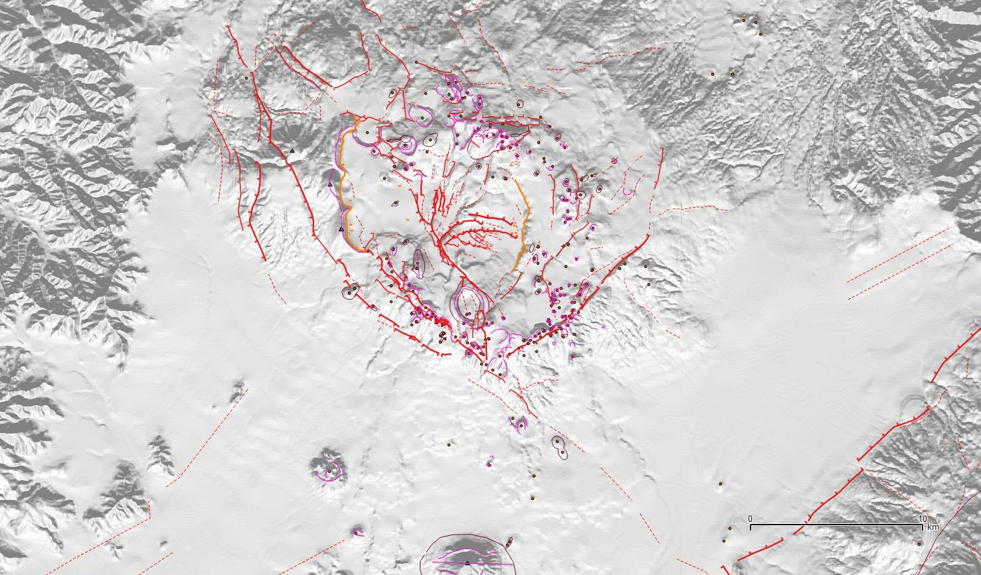

Los Humeros caldera
Arenas fault
Maxtaloja fault
Hidalgo fault
Figure 8. Recent and active faults in the Los Humeros volcano
Gravity and morpho-structural analysis in the Los Humeros
Cornejo N., Schill E., Piccardi L., Brogi A., Liotta D., Garduño V.H., Perez M., Carrillo J.

Slide 8
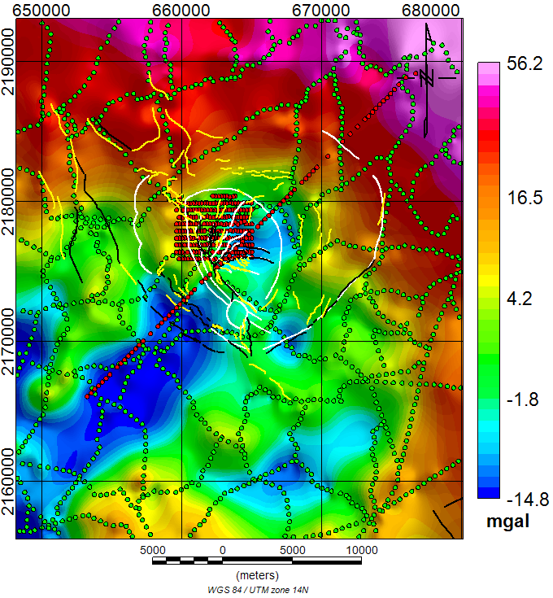
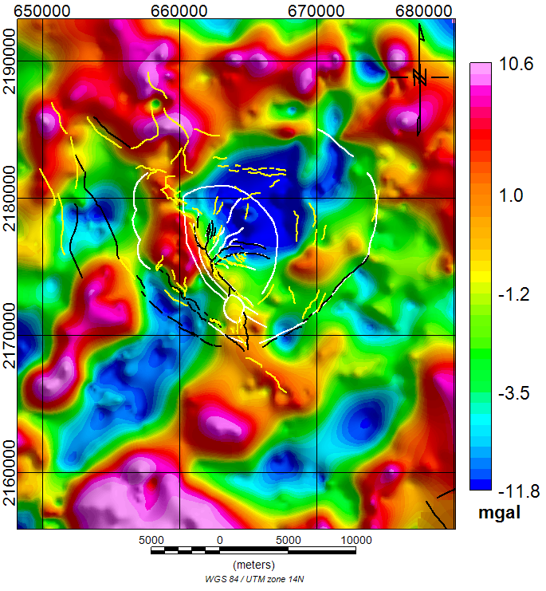
Los Humeros: gravity data
Complete Bouguer map
Residual anomaly
Figure 9. Regional gravity data (green dots) kindly provided by the Comisión Nacional de Hidrocarburos (http://www.gob.mx/cnh). Local gravity data acquired during the GEMex project (red dots).
Gravity and morpho-structural analysis in the Los Humeros
Cornejo N., Schill E., Piccardi L., Brogi A., Liotta D., Garduño V.H., Perez M., Carrillo J.

Slide 9
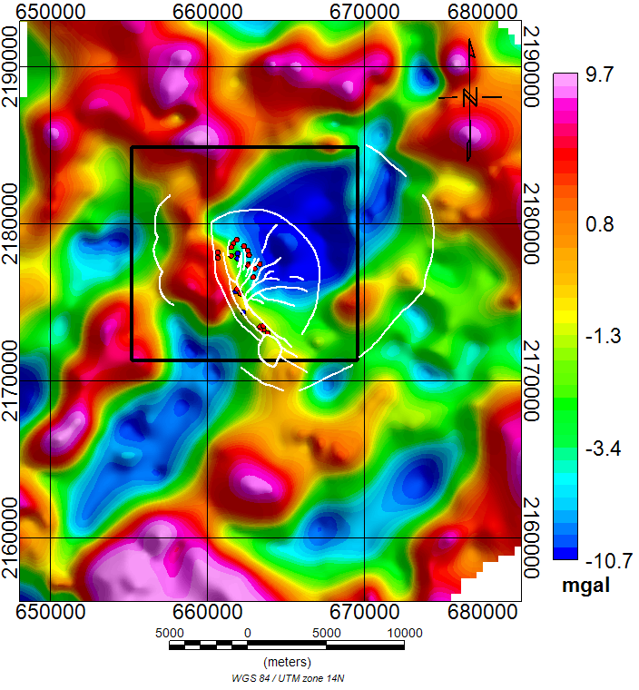
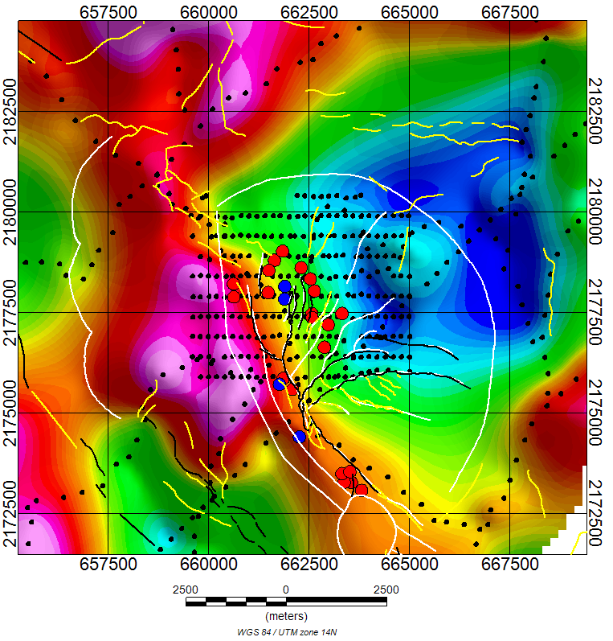
Los Humeros: residual anomaly
Figure 11. The inversion was carried out in an area ~13.5 km x 13.5 km. Black dots: total gravity stations. Red and blue dots: production and injection wells, respectively.
Gravity and morpho-structural analysis in the Los Humeros
Cornejo N., Schill E., Piccardi L., Brogi A., Liotta D., Garduño V.H., Perez M., Carrillo J.

Slide 10
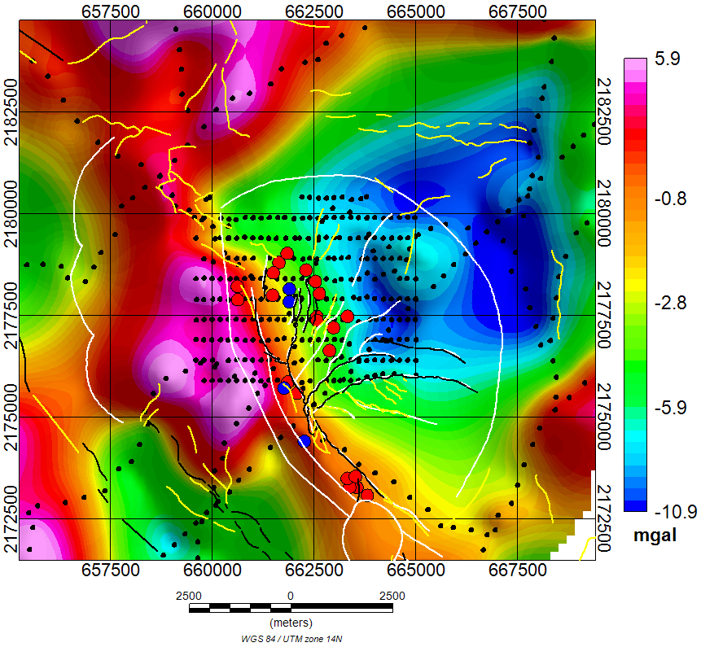
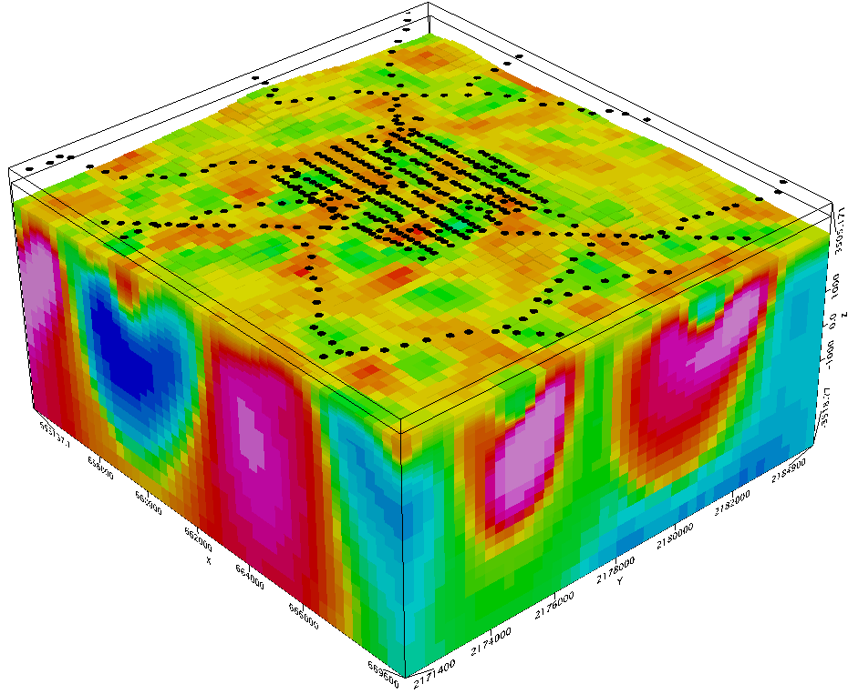

Los Humeros: 3D density model
The horizontal cell size: 300m x 300m
The vertical extension increases gradually
Local residual
Figure 12. Local 3D density model in Los Humeros geothermal field.
Gravity and morpho-structural analysis in the Los Humeros
Cornejo N., Schill E., Piccardi L., Brogi A., Liotta D., Garduño V.H., Perez M., Carrillo J.

Slide 11
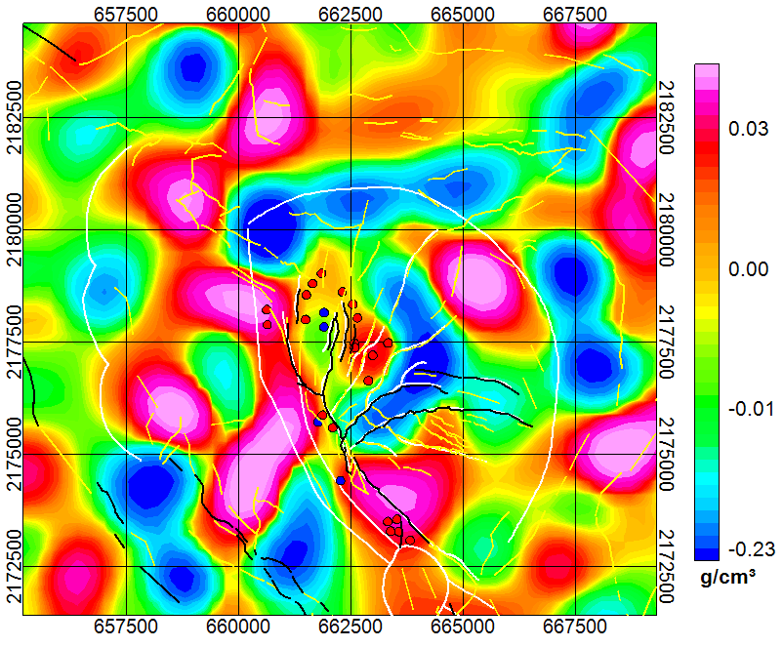
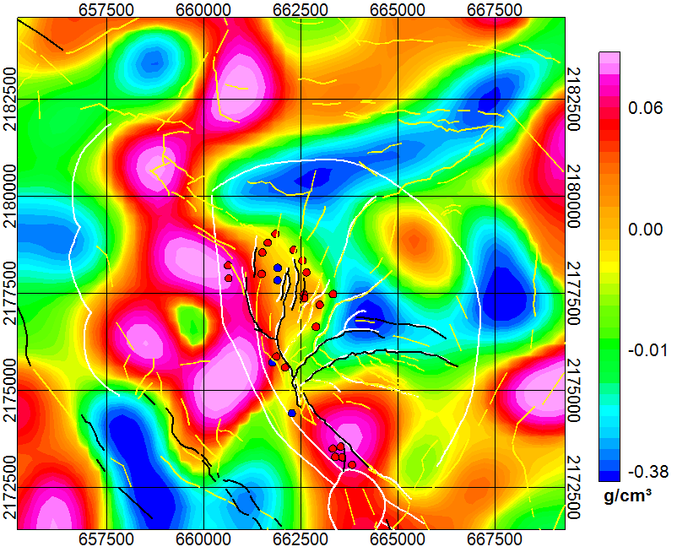
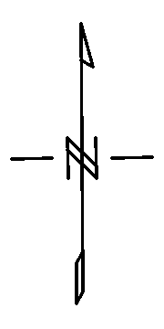
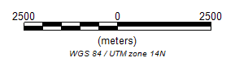
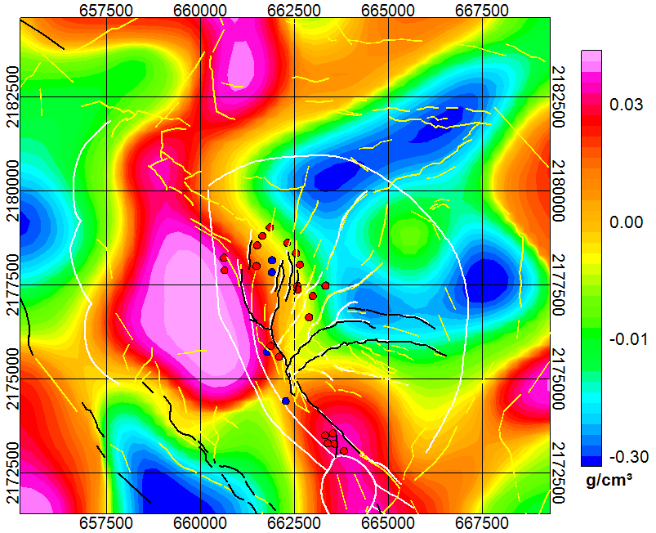
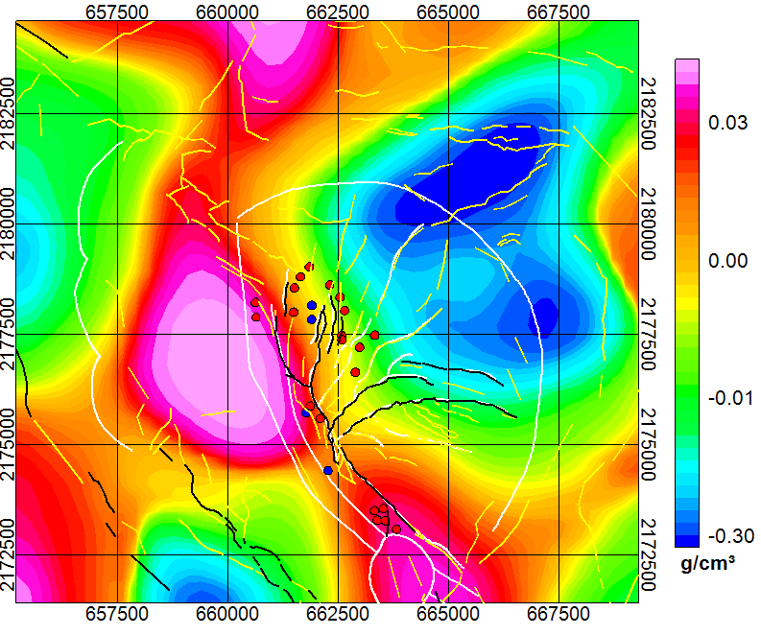
Density contrast at different depths
2000 m a.s.l.
1000 m a.s.l.
0 m s.l.
1000 m b.s.l.
Figure 13. Density contrast in g/cm³ at different depths. Red and blue dots: production and injection wells, respectively.
Gravity and morpho-structural analysis in the Los Humeros
Cornejo N., Schill E., Piccardi L., Brogi A., Liotta D., Garduño V.H., Perez M., Carrillo J.

Slide 12
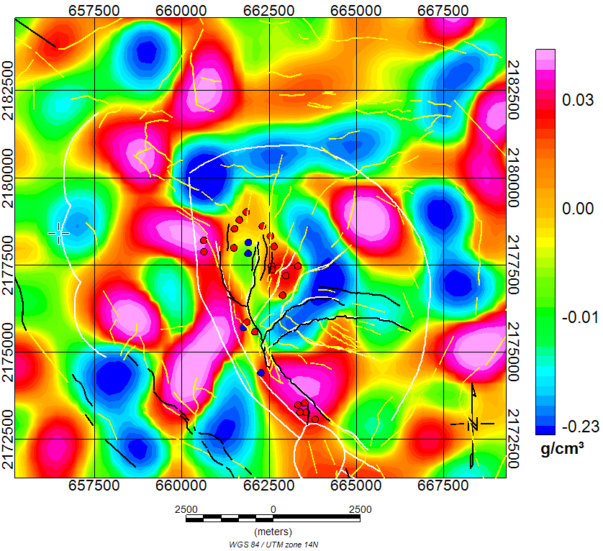
Los Humeros at 1000 m depth
2000 m a.s.l.
Production wells (red dots) are located mostly in a positive density contrast.
Injection wells (blue dots) are located in a negative density contrast.
Figure 14. Density contrast at 1000 m depth.
Gravity and morpho-structural analysis in the Los Humeros
Cornejo N., Schill E., Piccardi L., Brogi A., Liotta D., Garduño V.H., Perez M., Carrillo J.

Slide 13
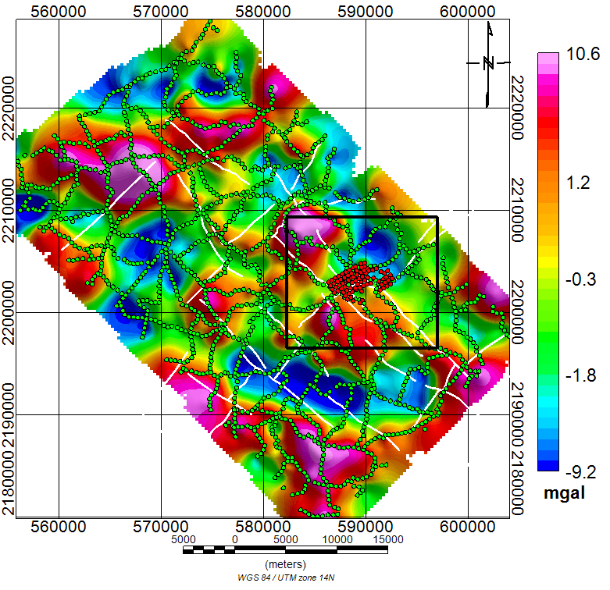
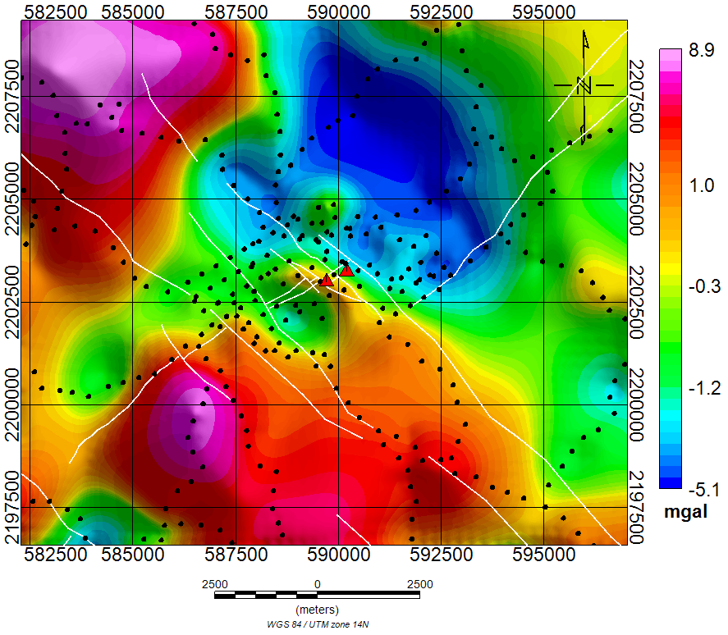
Acoculco: residual anomaly
Local residual
Figure 15. The inversion was carried out in an area ~14.5 km x 13 km. Black dots: gravity stations. Red triangles represent the wells.
Gravity and morpho-structural analysis in the Los Humeros
Cornejo N., Schill E., Piccardi L., Brogi A., Liotta D., Garduño V.H., Perez M., Carrillo J.

Slide 14
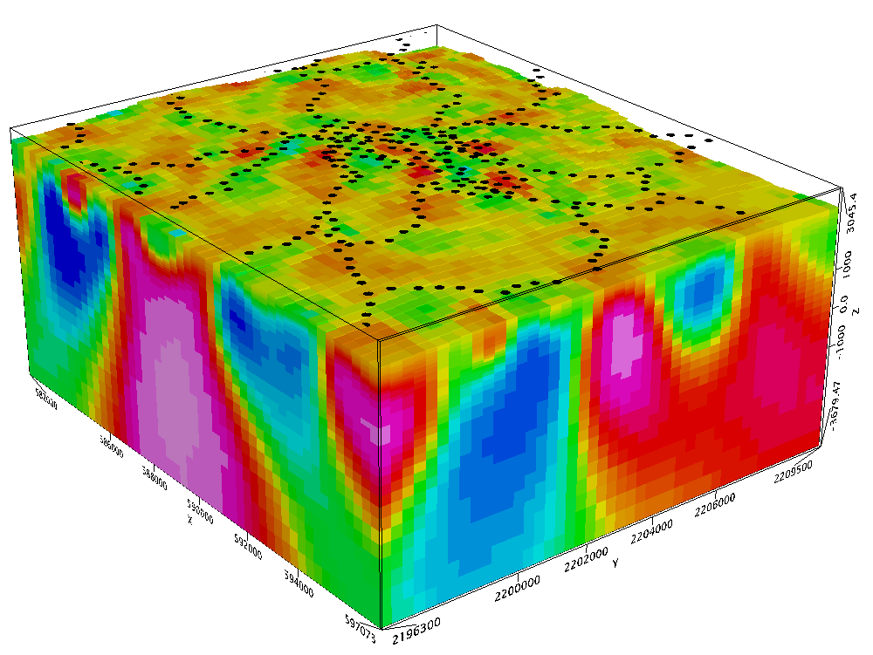

Acoculco: 3D density model
Local residual
The horizontal cell size is 300 x 300 m
The vertical extension increases gradually
Figure 16. Local 3D density model in Acoculco.
Gravity and morpho-structural analysis in the Los Humeros
Cornejo N., Schill E., Piccardi L., Brogi A., Liotta D., Garduño V.H., Perez M., Carrillo J.

Slide 15
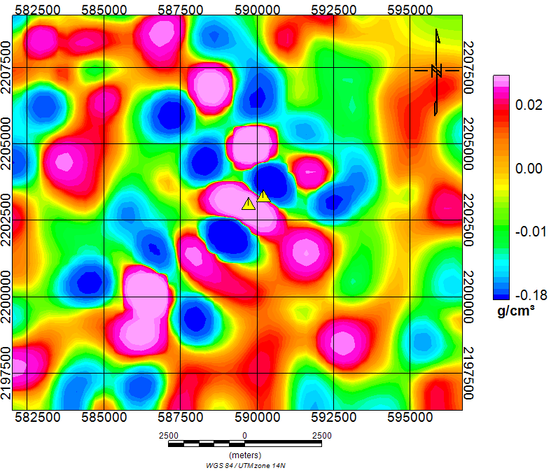
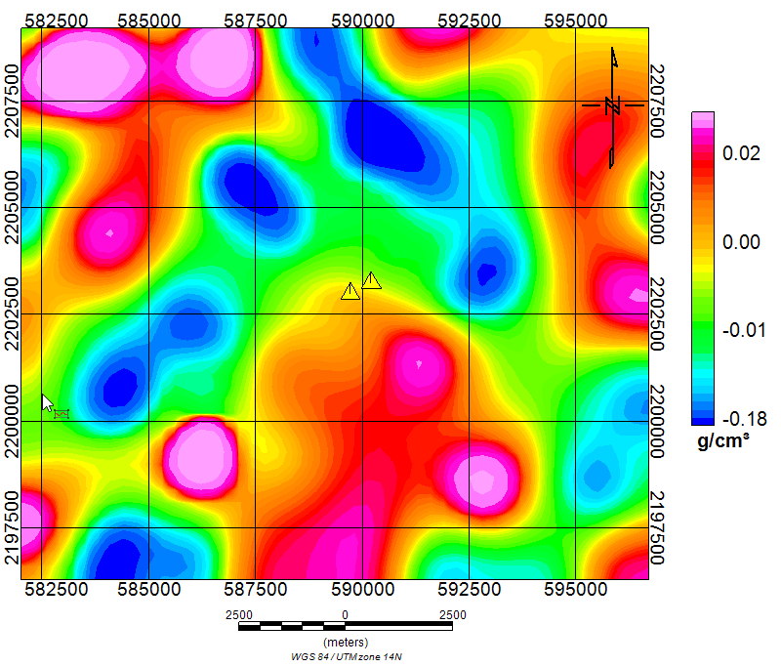
Acoculco at1000 m depth
2000 m a.sl.
1000 m a.s.l.
Figure 17. Density contrast at 1000 m and 2000 m depth.
Gravity and morpho-structural analysis in the Los Humeros
Cornejo N., Schill E., Piccardi L., Brogi A., Liotta D., Garduño V.H., Perez M., Carrillo J.

Slide 16
Conclusions
Two families of faults have been recognized in the regional setting: NE-SW and NW-SE oriented fault systems.
The circulation of the geothermal fluids are strictly controlled by lithological changes and fault zones.
The same geometry is also recognized from the morpho-structural analysis in the eastern sector of the TMVB.
The morpho-structural analysis is a key to the interpretation of residual anomalies: indications of caldera and fault structures.
The alignment of the majority of the anomalies follows NE-SW and NW-SE trending fault orientations.
Gravity and morpho-structural analysis in the Los Humeros
Cornejo N., Schill E., Piccardi L., Brogi A., Liotta D., Garduño V.H., Perez M., Carrillo J.

Slide 17

Acknowledgements
We acknowledge the Comisión Federal de Electricidad (CFE) for kindly providing support and advice and for granting access to their geothermal fields. Data has been kindly provided by CFE.
We also acknowledge our Mexican colleagues for their help an collaboration.
This project has received funding from the European Union’s Horizon 2020 research and innovation programme under grant agreement No. 727550 and the Mexican Energy Sustainability Fund CONACYT-SENER, project 2015-04-68074
The content of this presentation reflects only the authors’ view. The Innovation and Networks Executive Agency (INEA) is not responsible for any use that may be made of the information it contains.
Gravity and morpho-structural analysis in the Los Humeros
Cornejo N., Schill E., Piccardi L., Brogi A., Liotta D., Garduño V.H., Perez M., Carrillo J.

